Slide 1




JOIN US FOR THE
Join us to hear our reflections on the past year and our plans for the year ahead!
FRIDAY 26THJANUARY
8.30am for refreshments 9-10am for AGM

Slide 2


Slide 3
Our Charitable Objectives
To develop effective relationships between
the staff, parents & others associated with our school
To engage in activities or providing facilities & equipment
which support the school and advance the education
of the pupils

Slide 4




2023 highlights

Slide 5



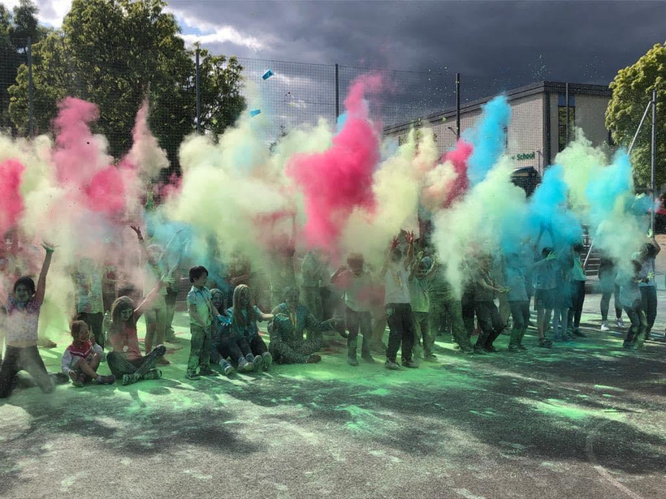
2023 highlights

Slide 6




2023 highlights

Slide 7
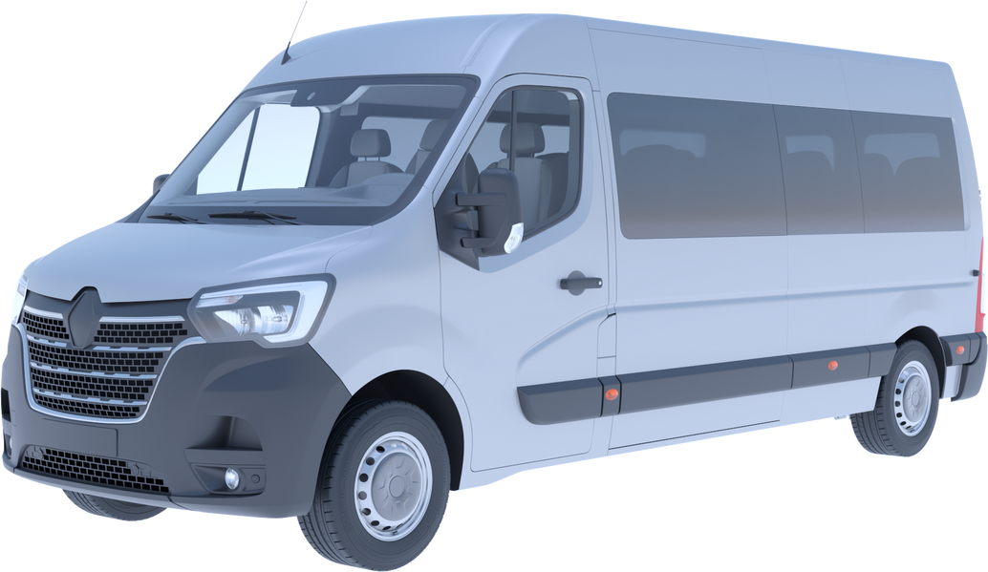


The Quest for a minibus!
In February 2022
we launched our minbus target.....

Slide 8
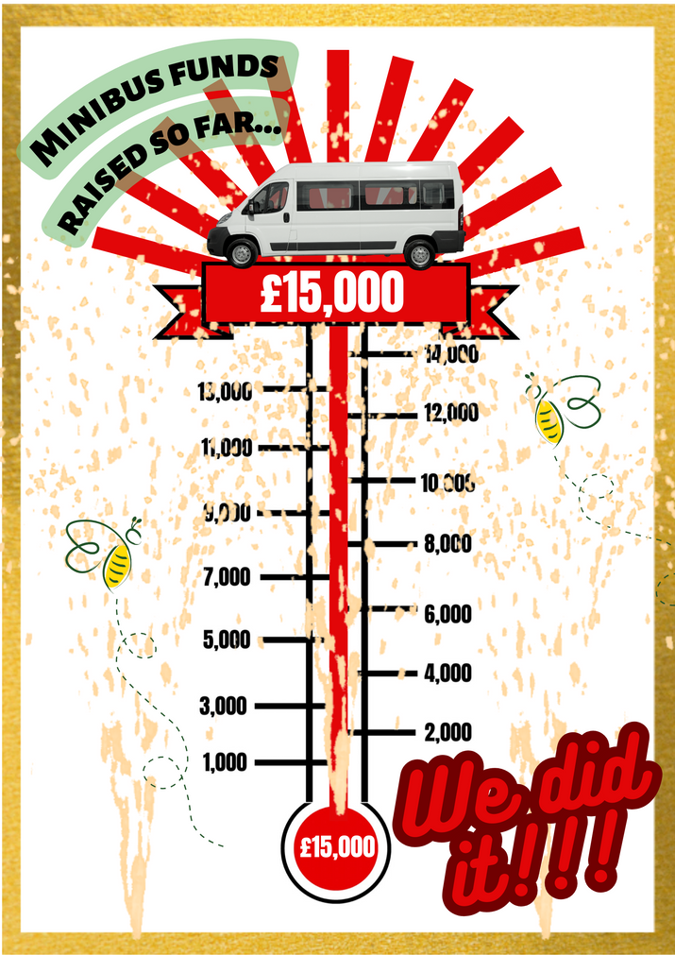

Minibus update
By March 2023 we had achieved our original target...but, as prices had dramatically increased, it wasn’t enough to secure a vehicle and we launched a new target...
...so the Fundraising continues!

Slide 9
Finance update
January 2023 opening balance
£8,236.48
December 2023 closing balance
£17,865.08
Total income for 2023
£9628.60*
*£5850 from generous private donors
£2800 from ActiveMe360
£978.60 from events
Current balance 25/01/24
£17,708.85

Slide 10
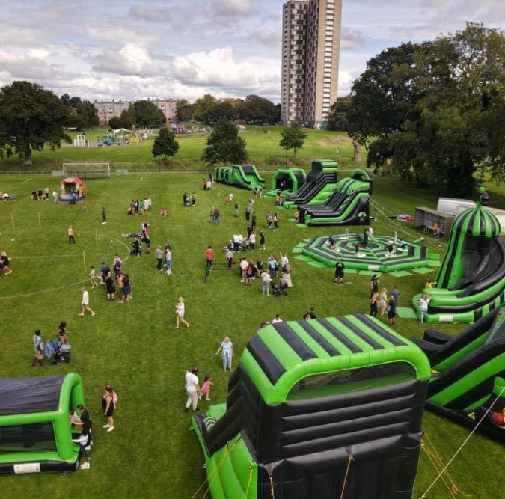



Events for 2024
March
January
`May

Slide 11


Our Structure in 2023
Chairperson
Mel Pooley
Secretary
Treasurer
Gemma Williams
Jayne England

Slide 12
Our Structure in 2024
Chairperson
Gemma Williams
Secretary
Treasurer
Vacancy*
Mel Pooley
*Our constitution adopted in 2016 states we need a minimum of 2 committee members

Slide 13
Time to vote on the committee
for the coming year....

Slide 14

We welcome your ideas!
We would love to hear of any fundraising activity you think could benefit the school.
Contact us by email friends@bassettgreen.net
or our Facebook page

Slide 15

Any Questions or suggestions?

Slide 16

Thank you
for coming!

