Slide 1




Slide 2


Slide 3
Our Charitable Objectives
To develop effective relationships between
the staff, parents & others associated with our school
To engage in activities or providing facilities & equipment
which support the school and advance the education
of the pupils

Slide 4





2024/25 highlights

Slide 5




2024/25 highlights

Slide 6


Other revenues
Parentkind – a charity that supports school PTAs - teamed up with Asda, who made millions of pounds available to donate to primary schools across the UK through their ‘Cashpot for Schools’ initiative. All we had to do was opt-in as we are a Parentkind member! t
Between 2nd September and 30th November 2024 – every time parents shopped with Asda using their Asda Rewards app, Asda donated 0.5% of the value of the shop to their chosen Primary school. Also, every time somebody opted-in to support our Primary school, Asda gave an additional £1 to the school Cashpot. Plus, Asda gave £50 to every school to get them started!
£407.19
raised!

Slide 7



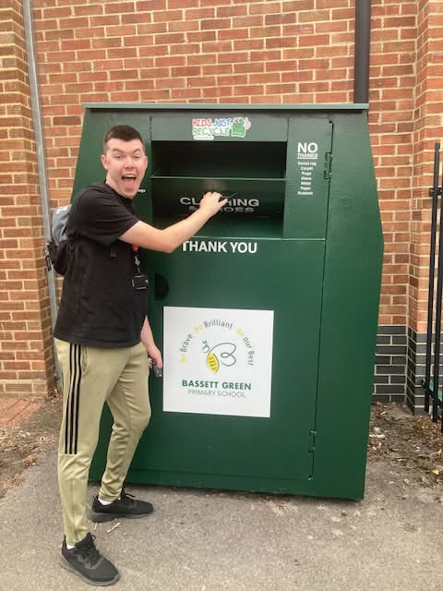

Other revenues
ACTIVE ME 360
KIDS JUST RECYCLE
DENNER UK
SCHOOL ARBOR ACCOUNT LINKED
WITH PTA BANK ACCOUNT

Slide 8
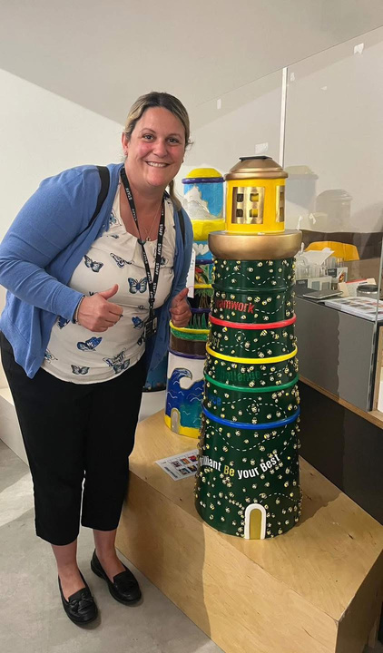

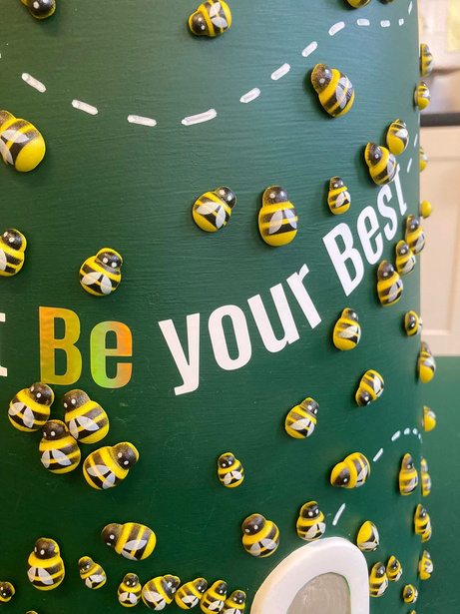



Fundraising Support
SCHOOL COUNCIL
SOUTHAMPTON CHILDREN’S HOSPITAL
LIBRARY

Slide 9
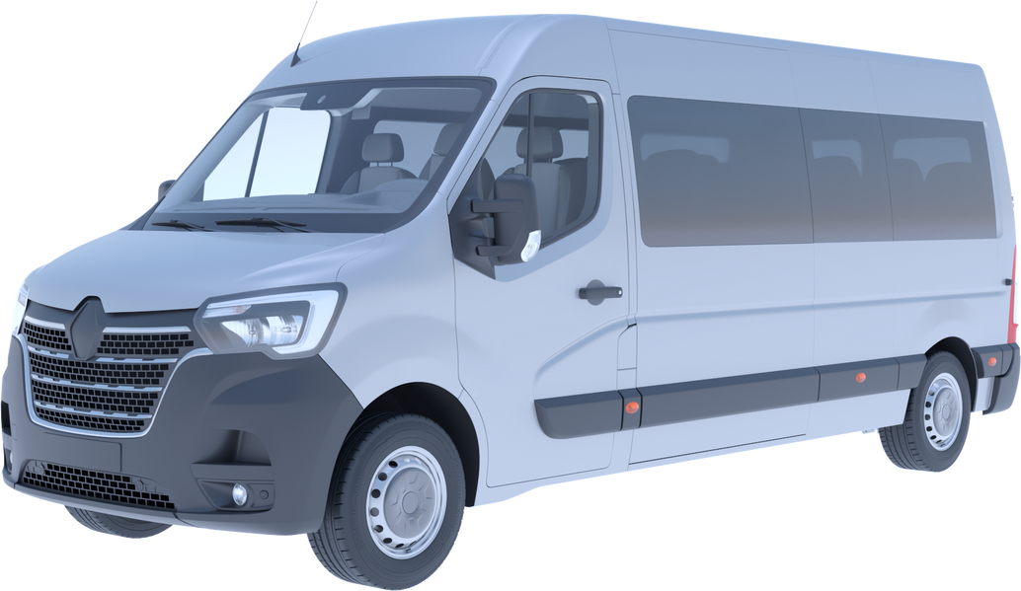


The Quest for a minibus!
In February 2022
we launched our minbus target.....

Slide 10
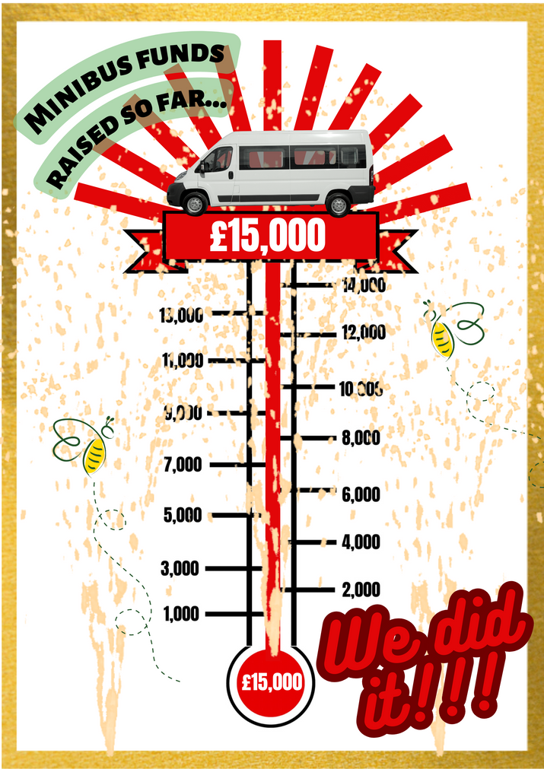

The Quest
for a minibus!
By March 2023 we had achieved our original target...but, as prices had dramatically increased, it wasn’t enough to secure a vehicle and we launched a new target...
...so the Fundraising continued...

Slide 11
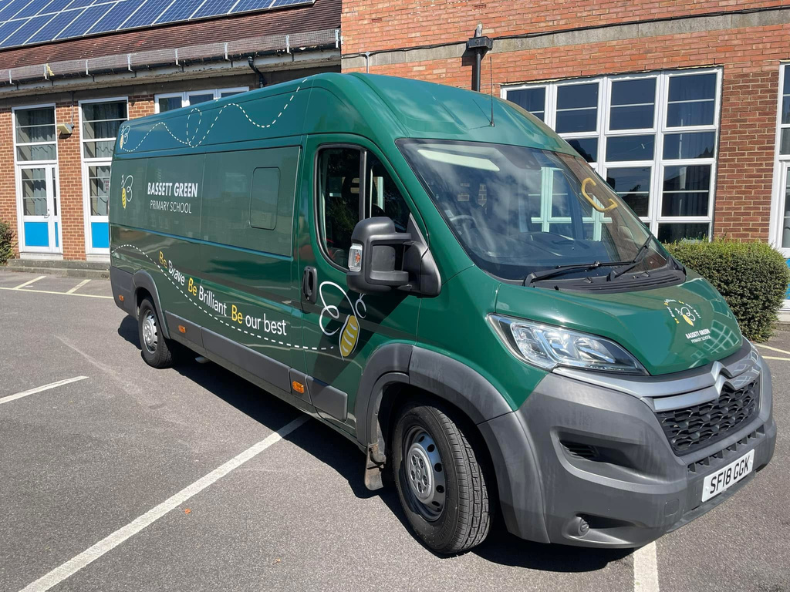
Welcome to the family!
By August 2024 we were able to release £20,000 to the school to help by our very own minibus!
HOORAY!

Slide 12
NEW TARGET!
£7,000
For improvements to the school hall including new blinds

Slide 13

Also in February 2025....
£2,000
released for for books to fill our new library!

Slide 14
Finance update
January 2024 opening balance
£17,865.08
Total income for 2024
£6,074.44
£20,000
Minus donation for minibus
December 2024 closing balance
£3939.52

Slide 15
Finance update
January 2025 opening balance
£3939.52
Total income for 2025 so far
£1043.94
Minus donation for books
£2000
Current balance 01/05/25
£2983.46

Slide 16

Upcoming Events for 2025
your
suggestions!
june
june/july

Slide 17


Our Structure in 2024/25
Chairperson
Gemma Williams
Secretary
Treasurer
Vacancy*
Mel Pooley
*Our constitution adopted in 2016 states we need a minimum of 2 committee members

Slide 18
Time to vote on the committee
for the coming year....

Slide 19

We welcome your ideas!
We would love to hear of any fundraising activity you think could benefit the school.
Contact us by email friends@bassettgreen.net
or our Facebook page

Slide 20

Any Questions or suggestions?

Slide 21

Thank you
for coming!

