Slide 1
Year 5 PSHE
RSE Parent Meet
June 2026

Slide 2

Hello & Thank you!
Notes:
Thank parents for attending workshop –helps us communicate the importance of Relationship and Health Education in schools.

Slide 3

Terminology
PSHE:
Personal, Social, Health & Economics (Education)
RE:
Relationships Education
Health and Wellbeing
Notes:
Explain that throughout the workshop, these terms will be mentioned a lot – explain their meaning.

Slide 4

Aims:
Share the background of our PSHE curriculum journey
Share the RE requirements for primary schools
Share the objectives we will teach
Q&A

Slide 5
Our PSHE/RSE Journey
Subject review
Planning (government expectations & recommended resources)
Ratified policy (including parent views - 2019)
Staff training including external support
1 hour a week (or equivalent) of PSHE lessons
Regular Subject Monitoring
Notes:
Emphasize the importance of it being a statutory requirement and the support we have given staff:
- Sex Education Forum Training, Government recommended resources from Medway – linked on the website and shown later on in the workshop, feedback, SLT support in the lessons and through our PPA and monitoring.

Slide 6
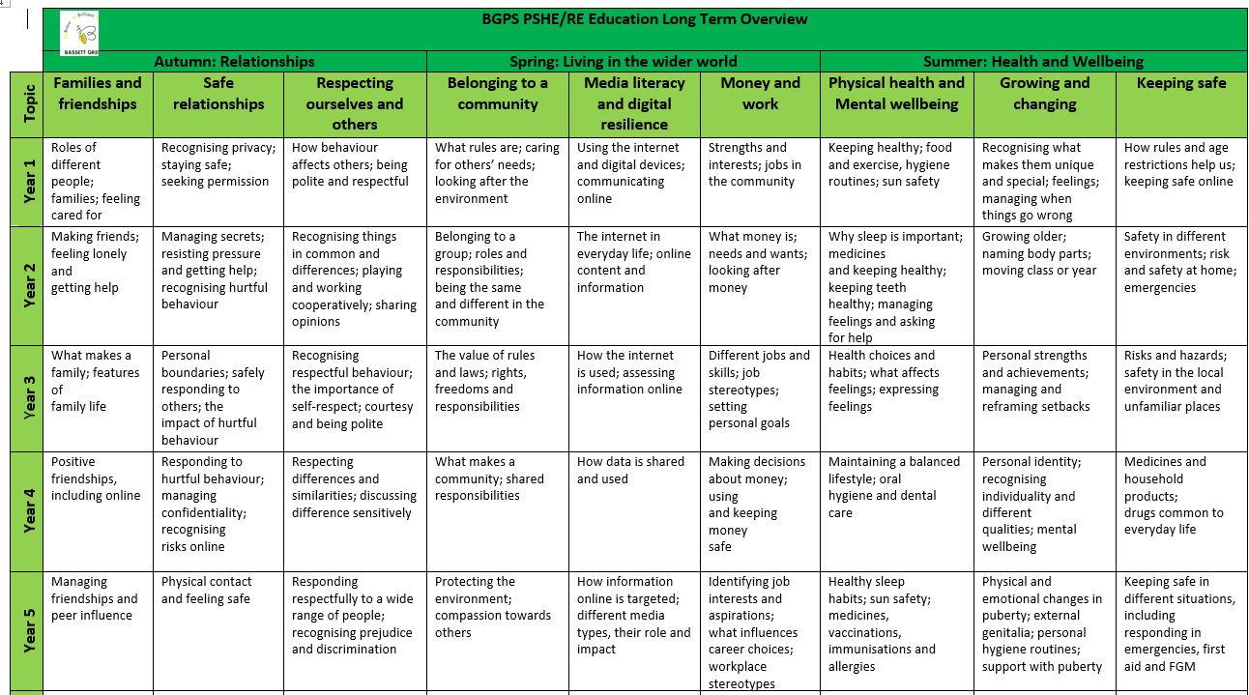
PSHE/RSE Requirements
From September 2020, the Health Education and Relationships Education aspects of PSHE education became compulsory in all schools.

Slide 7
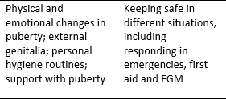
PSHE/RSE Requirements
From September 2020, the Health Education and Relationships Education aspects of PSHE education became compulsory in all schools.
Notes:
Note FGM- not compulsory - there is no policy to opt pupils out of this however if you feel, after having seen the information you do not wish your child to take part you can opt them out or the child can withdraw.
FGM stats:
Rise in FGM victims in Hampshire, Southampton and the Isle of Wight seen by NHS services
More female genital mutilation victims were seen in Hampshire, Southampton and the Isle of Wight by NHS services in recent years, new figures show.
is most commonly inflicted on girls under 15, particularly from Africa, the Middle East and Asia.
Forward, an African women-led organisation working to end violence against women and girls, said the crime is a "hidden form of violence" and added current data does not capture the true size of the problem in the UK.
NHS Digital figures show around 50 patients with FGM injuries in the former NHS Hampshire, Southampton and Isle of Wight CCG area were seen by health professionals throughout 2022 – up from around 15 the year before.
Recommended that we teach this to keep our children safe and free from harm in our school.

Slide 8
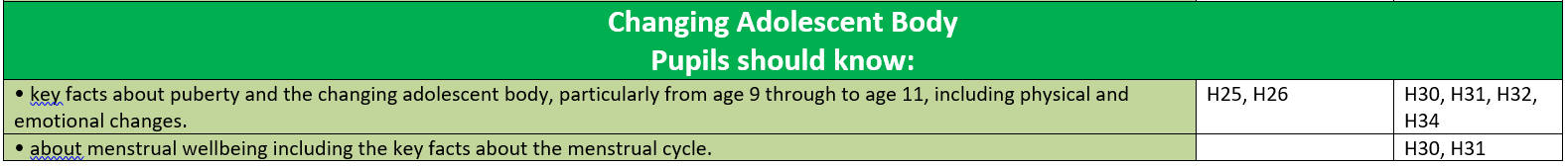
PSHE/RSE Requirements
From September 2020, the Health Education and Relationships Education aspects of PSHE education became compulsory in all schools.

Slide 9
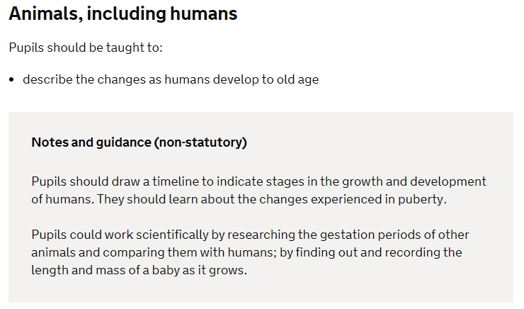
What will we teach your children?
The Year 5 Science Curriculum:

Slide 10
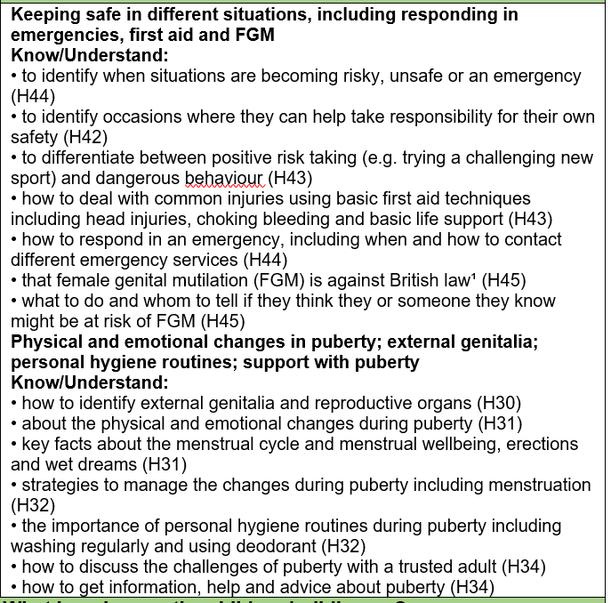
What will we teach your children?
From September 2020, the Health Education and Relationships Education aspects of PSHE education became compulsory in all schools.

Slide 11
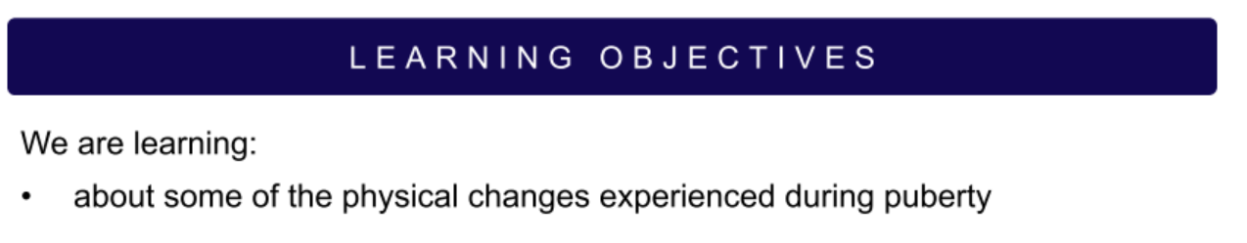
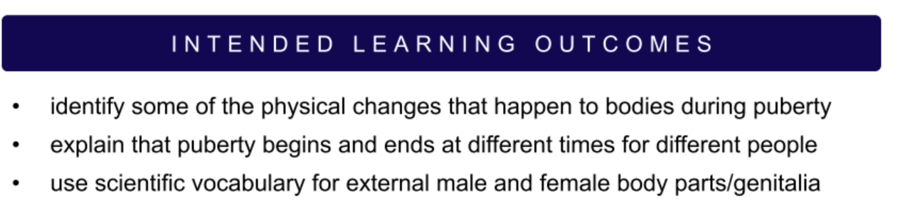
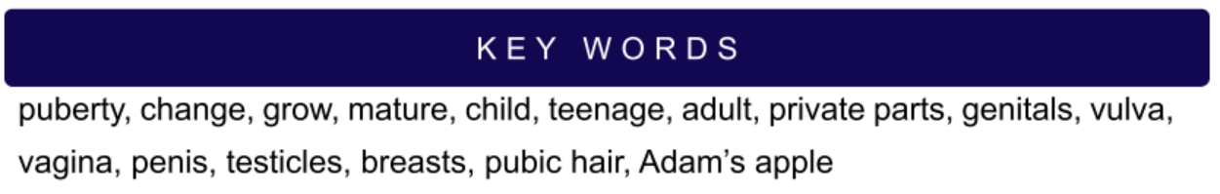
What will we teach your children (1)?

Slide 12
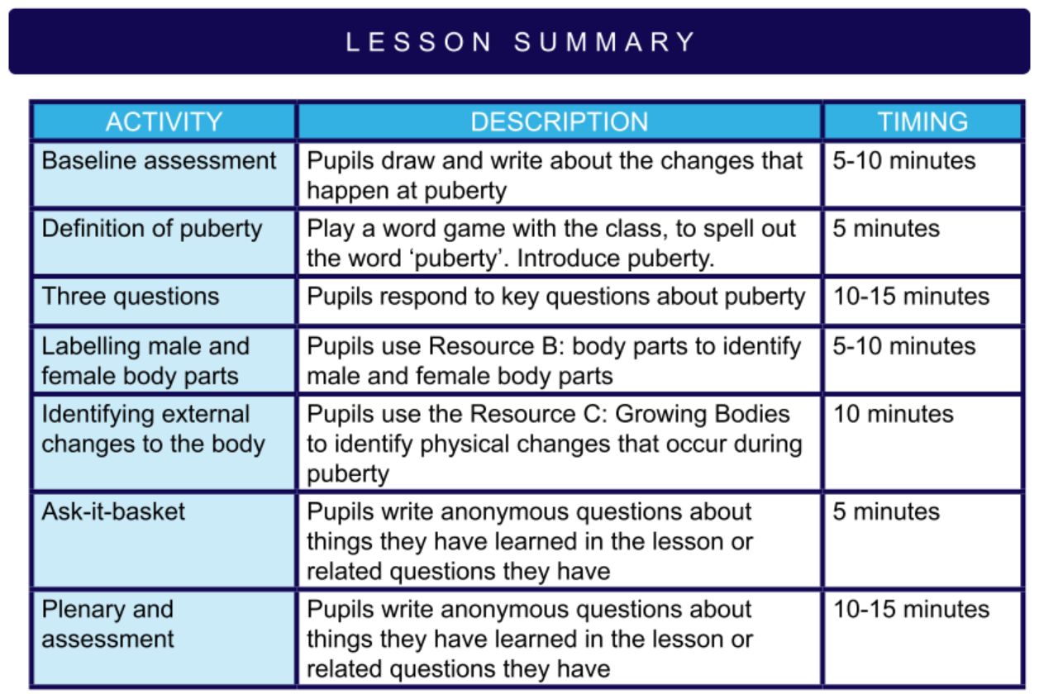
What will we teach your children (1)?

Slide 13
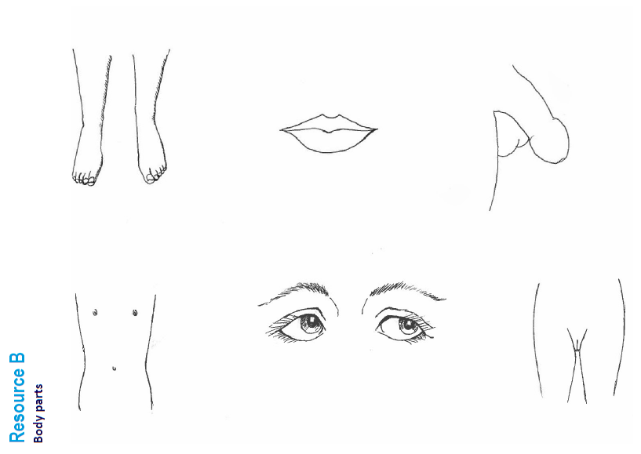

Slide 14
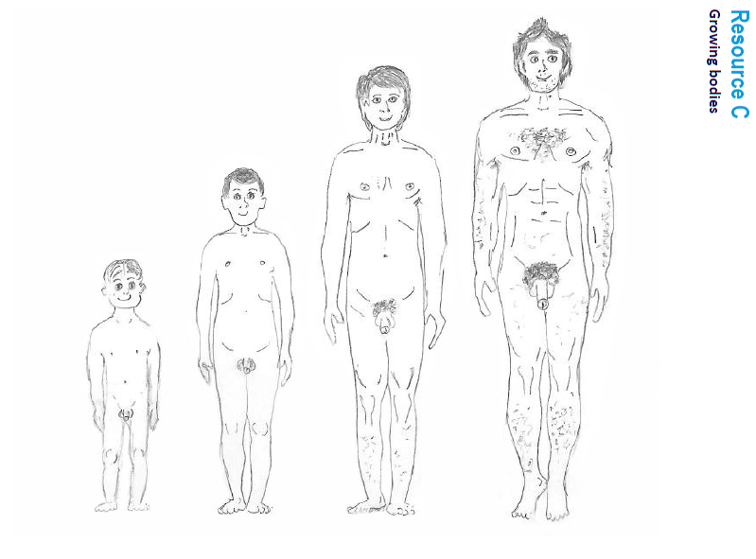

Slide 15
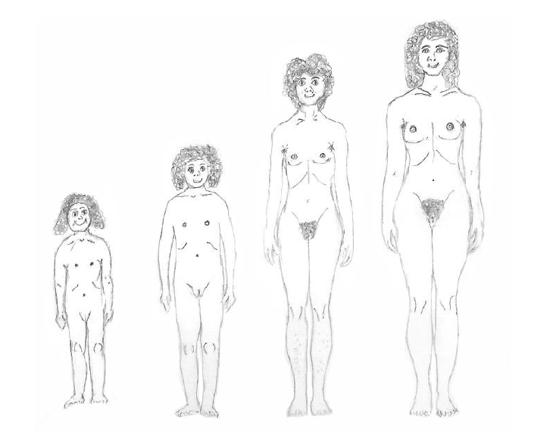

Slide 16
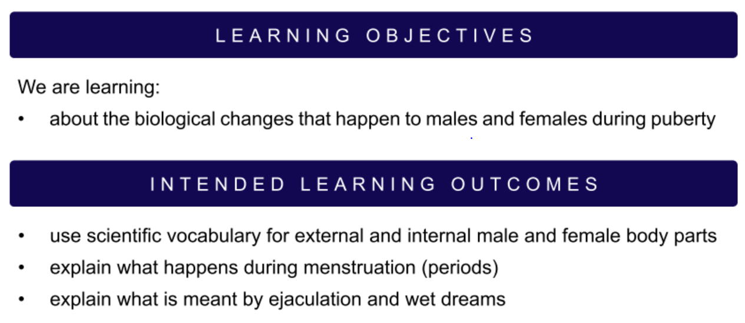
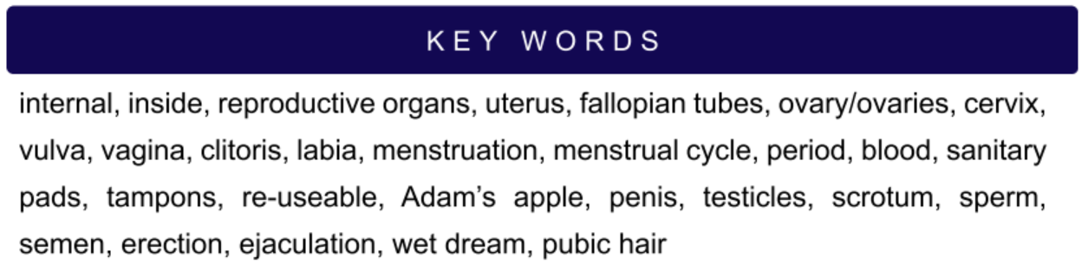
What will we teach your children (2)?

Slide 17
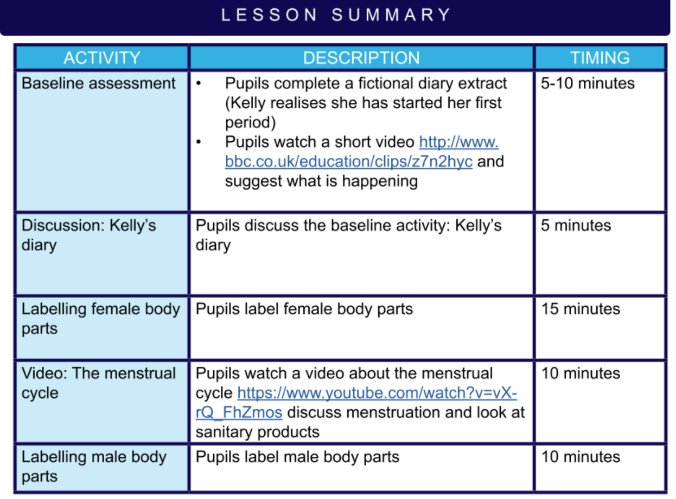
What will we teach your children (2)?
Notes:
Share videos if parents want to watch them – these are the new twinkl videos saved on the server: T:\Teachers Only\2023-2024\Planning- Short Term\Year 5\Summer 2\PSHE\New videos

Slide 18
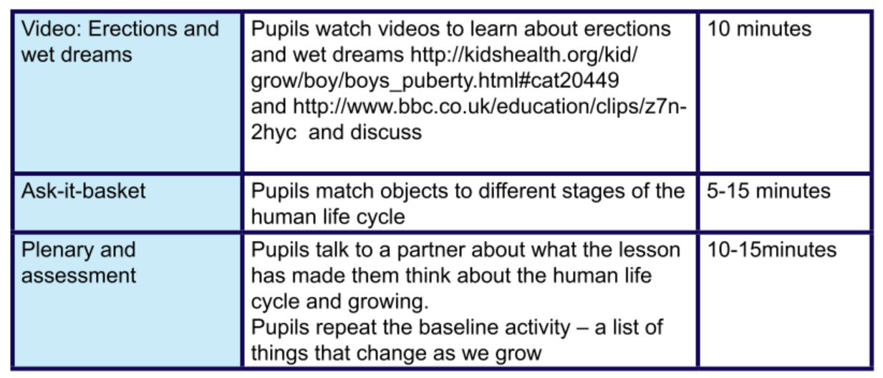
What will we teach your children (2)?
Notes:
Play video if they wish

Slide 19
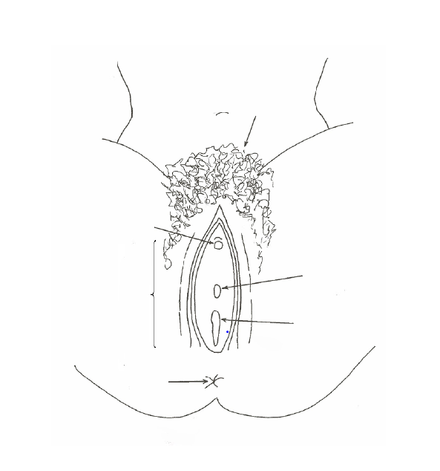
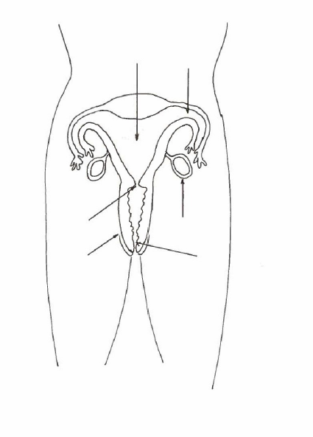

Slide 20
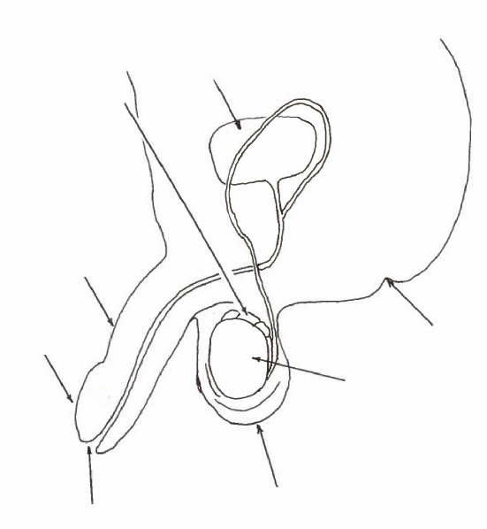

Slide 21


Slide 22
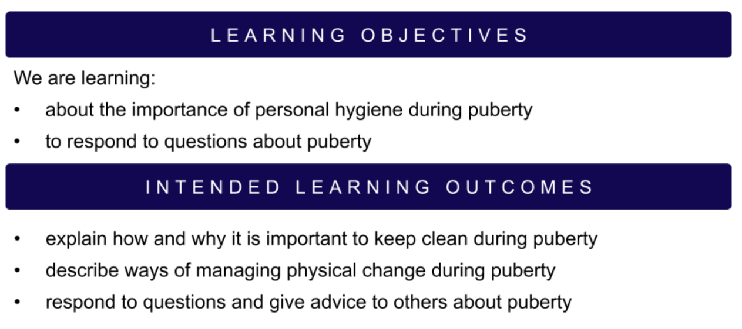
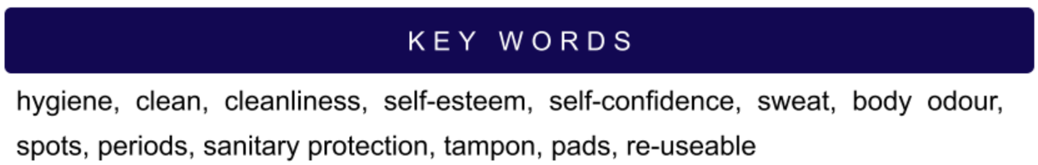
What will we teach your children (3)?

Slide 23
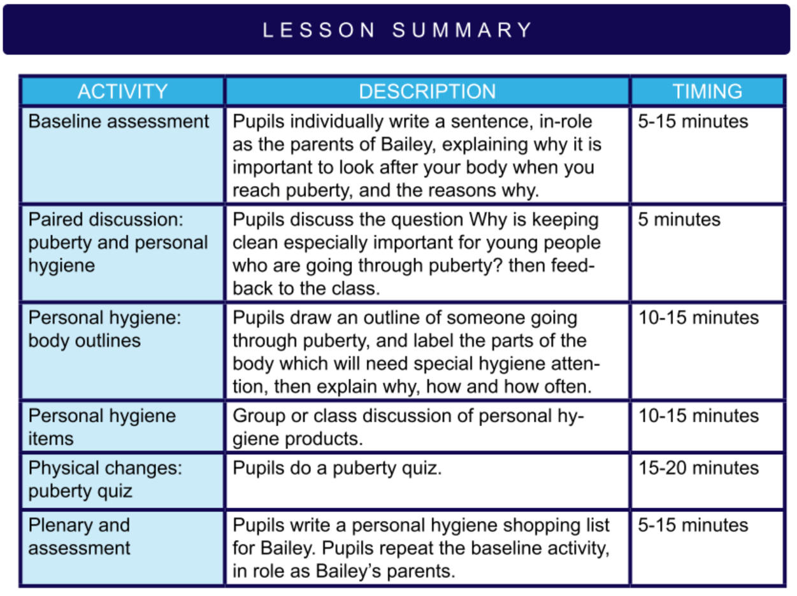
What will we teach your children (3)?

Slide 24
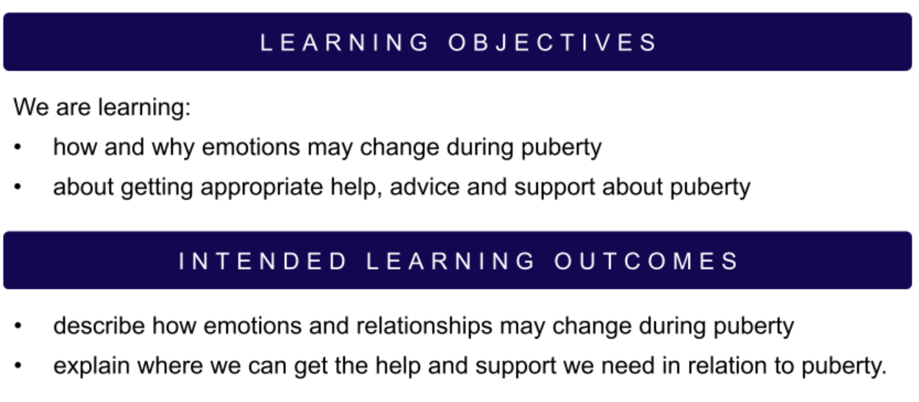
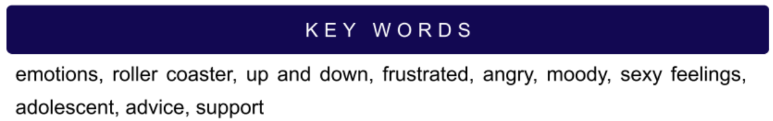
What will we teach your children (4)?

Slide 25
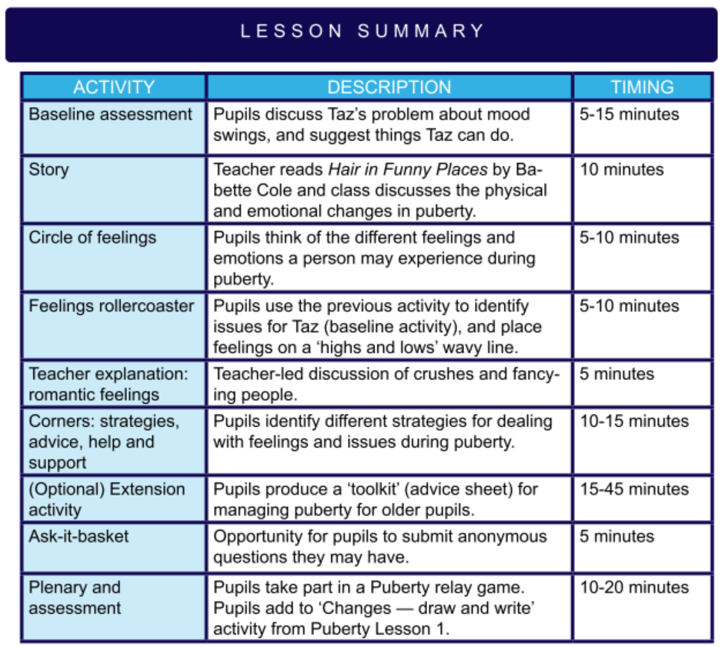
What will we teach your children (4)?

Slide 26
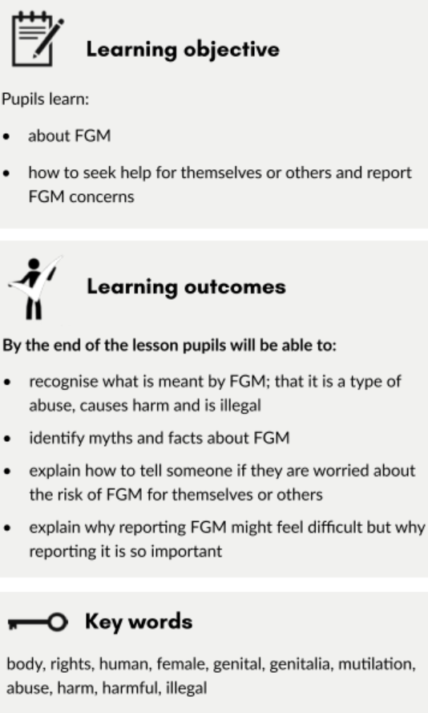
What will we teach your children (5)?
Notes:
Whilst there is no statutory requirement for primary schools to explicitly teach about FGM, there is a rationale within the Statutory guidance for Relationships Education, Relationships and Sex Education (RSE) and Health Education for teaching about FGM at primary level:
By the end of primary school, pupils should learn:
about the concept of privacy and the implications of it for both children and adults; including that it is not always right to keep secrets if they relate to being safe.
that each person’s body belongs to them, and the differences between appropriate and inappropriate or unsafe physical, and other, contact.
how to report concerns or abuse, and the vocabulary and confidence needed to do so.

Slide 27
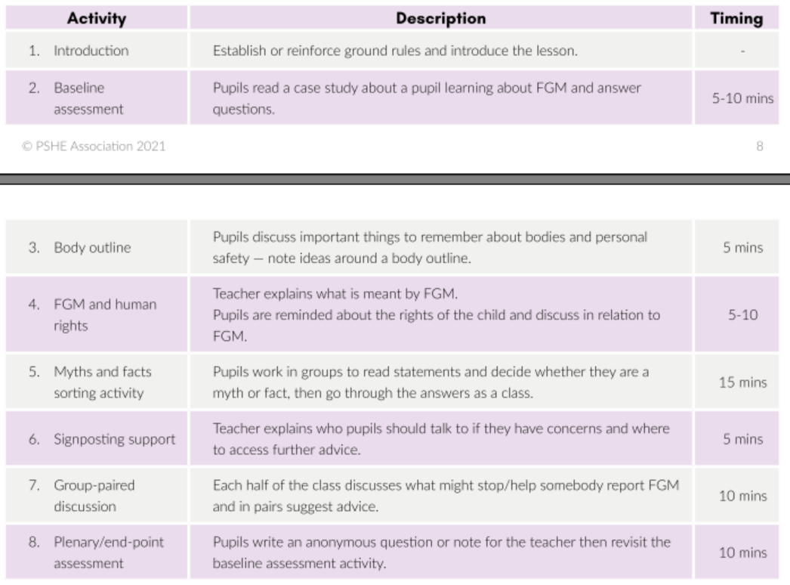
What will we teach your children (5)?
Notes:
Whilst there is no statutory requirement for primary schools to explicitly teach about FGM, there is a rationale within the Statutory guidance for Relationships Education, Relationships and Sex Education (RSE) and Health Education for teaching about FGM at primary level:
By the end of primary school, pupils should learn:
about the concept of privacy and the implications of it for both children and adults; including that it is not always right to keep secrets if they relate to being safe.
that each person’s body belongs to them, and the differences between appropriate and inappropriate or unsafe physical, and other, contact.
how to report concerns or abuse, and the vocabulary and confidence needed to do so.

Slide 28
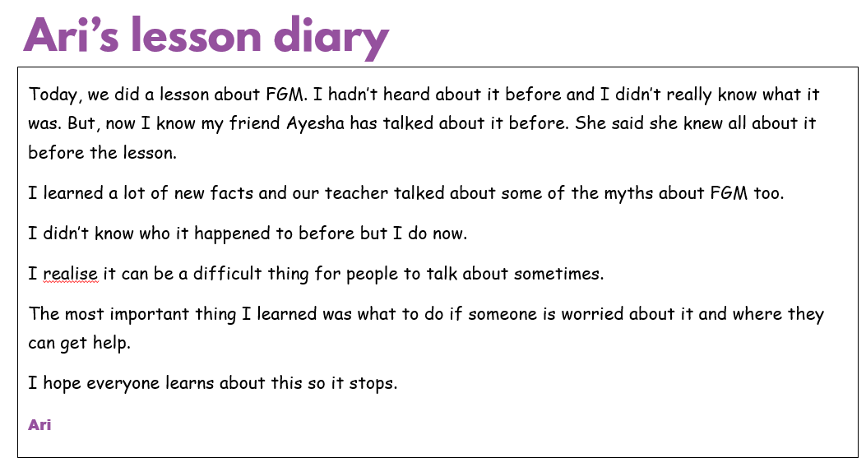

Slide 29
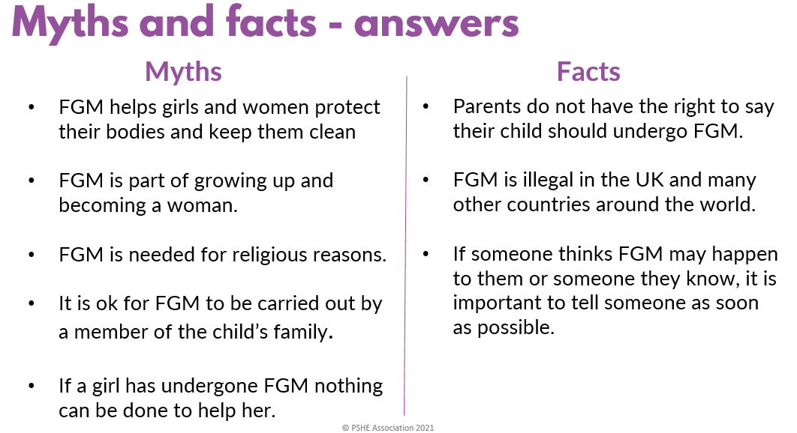

Slide 30
How and when will we teach it?
- In class with your child’s class teacher. ELT will be present to support where necessary.
- Starting from the week commencing 8th June

Slide 31
Q & A

