Slide 1

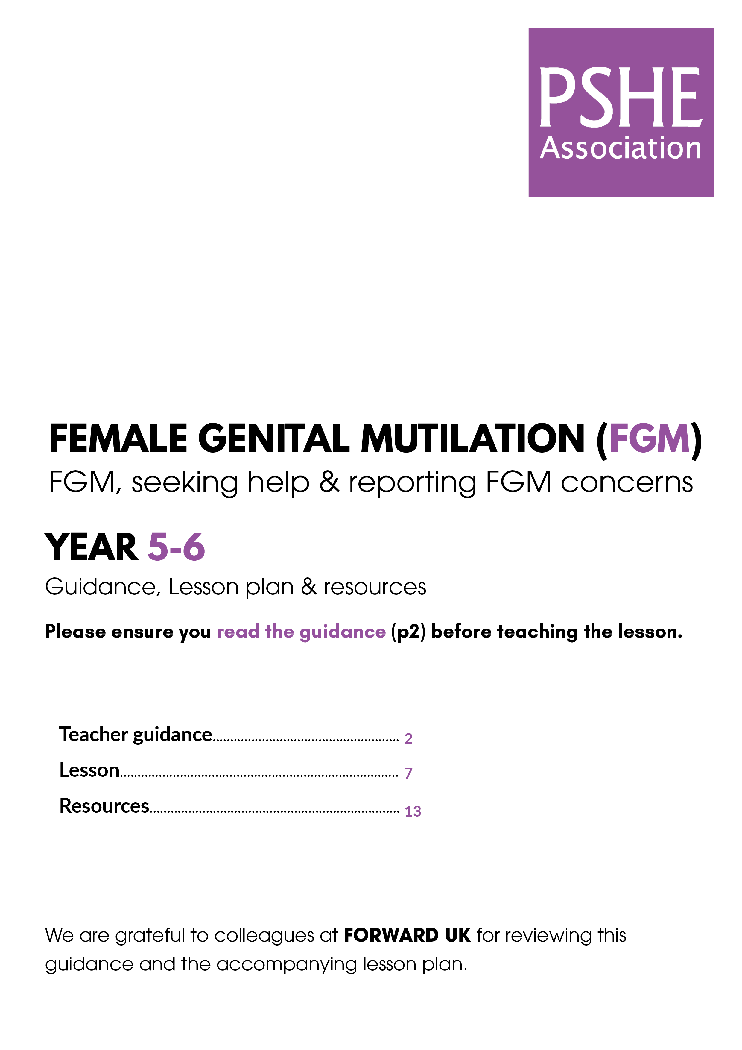

Ensure you read the guidance before teaching the lesson
Teacher
slide
Keeping safe: FGM
KS2 Lesson
Year 5/6
© PSHE Association 2021

Slide 2
Using this PowerPoint
Teacher
slide
The slides in this presentation are divided into two sections:
Teacher slides (purple) – provide key information regarding lesson preparation
Pupil slides (white) – provide a visual focus point for pupils during the lesson and delivery notes for teachers about the activities. Click ‘notes’ to view these.
Ensure that you select ‘Use Presenter View’ under the ‘Slide Show’ tab – this will allow you to preview the teaching notes on your monitor while the main presentation is displayed on a screen/smartboard.
© PSHE Association 2021

Slide 3



Challenge and support
Teacher
slide
The lesson includes suggestions for challenge and support activities, to help you differentiate appropriately for your class.
Challenge activities deepen and extend the learning for those who need more challenge or who finish the activity quickly.
Support activities are adapted to be more accessible for those who need it.
Look for the logo on the pupil slides. See delivery notes for details of the activities.
Support
Challenge
© PSHE Association 2021

Slide 4
Teacher
slide
Context
This lesson is for pupils in upper key stage 2. The lesson explains what Female Genital Mutilation (FGM) is, the law in relation to FGM and supports development of protective factors that will support young people to speak up, seek help and report if they or others are, or might be, at risk.
The lesson is not designed to be taught in isolation, but should always form part of a planned, developmental PSHE education programme. Teaching about FGM could be included in units on health, keeping safe, safe relationships, privacy, body parts (including external genitalia).
© PSHE Association 2021

Slide 5
Developing subject knowledge
Teacher
slide
FGM involves the partial or total removal of external female genitalia or other injury to the female genital organs for non-medical reasons.
In most places, where FGM is carried out, it is done between
infancy and 15 years old.
FGM has no health benefits and it is not required by any religion.
FGM is illegal in the UK and most other countries. It is illegal to take a child from the UK to another country for FGM.
FGM can cause severe bleeding and problems urinating, and later cysts and infections, as well as complications in childbirth.
FGM is a violation of the human rights of girls and women.
World Health Organisation, 2020.
© PSHE Association 2021

Slide 6
FGM and male circumcision
Teacher
slide
If questions about male circumcision arise, a distinction should be made between this and FGM. In some religions, or for medical reasons, males may be circumcised (when the foreskin – a small flap of skin that covers the end of the penis, is removed). However, FGM is not a religious requirement of any religion, carries a significantly higher risk of harm, causes lasting damage to a female body and is illegal.
© PSHE Association 2021

Slide 7

Safeguarding
Teacher
slide
It is important to consider sensitivities and prior knowledge about specific pupils’ circumstances. Be aware that individuals may have experienced FGM themselves or may know of someone who has. They may also become concerned that FGM may be carried out in the future. Any disclosure must be reported immediately to the police (see teacher guidance document on Mandatory reporting Duty).
© PSHE Association 2021

Slide 8




Teacher
slide
    Learning objective
To learn:
about FGM
how to seek help for themselves or others and how to report FGM concerns
    Learning outcomes
Pupils will be able to:
recognise what is meant by FGM; that it is a type of abuse, causes harm and is illegal
identify myths and facts about FGM
explain how to tell someone if they are worried about the risk of FGM for themselves or others
explain why reporting FGM might feel difficult but why reporting it is so important
© PSHE Association 2021

Slide 9




Teacher
slide
Preparing to teach
    Climate for learning
Make sure you have read the accompanying teacher guidance notes before teaching this lesson for guidance on establishing ground rules, the limits of confidentiality, communication and handling questions effectively.
  Resources required (See pdf version of lesson plan)
Box or envelope for anonymous questions
Resource 1: Ari’s lesson diary [copies for pupils - optional]
Resource 2: Myths and facts cards [one set of cards for each group of pupils]
Resource 2a: Myths and facts – answers [one teacher copy or copies for each group of pupils]
Two pieces of flipchart paper, blue tak and marker pens [for each half of the class]
Optional: Summary of United Nations Convention on the Rights of the Child (UNCRC)Plastic hoops or boxes for sorting activity
Optional: video clip: My Body, My Rules by FORWARD:
https://www.forwarduk.org.uk/forward-publications/my-body-my-rules-2015-fgm-animation/
https://www.youtube.com/watch?v=W2IStB6Z3Vw
      Further guidance
  Members of the PSHE Association can access our website for further guidance www.pshe-association.org.uk
60
    Duration This has been designed to be taught as a sixty-minute PSHE education lesson
© PSHE Association 2021
Notes:
The resources listed for this lesson are available in the PDF version of the lesson plan.

Slide 10
Lesson summary
Teacher
slide
Activity | Description | Timing
1. Introduction | Establish or reinforce ground rules and introduce the lesson. | 5 MINS
2. Baseline assessment | Pupils read a case study about a child learning about FGM and answer questions. | 5-10 MINS
3. Body outline | Pupils discuss important things to remember about bodies and personal safety – note ideas around a body outline | 10 MINS
4. FGM and human rights | Teacher explains what is meant by FGM. Pupils are reminded about the rights of the child and discuss in relation to FGM. | 5-10 MINS
5. Myths and facts | Pupils work in groups to read statements and decide if they are a myth or fact, then go through answers with the class. | 15 MINS
6. Signposting support | Teacher explains who pupils should talk to if they have concerns and where to go for further advice. | 5 MINS
7. Group/paired discussion | Each half of the class discuss what might stop / help somebody report FGM and in pairs suggest advice | 10 MINS
8. Plenary/end-point assessment | Pupils write an anonymous question or note-for-the-teacher and revisit the baseline assessment activity. | 10 MINS
© PSHE Association 2021

Slide 11

Keeping safe: FGM
Notes:
Teacher notes
Make sure you have read the accompanying teacher guidance notes before teaching this lesson. (https://www.pshe-association.org.uk/curriculum-and-resources/resources/keeping-safe-fgm-guidance-lesson-plan-year-5-6)
Explain that the lesson will discuss an issue that affects some children around the world and it is important they learn about this so they are informed and protected and can speak out about it in the future.

Slide 12

Ground rules
[Add your class rules here]
Notes:
Teacher Notes
Use this slide to display your class agreement / ground rules for PSHE education lessons. See Accompanying Teacher Guidance Notes (https://www.pshe-association.org.uk/curriculum-and-resources/resources/keeping-safe-fgm-guidance-lesson-plan-year-5-6).
Remind pupils of the ground rules for PSHE lessons and that if they have questions or are worried about things that go into or on to bodies they can write their name on a piece of paper and put in it the ask-it-basket so they can talk to the teacher later, rather than telling the whole class

Slide 13
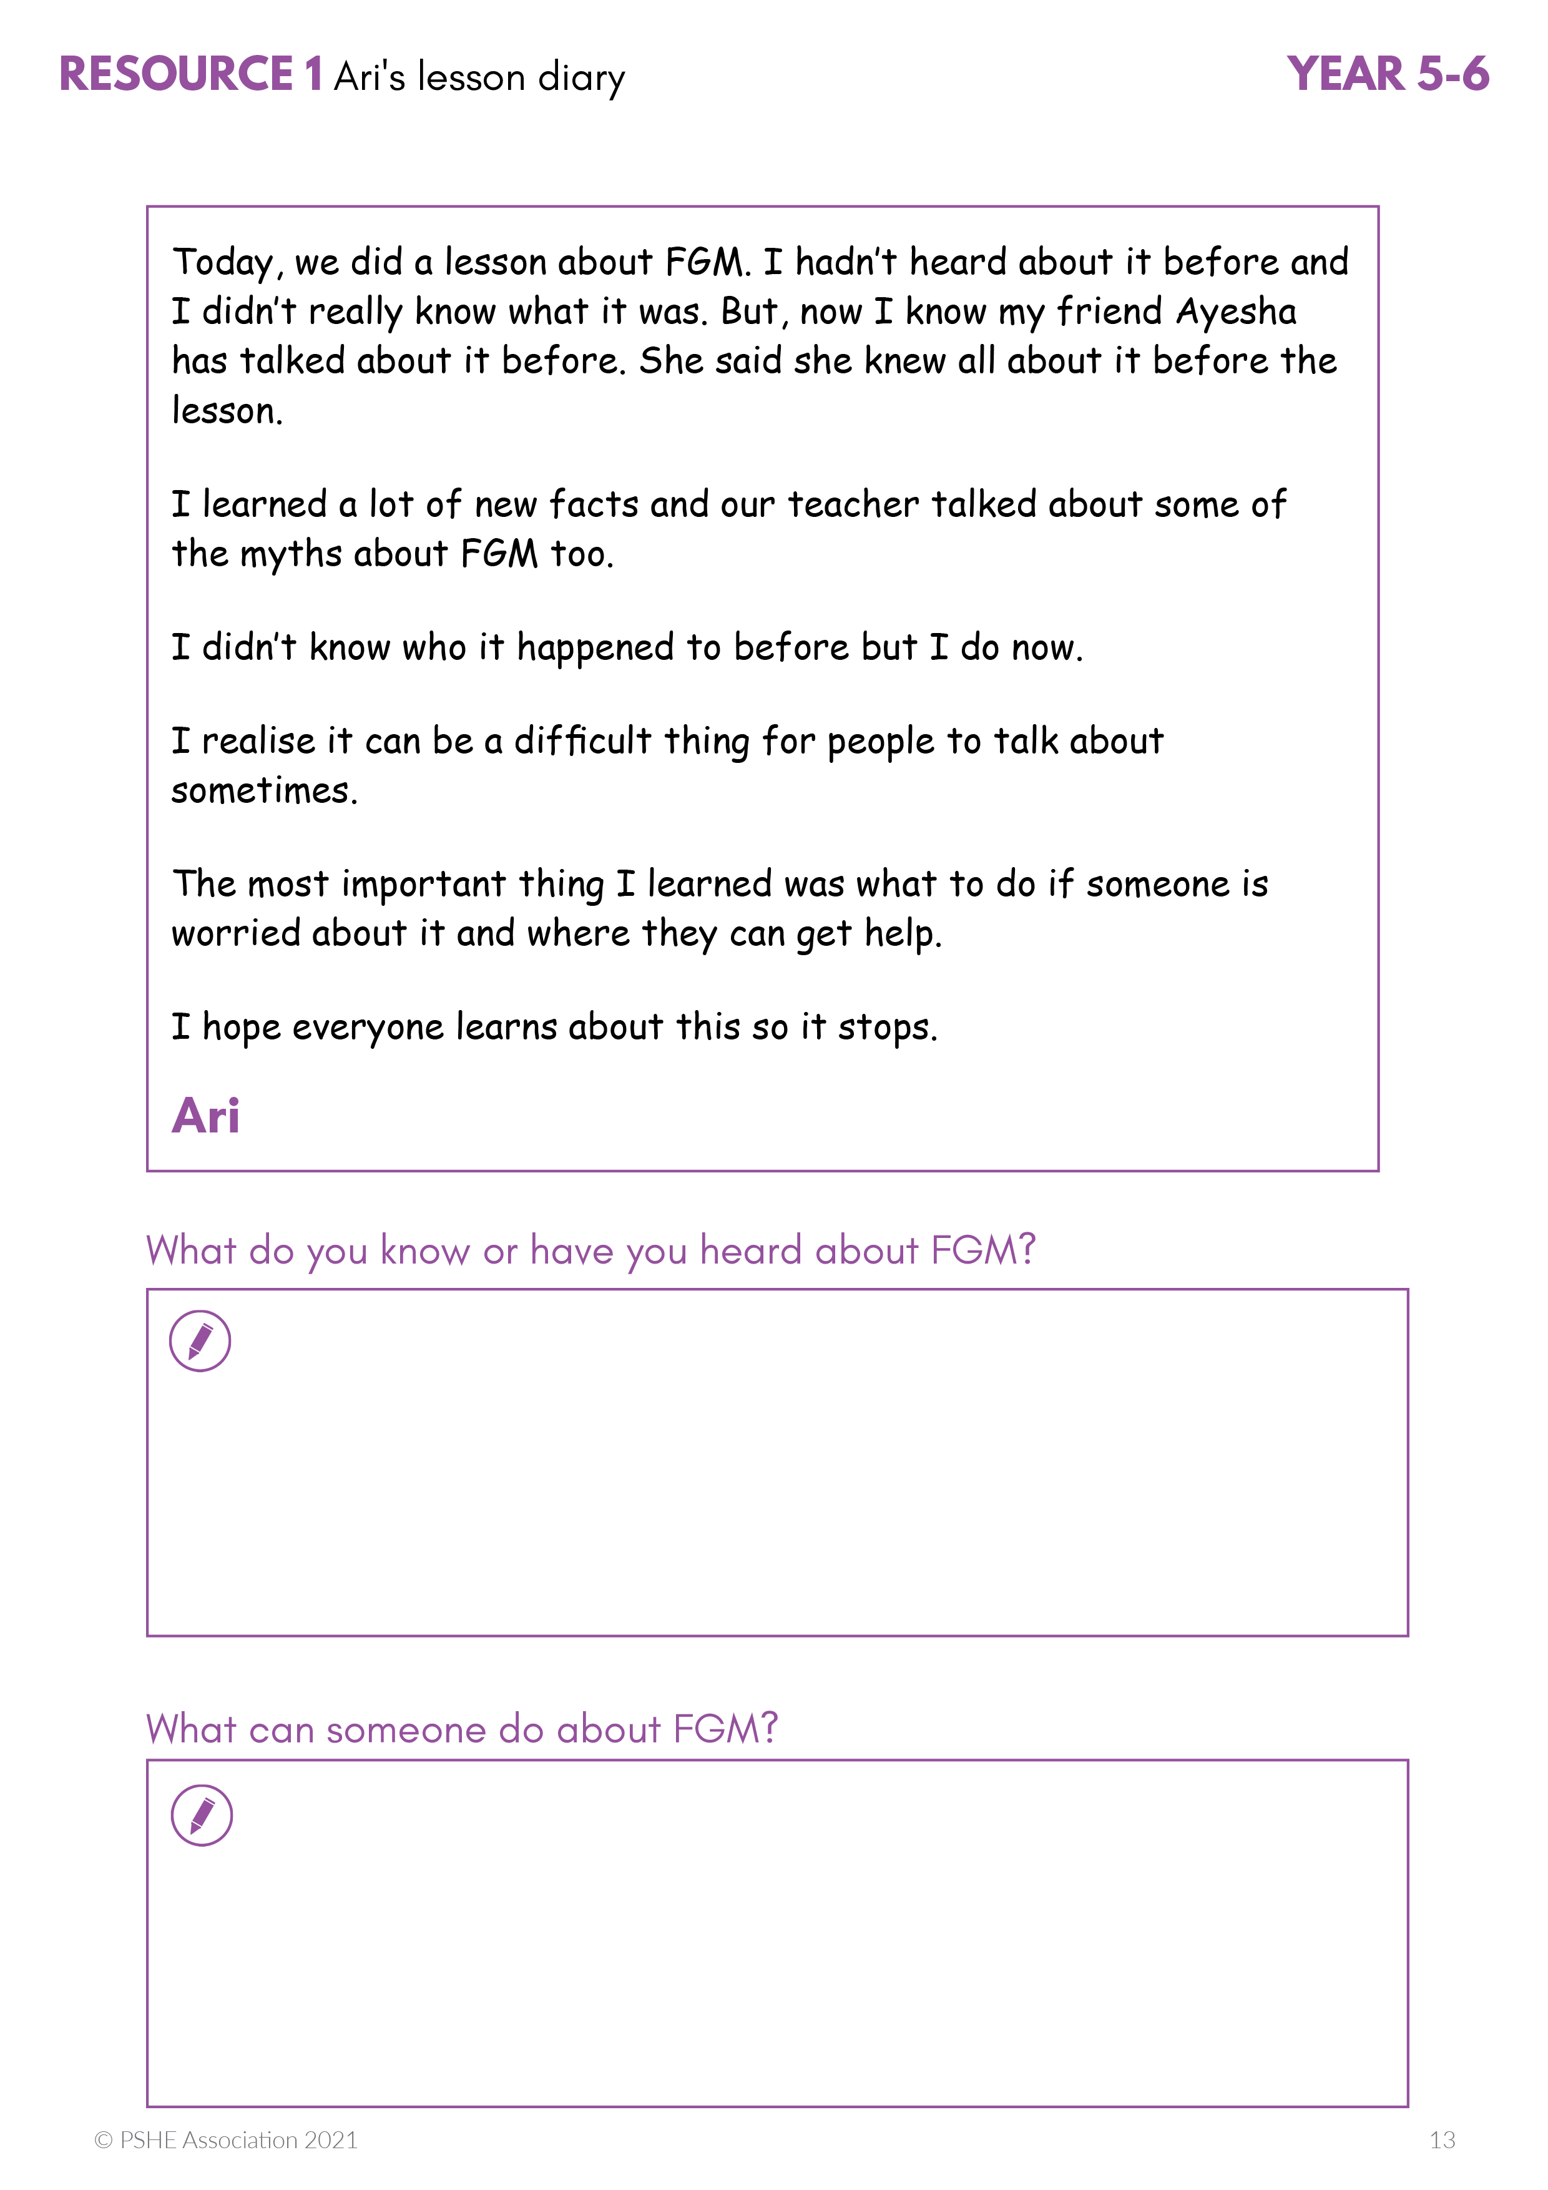
What’s our starting point?
Ari’s lesson diary
Read the diary extract and then answer these questions:
What do you know or have you heard about FGM?
What can someone do about FGM?
Notes:
Teacher Notes - Baseline assessment (5-10 mins)
After reading the diary extract, pupils answer the questions. Explain that if pupils have not heard of FGM they can just say or write ‘I don’t know’. It does not matter as they will be learning more about FGM in the lesson (do not provide further prompts or explanations at this point).
See next slide for enlarged version of the diary or provide pupils with copies of Resource 1: Ari’s lesson diary (from the PDF version of the lesson plan).
You can choose for pupils to discuss this as a whole class activity, in pairs or as an individual written activity. The purpose is to get a sense of what pupils already know or think about FGM and what worries or concerns they may have. If pupils work in pairs or individually, circulate around the class as they work or ask for feedback following the activity, then collect in their work and put it to one side. Pupils will return to this at the end of the lesson to reflect on their learning.

Slide 14
Ari’s lesson diary
Today, we did a lesson about FGM. I hadn’t heard about it before and I didn’t really know what it was. But, now I know my friend Ayesha has talked about it before. She said she knew all about it before the lesson.
I learned a lot of new facts and our teacher talked about some of the myths about FGM too.
I didn’t know who it happened to before but I do now.
I realise it can be a difficult thing for people to talk about sometimes.
The most important thing I learned was what to do if someone is worried about it and where they can get help.
I hope everyone learns about this so it stops.
^{Ari}

Slide 15
We are learning about FGM and how to ask for help for ourselves or others
      We will be able to:
  recognise that FGM is illegal and harmful
  identify some myths and facts about FGM
  explain how to tell someone if we are worried for ourselves or others
  explain the importance of doing this, even if it feels difficult
Notes:
Teacher Notes – Learning objective and outcomes
Introduce the learning outcomes – these are a pupil-friendly version of the outcomes on slide 6 (teacher slide).
.

Slide 16

Keeping our bodies safe
What can we remember about how to keep our bodies safe?
Notes:
Teacher Notes – Body outline (5 mins)
Ask pupils to think about the following question: What can we remember about how to keep our bodies safe?
Then share their responses, writing them around the body outline.
If pupils do not mention personal safety, make sure you direct them towards doing so and re-cap the PANTS rules for keeping private parts private.
Pupil responses might include: their body belongs to them; everybody is different; no-one should touch someone else’s body without permission; our bodies are special; it is important to keep our bodies healthy and clean, the PANTS rule (Private parts are private; Always remember your body belongs to you; No means no; Talk about secrets that upset you; Speak up - someone can help)

Slide 17
What is…?
F
female
… affects girls and women
G
genital
… vulva, vagina, clitoris
M
mutilation
… injure, damage or disfigure
Notes:
Teacher Notes – FGM and human rights (5-10 mins including next slide)
Explain the meaning of FGM in simple terms, using the slide content.
Explain that FGM is a type of abuse that is very harmful to people and their bodies. FGM means that someone changes or removes parts of the female genitals, which is very harmful. It happens to some girls in some cultures and places around the world (in Africa, Asia and the Middle East but it also happens in Europe and even in the UK) but not usually in a hospital. It is also scary and painful and it goes against a girl’s right to be safe.
This slide has been animated to provide descriptions which you may just prefer to talk through – slides should be adapted according to pupil needs.
F, ‘female’ – explain that this affects girls and women.
G, ‘genital’ - remind pupils what we mean when we talk about genitals or genitalia, and the names of the female genitalia (vulva, vagina, clitoris).
M, ‘mutilation’ – explain that to mutilate in relation to the human body is to injure, damage or disfigure.

Slide 18

Introduction: The Rights of the Child
The United Nations Convention on the Rights of the Child (UNCRC) is a set of rules to protect children and keep them safe and happy.
It has been signed and agreed by governments in most countries around the world.
Notes:
Teacher Notes – FGM and human rights (5-10 mins including previous slide)
Display a simple version of the United Nations Convention on the Rights of the Child (UNCRC) (or provide copies for pupils to read in pairs). Explain
briefly that this is a set of rules for governments that have been signed and agreed by most countries around the world. Explain that all the rights are equally important and link together as a set of rules or principles to protect children and keep them safe and happy.
Explain that FGM goes against one right in particular. Ask for suggestions for which it might be and if necessary explain that it is Article 19 (protection from violence, abuse and neglect) Governments must do all they can to ensure that children are protected from all forms of violence, abuse, neglect and bad treatment by their parents or anyone else who looks after them.
[A summary of the UN Convention on the Rights of the Child, Unicef, 2017]

Slide 19
Myths and facts
Read the statement on the card.
Decide whether it is a myth (not true) or fact (true).
Sort the cards into two piles: myths and facts
Myth
Fact
Notes:
Teacher Notes – Myths and facts sorting activity (15 mins – including next slide)
Working in small groups of about four, pupils read each statement from Resource 2: Myths and facts cards (from the PDF lesson plan) and sort the cards, deciding whether each is a myth or a fact.
Support: Give pupils fewer cards and decide if they are myths or facts (e.g. numbers 3, 4, 5 and 8) .
Challenge: Pupils further explain their thinking about why they think the statement is it a myth or fact.

Slide 20
Myths and facts - answers
Myths
Facts
FGM helps girls and women protect their bodies and keep them clean
FGM is part of growing up and becoming a woman.
FGM is needed for religious reasons.
It is ok for FGM to be carried out by a member of the child’s family.
If a girl has undergone FGM nothing can be done to help her.
Parents do not have the right to say their child should undergo FGM.
FGM is illegal in the UK and many other countries around the world.
If someone thinks FGM may happen to them or someone they know, it is important to tell someone as soon as possible.
Notes:
Teacher Notes – Myths and facts sorting activity (15 mins – including previous slide)
Go through the answers with the class, giving additional information from Resource 2a: Myths and facts – answers.

Slide 21
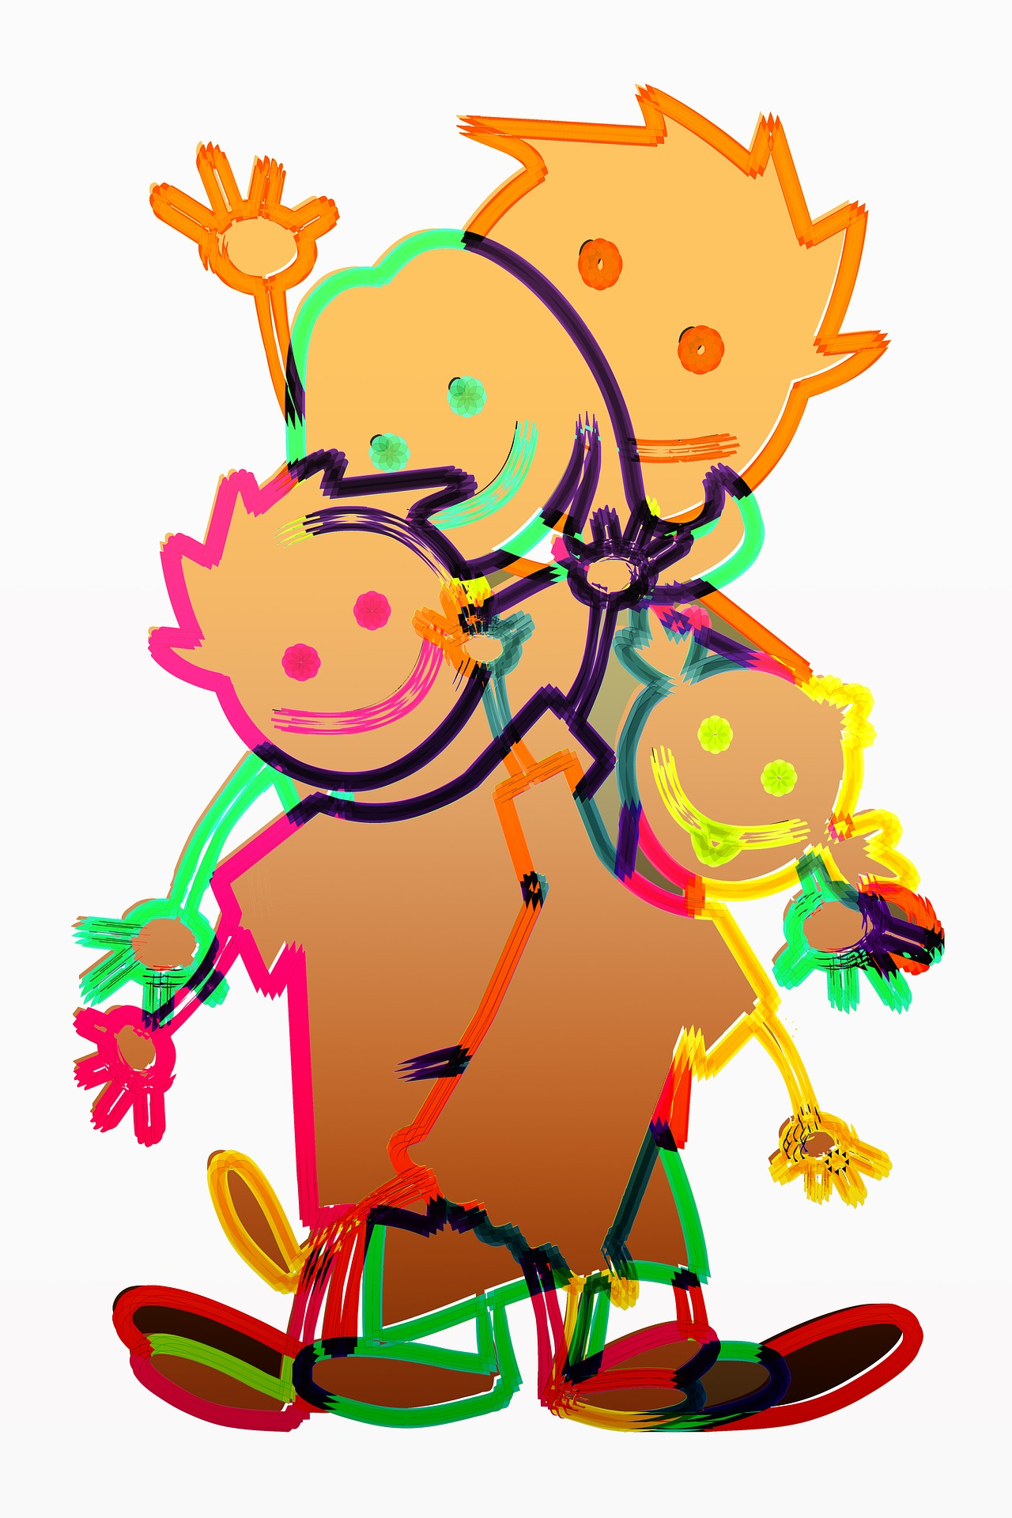
Never keep an unsafe secret
Secrets that cause concern should always be shared to help the people involved stay safe.
Notes:
Teacher Notes – Signposting support (5 mins – including next slide)
Explain that a young person may feel under pressure to keep FGM a secret. Someone under threat of FGM might be told they are going on a special holiday but not to tell anyone, or that they are going to have a special secret ceremony to do with growing up or becoming a woman. It is important to remember that secrets and surprises that do harm do not feel good and that we usually get a sense if something is wrong. Secrets that make someone worried or uncomfortable should always be shared with an adult they trust.

Slide 22


Who to ask for help
If someone is concerned for themselves or someone they know, they should talk to an adult or organisation they trust, such as:
Class teacher
Another adult in school
An adult at home or outside the family
ChildLine: 0800 1111 www.childLine.org.uk
NSPCC FGM helpline: 0800 028 3550;
Email: fgmhelp@nspccc.org.uk
Police: 101 (emergency: 999)
Notes:
Teacher Notes – Signposting support (5 mins – including previous slide)
Ask the pupils to suggest who someone could ask or where they could go for help either for themselves or for someone else they are worried about. Explain that a child or young person concerned about FGM, whether it has already happened to them or someone they know, or it might happen in the future, can talk to any of these people / organisations.

Slide 23

Group discussion
Some people might find it difficult to report concerns about FGM.
In two groups, discuss:
A. What might make it difficult for someone to report FGM?
B. What might help someone to report FGM?
Notes:
Teacher Notes – Group/paired discussion (10 mins)
State that some young people might find it difficult to report FGM.
Divide the class in half. One half discusses: What might make it difficult for someone to report FGM? And the other half discusses: What might help somebody to report FGM?
Pupils record their responses on flipchart paper. After a short time bring the class back together to compare their ideas.
Pupils’ responses might include:
What might make it difficult for somebody to report FGM? - worried they will get into trouble; worried parents will get into trouble; not knowing what will happen to them or their parents; embarrassed to talk about it; fear something bad will happen to them; find it upsetting to talk about.
What might help somebody to report FGM? - knowing who they can talk to and what to say; wanting to keep their body safe; knowing that it is illegal; wanting to protect their family; knowing it is not a religious requirement; talking confidently about their body and about FGM; remembering the United Nations Convention on the Rights of the Child (UNCRC), remembering the PANTS acronym; being able to ask advice by email or text; knowing who they can speak to at school.
Suggestions for the teacher to guide pupils’ learning:
‘Talk it through with your teacher, they will know how to help.’
‘The most important thing is that you keep your body safe.’
‘Sometimes, people don’t understand the harm that this type of abuse can do, adults sometimes need help to learn this too, maybe your parents don’t understand.’
‘It is always best to ask if you are not sure or are concerned, then the right people will know how to help.’

Slide 24
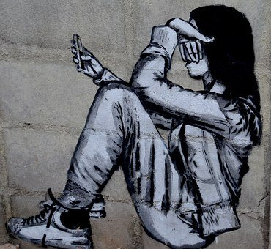
Ari’s dilemma
Think back to Ari’s lesson diary from the start of the lesson.
Ari’s friend is worried she may be at risk of FGM.
What advice could Ari give?
Notes:
Teacher Notes – Group/paired discussion (10 mins – including next slide)
Remind the pupils of the baseline assessment – Ari’s diary entry. Ask them to imagine that Ari has a friend who is worried they may be at risk of FGM. In pairs, pupils think about what advice Ari could give this. Pupils share their ideas. On the next slide are some suggestions.

Slide 25
Ari’s advice
Sometimes people don’t understand the harm this can do, but it is abuse and you must tell someone.
Talk it through with your teacher, they will know how to help.
It is best to ask if you are not sure, the right people will know how to help.
The most important thing is that you keep your body safe.
Notes:
Teacher Notes
Afterwards remind the class that it is very important that Ari tells a trusted adult if the friend doesn’t.

Slide 26

About today’s lesson
On a piece of paper write down a question you have or a note for your teacher (something that surprised or concerned you, or something you are thinking about).
If you want to talk to someone about it remember to write your name on the paper.
Notes:
Teacher Notes – Plenary/reflecting on today’s learning and end-point assessment (5-10 mins including next slide)
Provide an opportunity for pupils to record a question or a ‘note for the teacher’ about the lesson (this might be something that surprised or concerned them or just a general reflection on what they have learnt). Remind pupils that if they want to talk to someone for more advice, to put their name on the paper. Collect these in the box or envelope.
Be sure to check these carefully after the lesson and follow up any concerns in line with safeguarding and child protection policies. Any disclosure of FGM must be reported immediately to the police (see teacher guidance on Mandatory reporting Duty).

Slide 27
What has been learnt?
Now go back the questions about Ari’s lesson diary from the start of the lesson.
What do you know about FGM?
What can someone do about FGM?
Is there anything you would like to change?
Is there anything you would like to add?
Notes:
Teacher Notes – Plenary/reflecting on today’s learning and end-point assessment (5-10 mins including previous slide)
Pupils then go back to the baseline assessment from the start of the lesson. If they have completed this individually they can use a different colour pen or pencil to amend or add to their initial ideas. If it was a whole class or paired discussion, allow time to discuss and reflect on the learning.

Slide 28
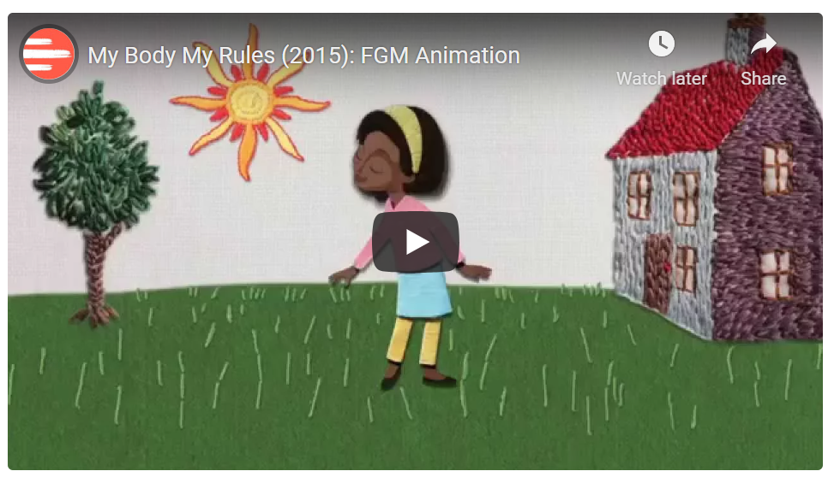
Additional activity – My Body, My Rules
Watch the video My Body, My Rules
What are the character’s feelings at different points in the film?
What are the key messages in the film?
At the end of the film it says, ‘Together we can end FGM,’
What does this mean to you?
Notes:
Teacher Notes – Extension activity
Watch the video (3 mins) My Body, My Rules by FORWARD. Pupils discuss the character’s feelings at different points in the film. Then discuss:
What are the key messages in the film?
At the end of the film it says, ‘Together we can end FGM’ – What does this mean?
Video:
https://www.forwarduk.org.uk/forward-publications/my-body-my-rules-2015-fgm-animation/
https://www.youtube.com/watch?v=W2IStB6Z3Vw

