Slide 1
Year 6 PSHE
RSE Parent Meet
June 2026

Slide 2

Hello & Thank you!
Notes:
Thank parents for attending workshop –helps us communicate the importance of Relationships and Sex Education in schools
Explain it will be recorded for other parents so it can be uploaded onto the website.
Check if there are any other parents who don’t want to be frecorded? If so turn camera off.

Slide 3

Terminology
PSHE:
Personal, Social, Health & Economics (Education)
RSE:
Relationships & Sex Education
Notes:
Explain that throughout the workshop, these terms will be mentioned a lot – explain their meaning.

Slide 4

Aims:
Share the background of our PSHE curriculum journey
Share the new RSE requirements for primary schools
Share the objectives we will teach
Policy withdrawal process
Q&A

Slide 5
Our PSHE/RSE Journey
Subject review
New planning (government expectations & recommended resources)
New ratified policy (including parent views - 2019)
Staff training including external support
1 hour a week (or equivalent) of PSHE lessons
Regular Subject Monitoring
Notes:
Emphasize the importance of it being a statutory requirement and the support we have given staff:
- Sex Education Forum Training, Government recommended resources from Medway – linked on the website and shown later on in the workshop, feedback, SLT support in the lessons.

Slide 6
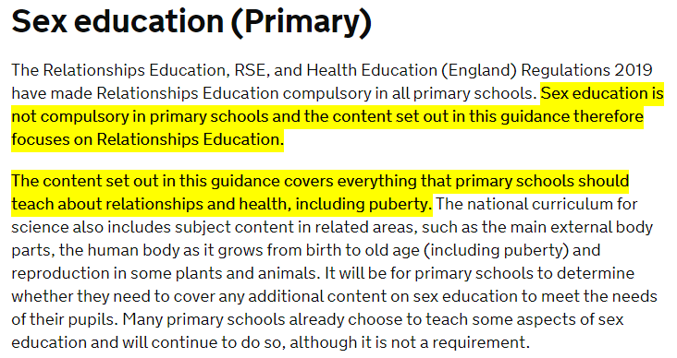
PSHE/RSE Requirements
From September 2020, the Health Education and Relationships Education aspects of PSHE education became compulsory in all schools.

Slide 7
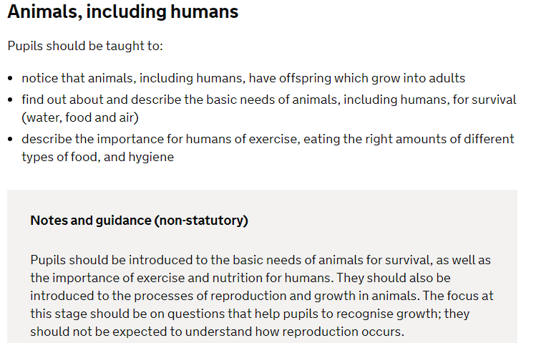
Science Requirements: What do we teach?
The Year 2 Science Curriculum:
Notes:
Emphasise that throughout these next few slides the science curriculum will naturally raise questions in your children’s minds. You may have already had them come home asking how babys are made because of the nature of the topics covered in science. Therefore it makes sense to close the cycle from the learning giving your children factually accurate information. Research shows that children who receive factually accurate information are more likely to have safe positive relationships later in life and conceive a child in a loving relationship than those who have not been taught the facts. This is why as a school we have chosen, like the vast majority of primary schools to teach sex education to support the relationships education which is compulsory.

Slide 8
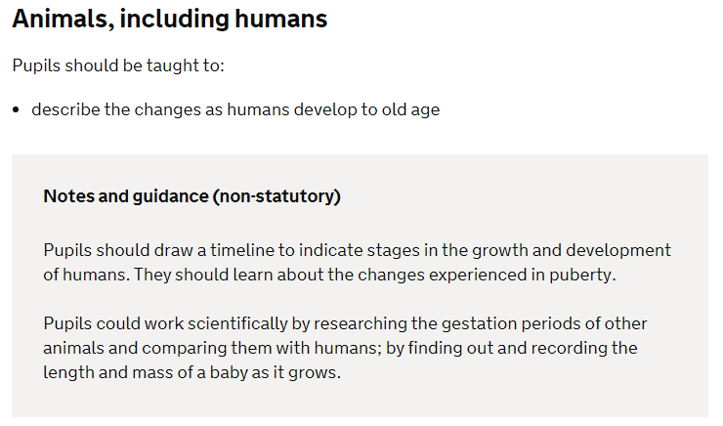
Science Requirements: What do we teach?
The Year 5 Science Curriculum:

Slide 9
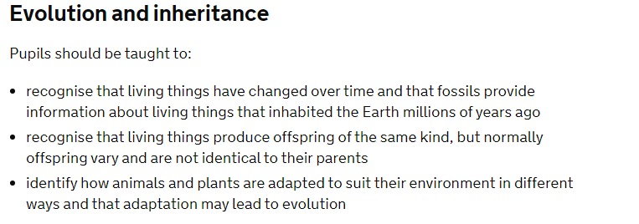
Science Requirements: What do we teach?
The Year 6 Science Curriculum:
Notes:
At this age your children may have heard inaccurate information from peers or outside sources on how a baby is made so it is crucial to help them understand the facts – linking back to the point made on the first of these curriculum slides.

Slide 10
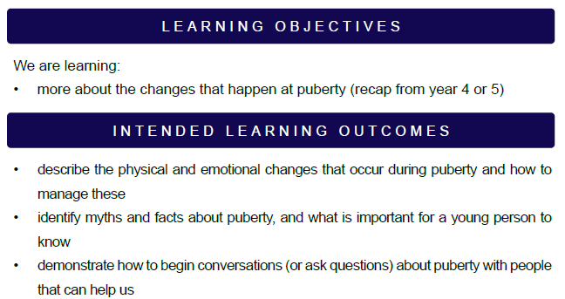
What are we planning to teach?
Notes:
Asa result of the research, local school stances and government recommendations we are co-insiding our sex education with relationships education and our science curriculum.
Explain there will be a series of four lessons which are linked and not isolated so that pupils have a wider view of a baby being born into a loving relationship.

Slide 11
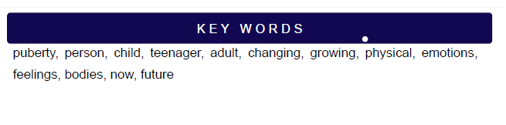

Slide 12
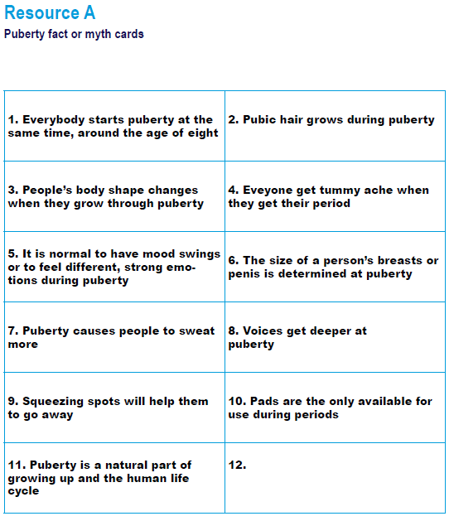
Notes:
Recap on what they will have learnt in year 5.

Slide 13
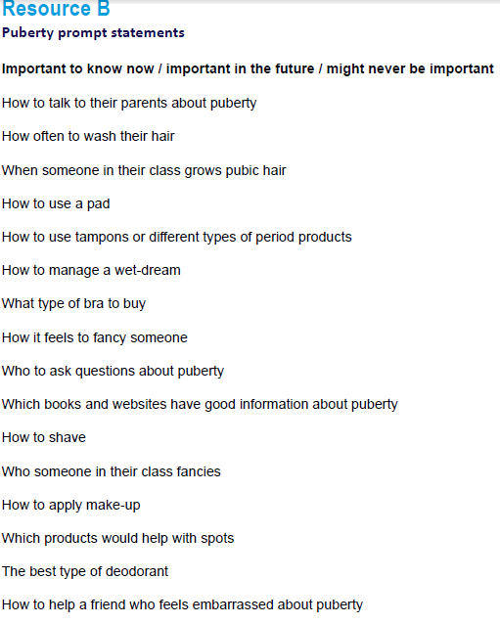

Slide 14
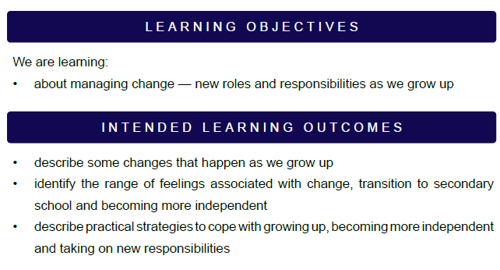
What are we planning to teach?

Slide 15
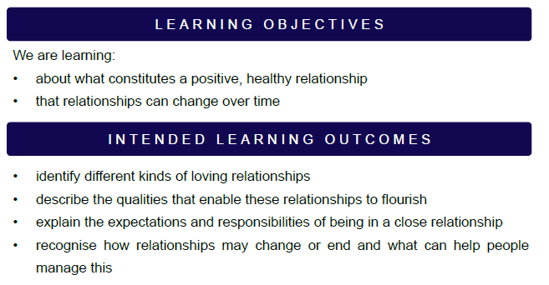
What are we planning to teach?

Slide 16
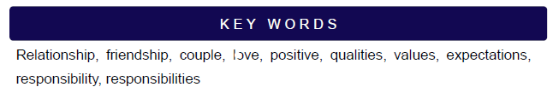

Slide 17
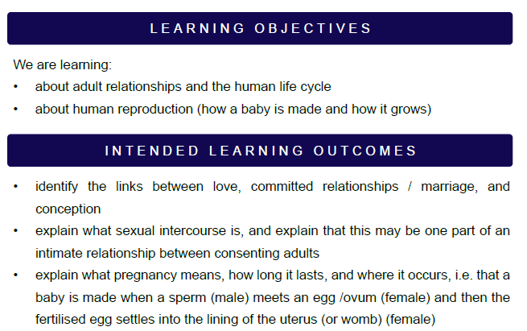
What are we planning to teach?
Notes:
Explain that this is the only lesson which parents could opt their children out of but we strongly recommend that they don’t for their own personal growth – relate back to what the research proves again.

Slide 18
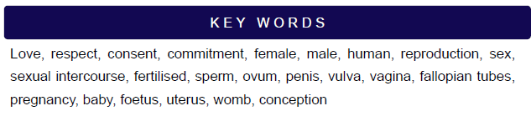
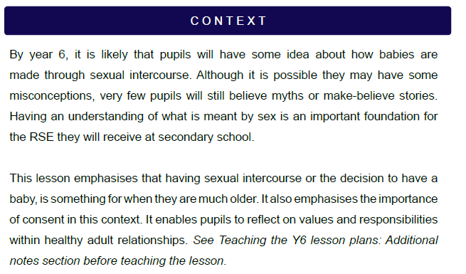

Slide 19
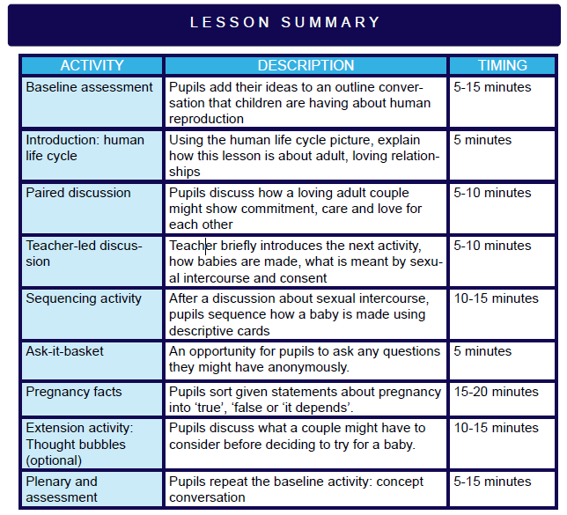

Slide 20
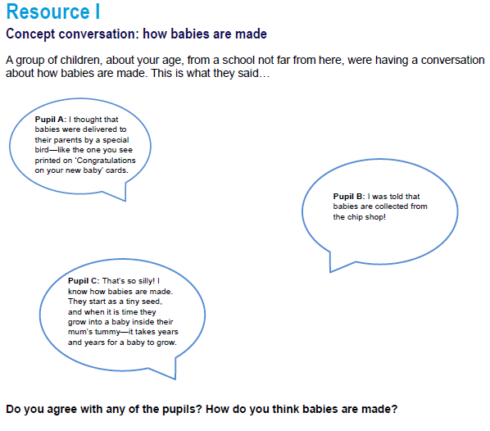

Slide 21
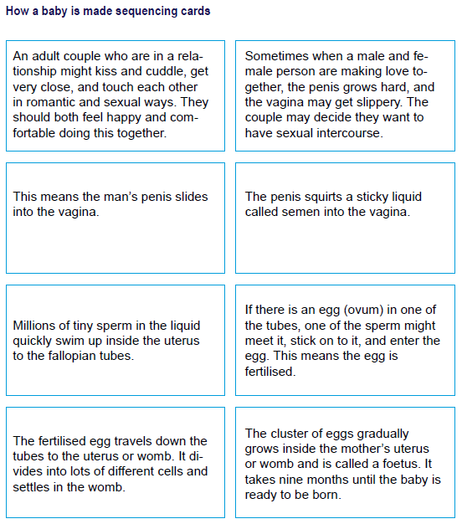

Slide 22
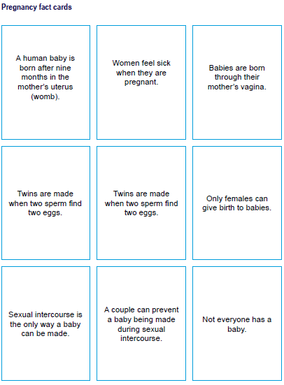

Slide 23
What will we teach?
• about the responsibilities of being a parent or carer and how having a baby changes someone’s life
• A basic understanding of contraception at primary level. Including basic information about common forms of contraception (for example, condoms and the contraceptive pill) and how these can prevent a baby being made.

Slide 24
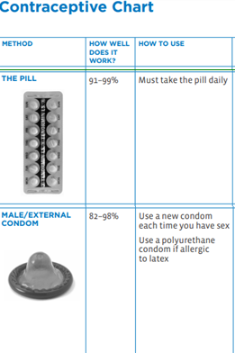

Slide 25
How and when will we teach it?
- In class with your child’s class teacher. ELT will be present.
- W/C Monday 22nd June (most likely the Friday)
- If appropriate, in smaller/gender groups for Q & A.

Slide 26
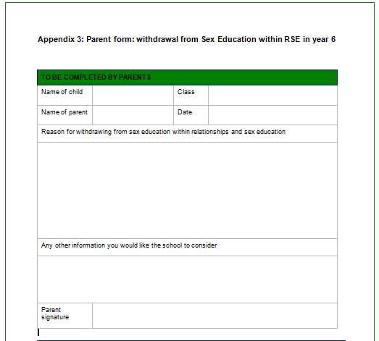
Policy: Parents Withdrawal Rights
If you choose to withdraw your child, they will continue with other curriculum teaching in PSHE with a member of staff in the year group.

Slide 27
Q & A

