Slide 1



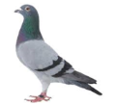

n l

Slide 2



n t n l

Slide 3
n d d

Slide 4

n ct n l

Slide 5

n l

Slide 6
n p nt
n s p nt s

Slide 7


n

Slide 8

n st

Slide 9

n sp l

Slide 10

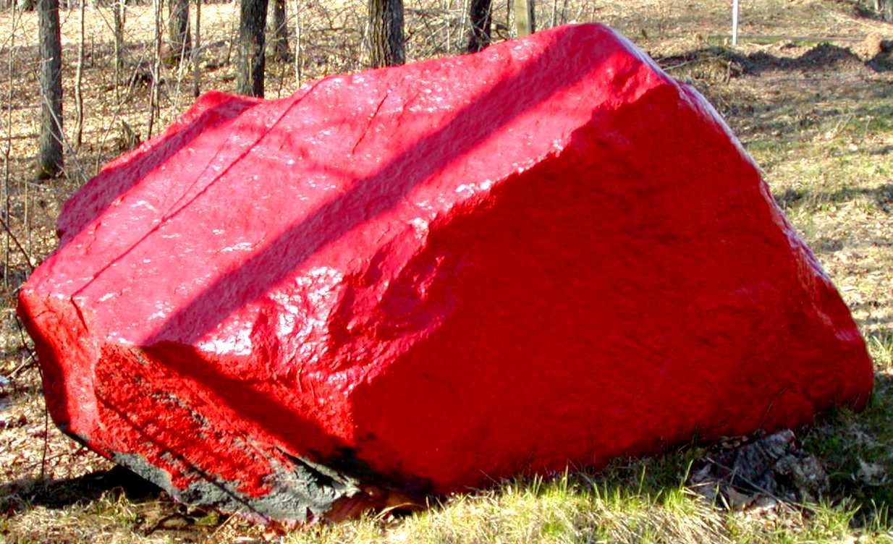











blanco
blanca
rojo
roja
amarillo
amarilla
Neigh!
morado
morada
Neigh!
dorado
dorada
negro
negra
verde
verde
pardo
parda
azul
azul
gris
gris
Notes:
Repeat if correct

Slide 11
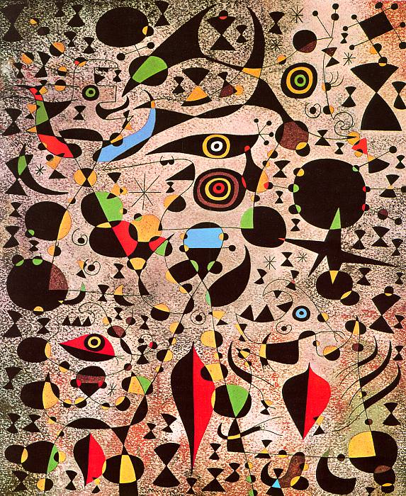
Notes:
Woman Encircled by the Flight of a Bird, 1941, by Joan Miró

Slide 12
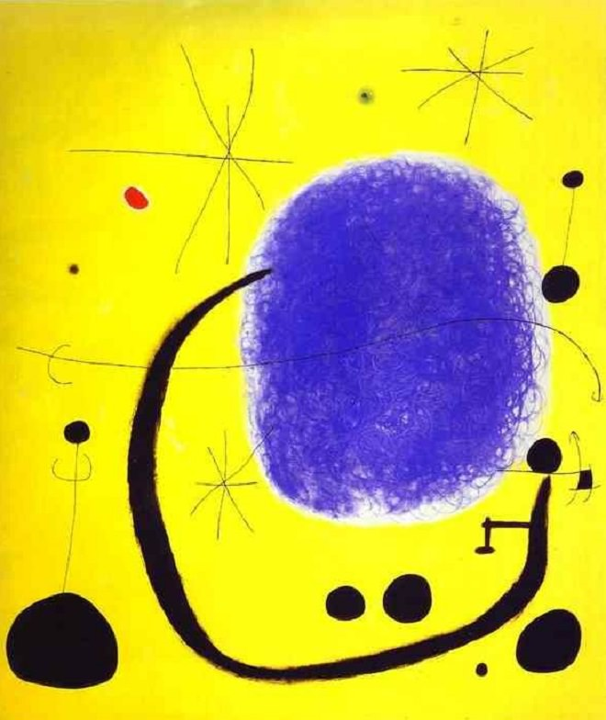
Notes:
The Gold of the Azure, 1968, by Joan Miró

Slide 13
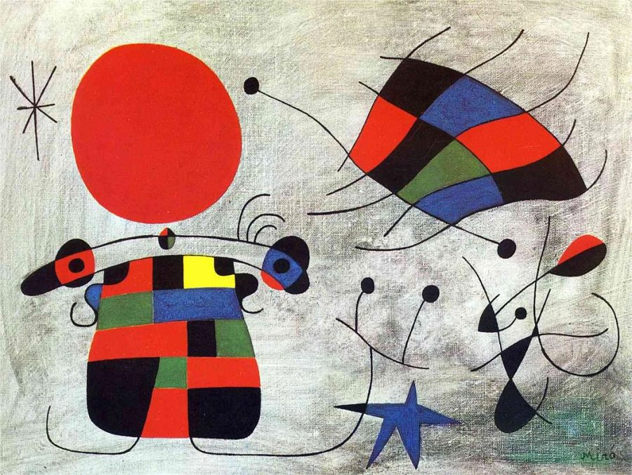
Notes:
The Smile of the Flamboyant Wings, 1953, by Joan Miró

