Slide 1
Before we start:
Watch this video to see a typical event that happens in the week leading up to Easter in Spain.
What can you see in the video?
What do you think is going on?
Why?
https://www.youtube.com/watch?v=LUyJmp-_2ZY

Slide 2
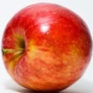
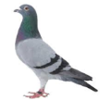
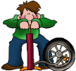
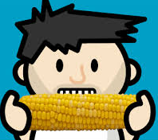
P s n sp
Los objetivos:
To discover a Spanish Easter tradition.
To evaluate key features of nouns.
Para triunfar:
Find out facts about Easter week.
Use phonic knowledge to write 7 Easter nouns correctly.
Identify masculine, feminine and plural endings.
Categorise the nouns according to gender and number.
Make Easter nouns plural.

Slide 3
Find out facts about Easter week:
Watch this video about Easter week – Semana Santa.
It is in Spanish with English subtitles to read, so you could watch with an adult to help you.
Remember, Spain is a Christian country and this is a big event in the Christian calendar.
https://www.youtube.com/watch?v=qTfWYfHIGig

Slide 4
Find out facts about Easter week.
Can you now explain what happens in Easter week in Spain?
If not, watch again and pause the video. Explain as you watch.

Slide 5
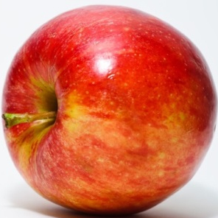
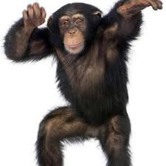
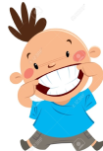

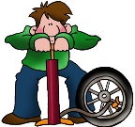


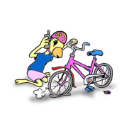
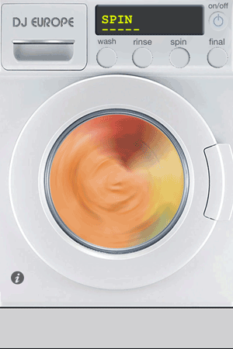
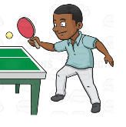


Slide 6

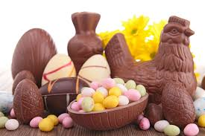
Use phonic knowledge to write 7 Easter nouns correctly.
ch c l t
Dictionary tip: nm

Slide 7


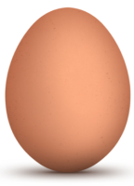
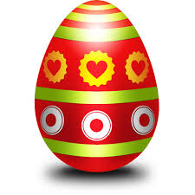

Slide 8
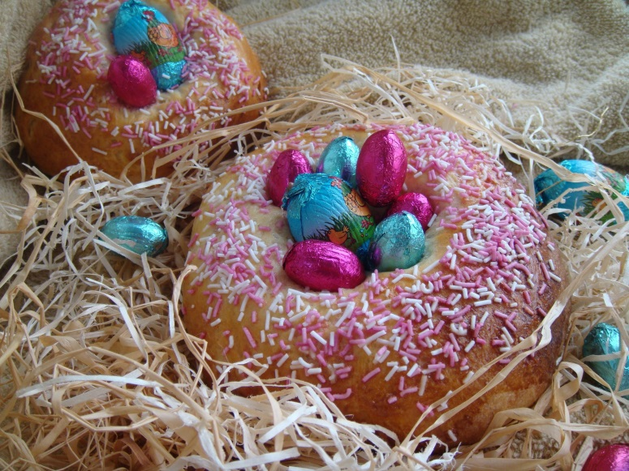
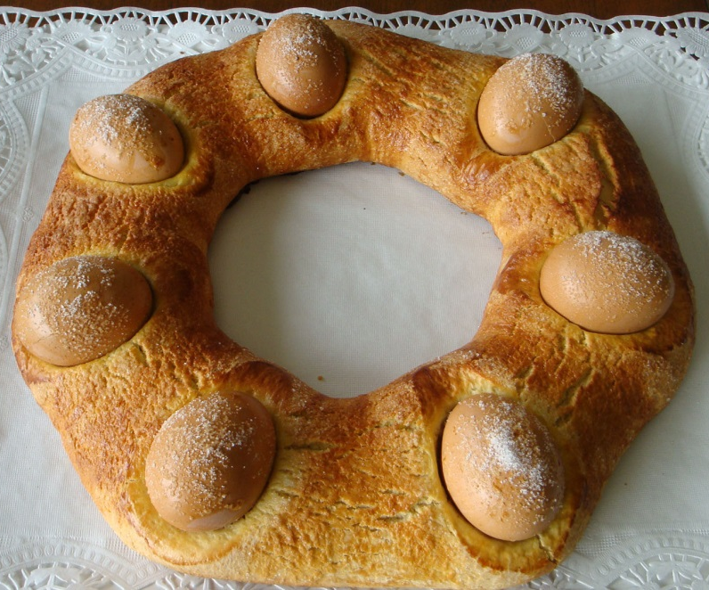
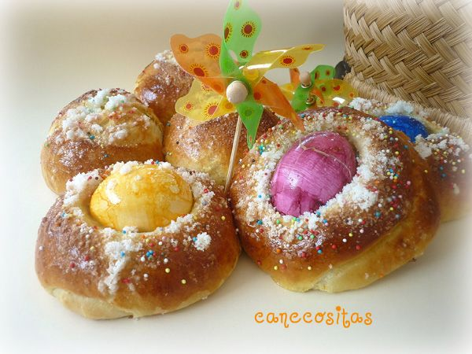
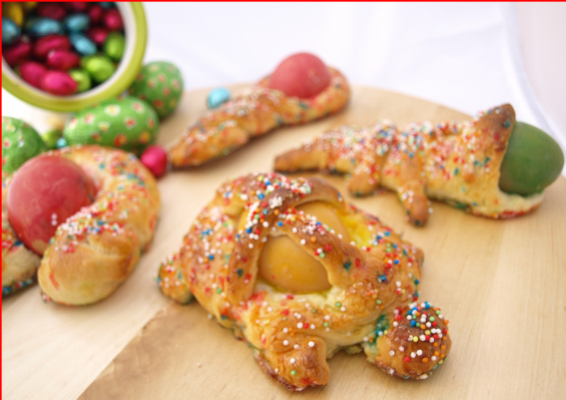
m n d P s

Slide 9
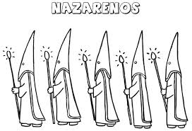
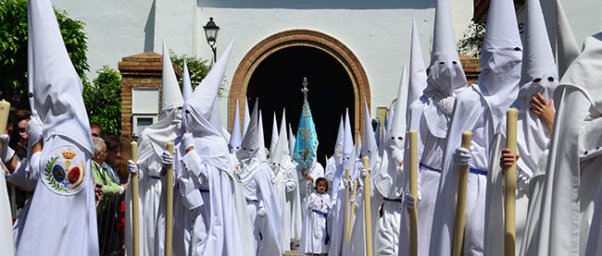


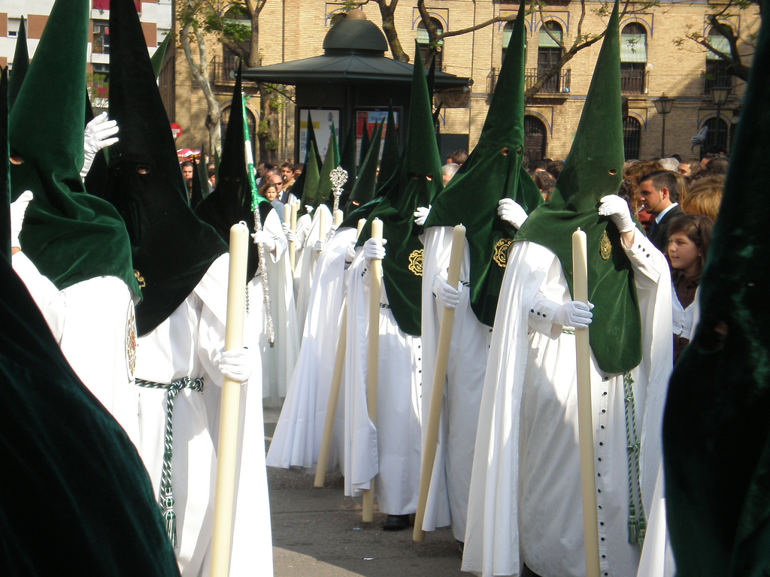
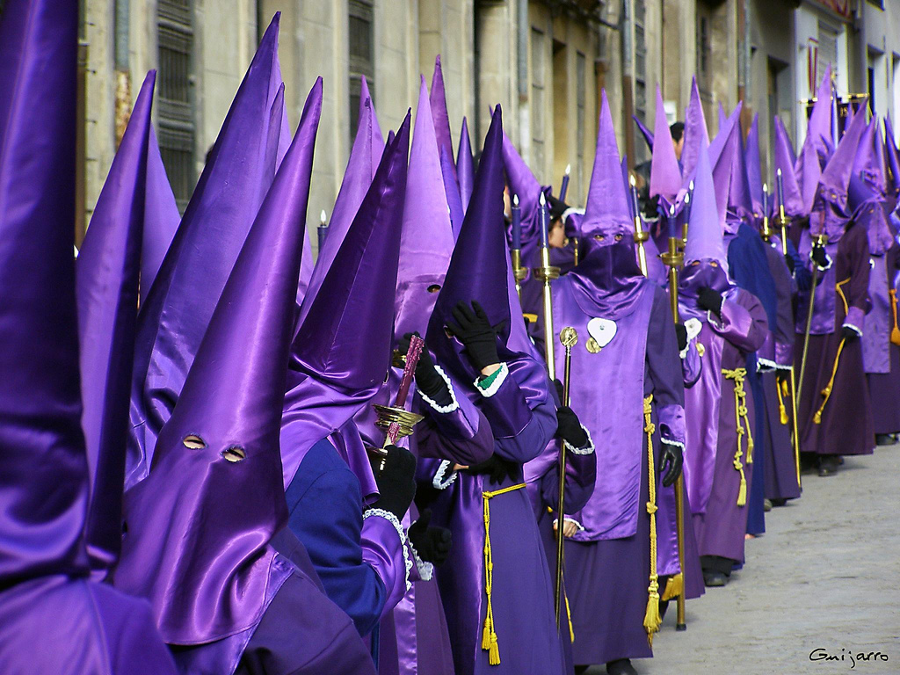
n n s

Slide 10
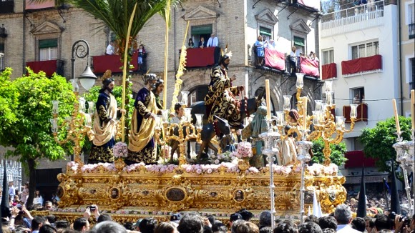
p s s

Slide 11


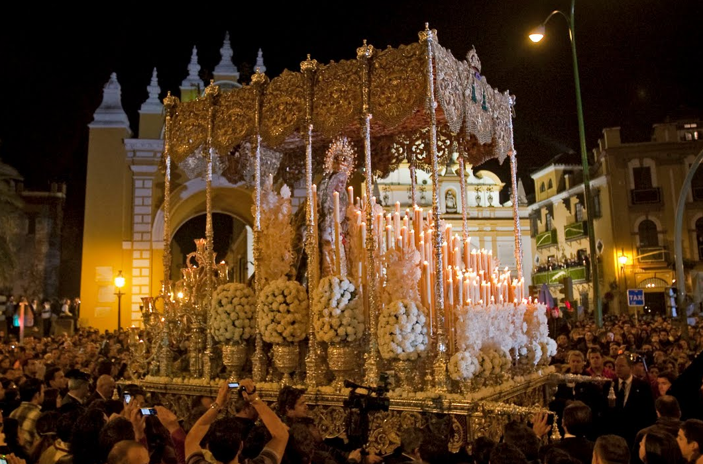
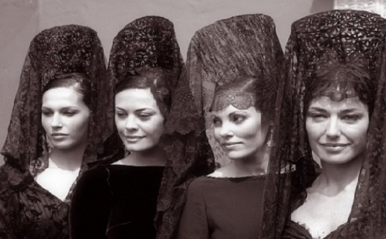
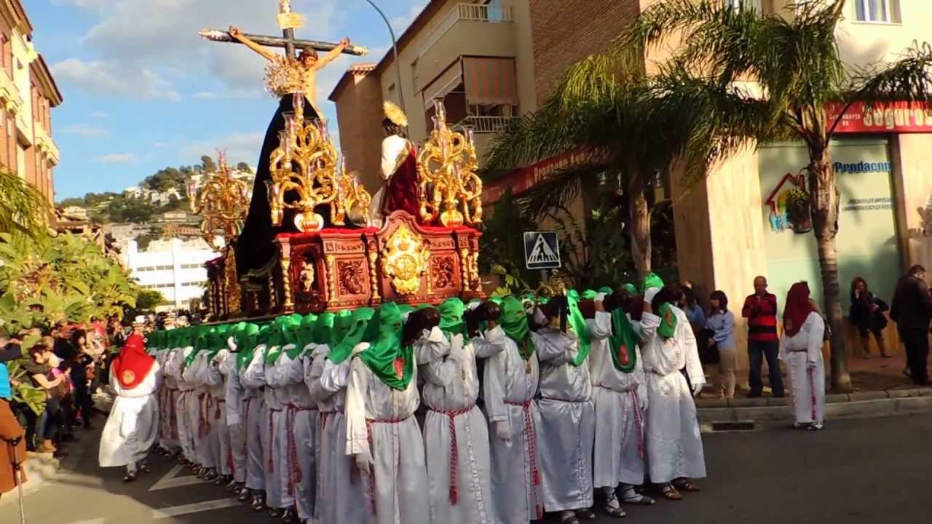
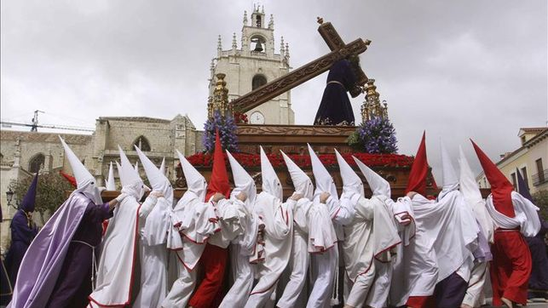
Dictionary tip: nm
p s n

Slide 12
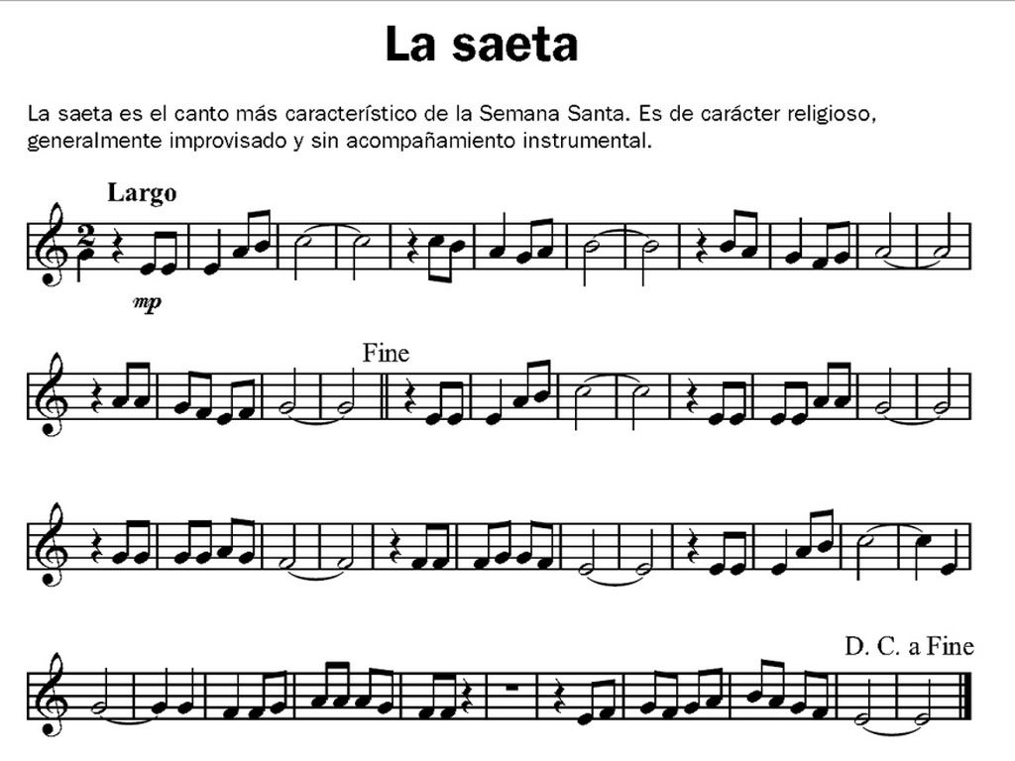
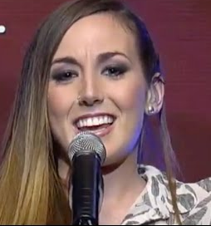
s t
https://www.youtube.com/watch?v=wTanPXQjg0c

Slide 13
You now have a list of 7 nouns linked to Easter in Spain.
Let’s think about a grammar rule in Spanish – all nouns are masculine or feminine.

Slide 14
un conejo un gato un caballo un bolígrafo un pegamento
Masculine
Feminine
Singular nouns (only 1)
una goma
una regla
una tortuga
How can you spot many masculine or feminine nouns in Spanish?

Slide 15
un conejo un gato un caballo un bolígrafo
Masculine
Feminine
Plural – 2 or more
una goma
una regla
una tortuga
os
s
s
s
os
s
s
s
os
s
s
s
os
s
How do masculine and feminine nouns become plural?

Slide 16









Los objetivos: To discover a Spanish Easter tradition.
To evaluate key features of nouns.
Para triunfar:Find out facts about Easter week.
Use phonic knowledge to write 7 Easter nouns correctly.
Identify masculine, feminine and plural endings.
Categorise the nouns according to gender and number.
Make Easter nouns plural.
Categorise the nouns according to masculine/feminine and number.
Look at the end of the noun. (You have a tip to help with the first 2).
Does the noun end in –o, -a or –os or –as?
Masculine, feminine or masculine plural or feminine plural?
Type them in the correct column of the table.
chocolate
Dictionary tip: nm
procesión
Dictionary tip: nf
huevo
pasos
saeta
nazarenos
monas de Pascua
Masculine singular (-o) un = a | Feminine singular (-a) una = a | Masculine Plural (-os) unos = some | Feminine plural (-as) unas = some
chocolate

Slide 17
Los objetivos: To discover a Spanish Easter tradition.
To evaluate key features of nouns.
Para triunfar:Find out facts about Easter week.
Use phonic knowledge to write 7 Easter nouns correctly.
Identify masculine, feminine and plural endings.
Categorise the nouns according to gender and number.
Make Easter nouns plural.
Answers in the table below.
Can you spot masculine, feminine and plural nouns?
What are the clues at the end of the words?
If you don’t know, where can you check?
chocolate
procesión
huevo
pasos
saeta
nazarenos
Masculine -o ending, feminine –a ending,
Plural –s ending.
monas de Pascua
Masculine singular (-o) un = a | Feminine singular (-a) una = a | Masculine Plural (-os) unos = some | Feminine plural (-as) unas = some
chocolate | saeta | pasos
huevo | mona de pascua | nazarenos
 | procesión
In a dictionary. Nm = masculine
nf = feminine

Slide 18
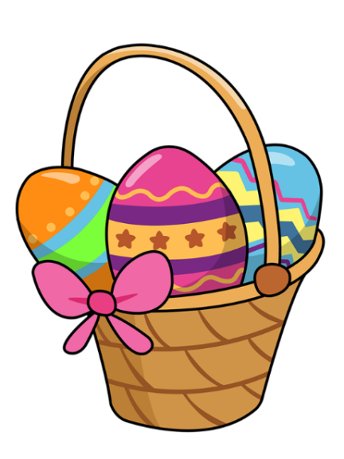
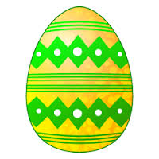
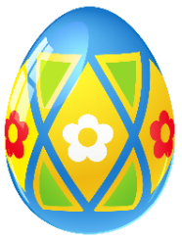
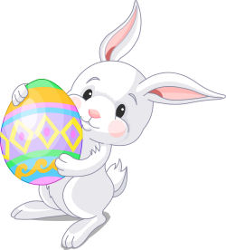
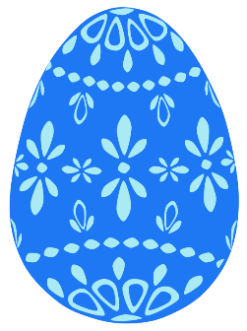
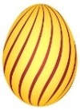
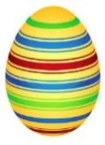
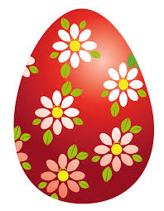
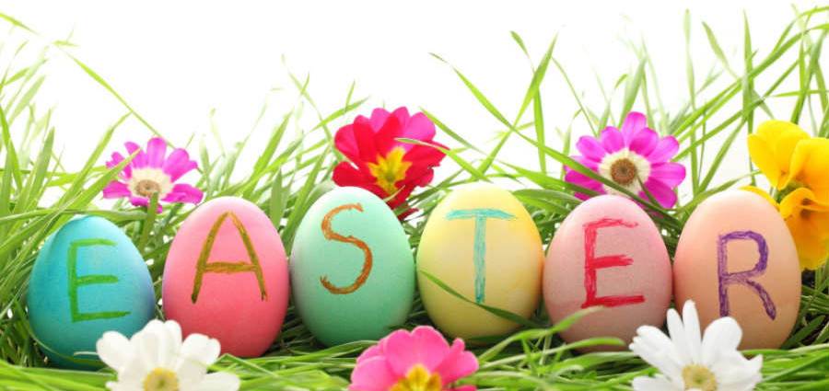
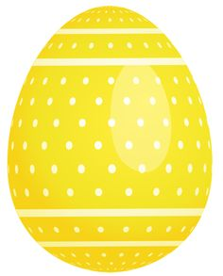
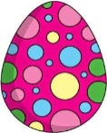
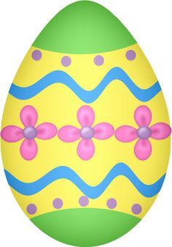
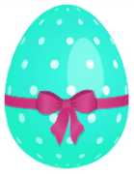
¡F l s P s s!
Happy

Slide 19
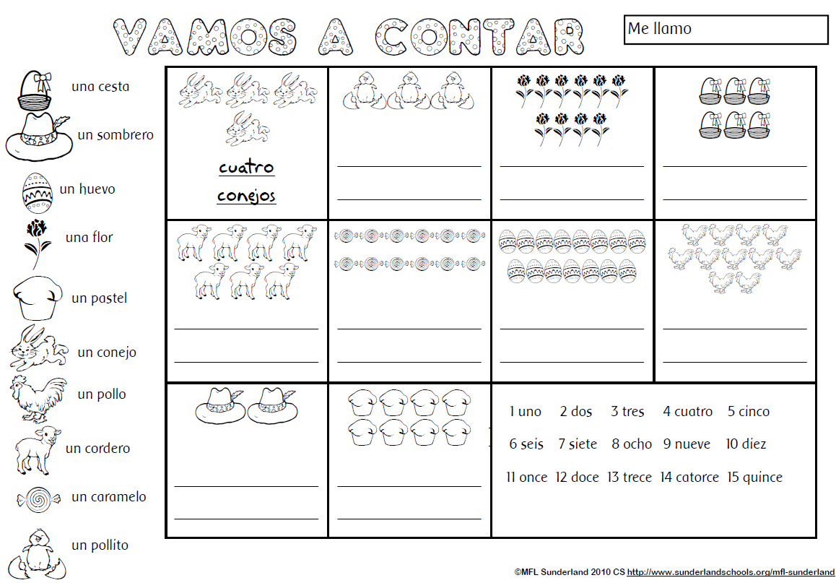
Make Easter nouns plural.
Count and write the correct number.
Find the Spanish noun in the list – make it plural!
You can print and colour this page if you like, as well as completing the challenge task!
Notes:
Tip: replace un/una with the correct Spanish number. Add –s to the noun.

Slide 20
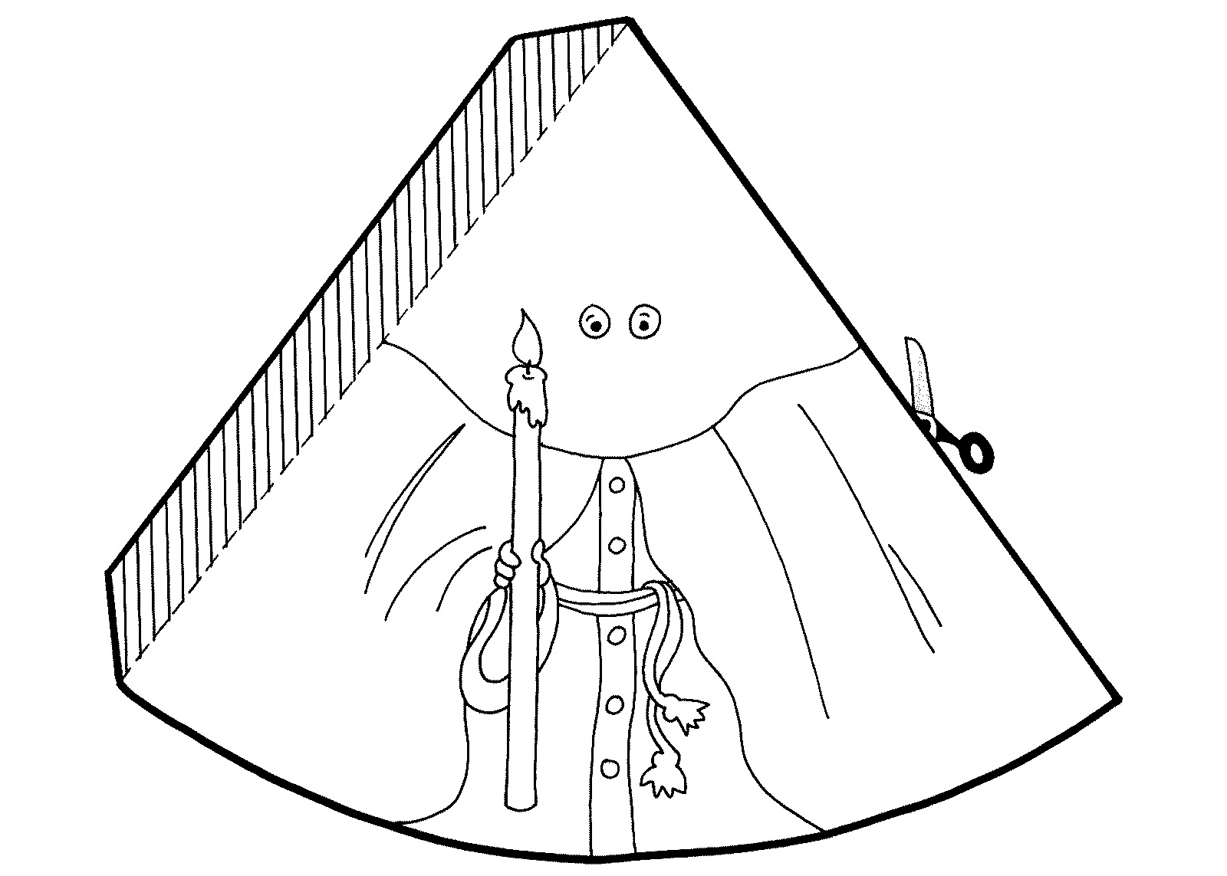
Make a Nazareno, like in the video you watched.
You will need to
print this page.
You choose the
colours –
name them
in Spanish!
When you finish colouring, cut out and curl round the nazareno so you can stick it to the shaded flap. It will stand up.

Slide 21
Make Easter nouns plural.
ANSWERS
tres
pollitos
diez
flores
seis
cestas
siete
corderos
doce
caramelos
quince
huevos
once
pollos
dos
sombreros
ocho
pasteles
Notes:
Tip: replace un/una with the correct Spanish number. Add –s to the noun.

