Slide 1
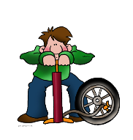
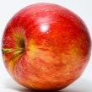

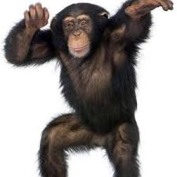
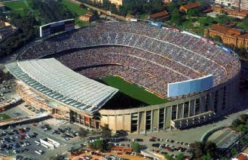
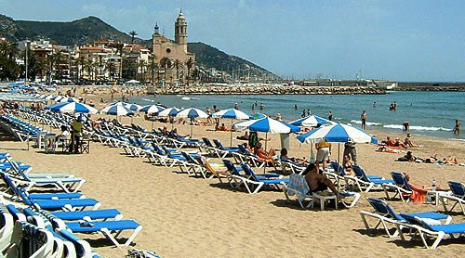
n l d d
= In the city
El objetivo:
To link the spelling, sound and meaning of 6 places in town.
Para triunfar:
Use phonic knowledge to say and write place nouns in Spanish.
Match nouns and pictures.
Find the correct word for the place in town.
Apply the correct indefinite article: un/una.

Slide 2
In this lesson you will need:
  Paper
  A pencil
How many Spanish phonic sounds can you say aloud on the next slide?

Slide 3

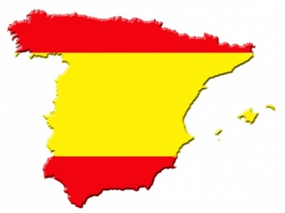


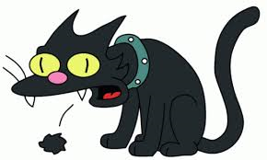

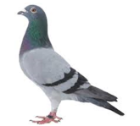

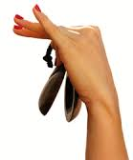
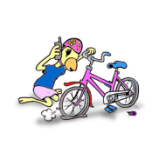
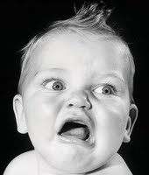
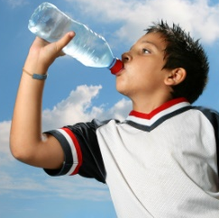





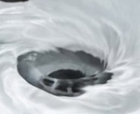

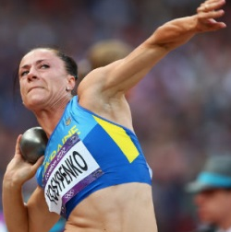

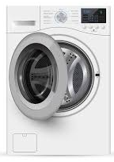

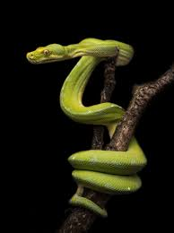
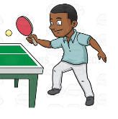
e
y between vowels
a
o
u
Spanish phonics
i
ca
co
cu
qu
z
ce
ci
ga
go
gu
gui
gue
ge
gi
j
h
ll
ñ
r
rr
s
v

Slide 4
How did you do?
Use your phonic knowledge to say the place nouns on the next slide.
The first one is quite long in English and Spanish: Shopping centre.

Slide 5
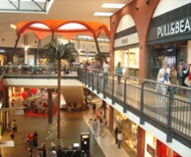






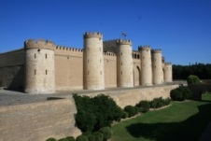




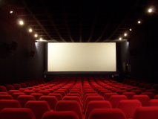





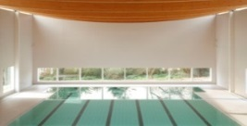
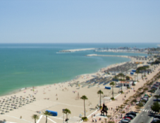


Say the place nouns using your phonic knowledge.
1. nt m l
2. st
3. n
4. st d
5. p s n
6. pl

Slide 6
1. nt m l
2. st
3. n
4. st d
5. p s n
6. pl
Go to this link to listen and repeat the Spanish for places in town: https://basset-green-primary-school.secure-primarysite.net/year-4/

Slide 7
1. nt m l
2. st
3. n
4. st d
5. p s n
6. pl
Use your phonic knowledge to spell each place in town with your pencil and paper.

Slide 8
Answers:
Centro comercial
Castillo
Cine
Estadio
Piscina
Playa Don’t worry if you spelled this as “plaia”, it could have been!

Slide 9
Match the place nouns and pictures.
A
1. estadio
2. playa
B
3. castillo
C
4. cine
D
5. centro comercial
6. piscina
E
F

Slide 10
How do you think you did?
Ready for the answers?

Slide 11
Match the place nouns and pictures.
A
F
1. estadio
C
2. playa
B
3. castillo
E
C
4. cine
B
D
5. centro comercial
A
6. piscina
E
D
F

Slide 12
Which word is correct for each picture?
estadio
playa
castillo
cine
centro comercial
piscina

Slide 13
Recap!
Centro comercial
Castillo
Cine
Estadio
Piscina
Playa
Challenge: Can you identify some nouns which need masculine “un” and those which need feminine “una”?
Tip: Look at the last letter.
(-o, -a)

Slide 14
Answers:
un centro comercial
un castillo
un cine
un estadio
una piscina
una playa
¡Fenomenal!
Well done for completing your Spanish lesson.

