Slide 1
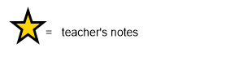
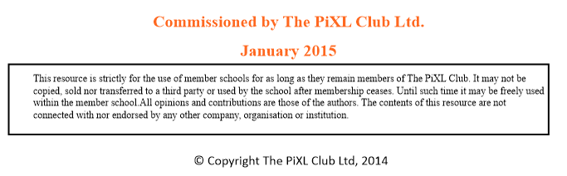
R8 Identify/explain how meaning is enhanced through choice of words and phrases.

Slide 2


R8d. Can identify what impression a word/words give the reader.

Slide 3

Teacher Information
These slides look at the skill of being able to identify what impression a word/words in a text have on the reader. This helps children to understand and identify why writers make certain choices in their work. This also includes some ‘find and copy’ style questions.
A modelled example and guided questions give some tips for thinking about word meaning and choices and their effect on the reader. Practice questions allow children to apply their skills.

Slide 4
What impression…
Sometimes we are asked what impression a word/words within a text have on the reader.
It is important to understand what the word impression means.
Impression = an idea, feeling, opinion
Therefore it is asking you what idea/feeling/opinion a word/words give you about a text. E.g. do they make something sound mysterious, scary, funny, positive, negative? Do they make you empathise with a character or dislike them?

Slide 5
What impression do these words/group of words give you?
…career across the sky chaotically
…effortlessly
His heart torn between terror and rapture…
Discuss with your teacher, teaching assistant or learning partner. You may need to use a dictionary or thesaurus.

Slide 6
How did you do?
Gives the impression that something is moving across the sky swiftly and in an uncontrolled way.
Gives the impression that someone did not have to work at it, they did it easily.
Gives the impression that he cannot decide whether to be scared or delighted.

Slide 7
What skills and strategies are required when answering these types of questions?
Decoding the word/s.
Understanding the context in which they are used.
Understanding their meaning.
Deciding what idea/feeling/opinion the word/s give you about something or someone.

Slide 8
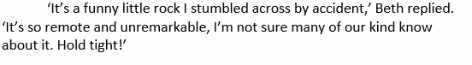
Example question 1
…so remote and unremarkable…
Give two impressions this gives you of the planet.
We know that remote means faraway in this context and we know that unremarkable means ordinary/not special in this context. Therefore the two impressions this gives you of the planet are:
That it is faraway
That it is ordinary/not special

Slide 9
Example question 2…
Find and copy a word/group of words that give us the impression that the planet is ordinary.
We need to scan the text to look for words meaning ordinary.
The word unremarkable means ordinary we would use that in out answer. As it is asking us to find and copy we would make sure we did this accurately.

Slide 10
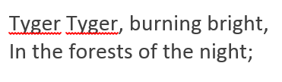
Your turn…
Give one impression this gives you of the tiger (tyger).
Answer on the next slide!

Slide 11
Answer…
Give one impression this gives you of the tiger (tyger).
It says burning bright – this gives the impression that the tiger is like a fire blazing through the forest.

Slide 12
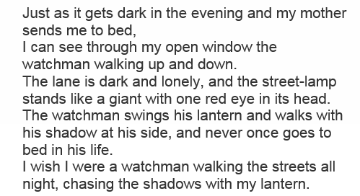
Your turn...
Find and copy a word/group of words that give us the impression that the street-lamp is alive.
Answer on the next slide!

Slide 13
Answer...
Find and copy a word/group of words that give us the impression that the street-lamp is alive.
We need to scan the text to find words that might give us the impression that the street lamp is alive. It says: the street-lamp stands like a giant with one red eye in its head. You need to copy these words accurately when you write your answer. You would also be correct if you copied: stands like a giant or one red eye in its head.

Slide 14
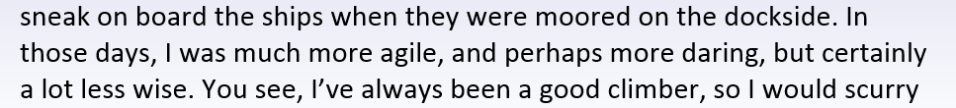
Your turn...
Give two impressions that the underlined give you of the rat when he was younger.
Answer on the next slide!

Slide 15
Answer...
Give two impressions that the underlined give you of the rat when he was younger.
It says that he was: perhaps more daring – this gives us the impression that he was braver/took more risks when he was younger.
It says that he was: a lot less wise this gives us the impression that he didn’t know as much when he was younger
(You could also refer to where it says that he was: much more agile meaning that he could move better/more quickly when he was younger.)

