Slide 1


Reading
Y6 Therapy
R7a. Can identify/explain how the sequence of events in narrative fiction contributes to meaning as a whole
Commissioned by The PiXL Club Ltd.
May 2019
This resource is strictly for the use of member schools for as long as they remain members of The PiXL Club. It may not be copied, sold nor transferred to a third party or used by the school after membership ceases. Until such time it may be freely used within the member school.
All opinions and contributions are those of the authors. The contents of this resource are not connected with nor endorsed by any other company, organisation or institution.
PiXL Club Ltd endeavour to trace and contact copyright owners. If there are any inadvertent omissions or errors in the acknowledgements or usage, this is unintended and PiXL will remedy these on written notification
© Copyright The PiXL Club Limited, 2019

Slide 2

Vocabulary Task
Read it:
contribute
Define it
Use it
Link it
synonym:
antonym:
Deconstruct it
focus element: con
meaning:

Slide 3

Order matters
sequence
consequence
Discuss
What do these words mean?
What links can you make between both their meaning and the way they are spelt?

Slide 4
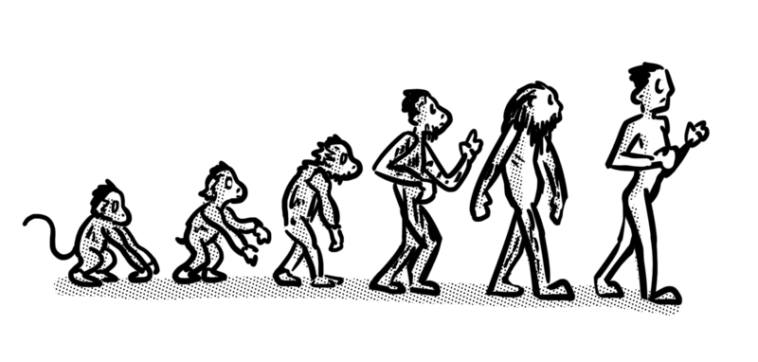
Order matters
Sequence means the order in which things happen. Consequence is the result of something happening. In fact, the prefix con- means together, with. So consequence literally means with order.
Understanding the order of a narrative is important because a good story should have a structure (sequence) and the actions of the characters should follow that order (consequence). So, understanding the order of events should help you to understand other aspects of the story.

Slide 5
Spot the order
Let’s think about some well-known stories.
See if you can identify either the event or the consequence. Click to check.
The third little pig builds a house of brick that the wolf can’t blow down.
The wolf climbs up on the roof to go down the chimney.
Charlie finds the last golden ticket.
Charlie is able to visit the chocolate factory.
Event
Young Harry Potter keeps making strange things happen.
Consequence
Harry discovers that he is a wizard and goes to a school for magic.

Slide 6
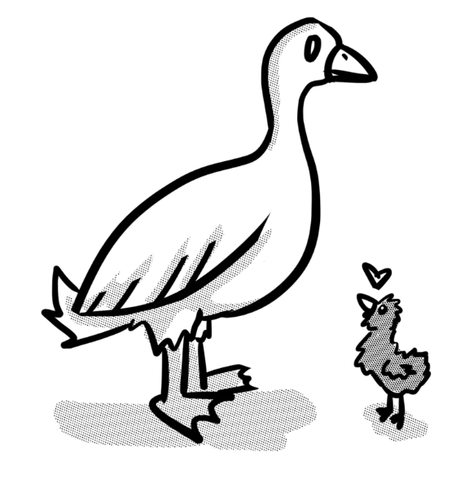
Spot the order
It is important to be able understand the order of a whole story in able to make sense of what is happening or the actions of some of the characters.
Write the numbers 1 – 4 in the boxes to show the order in which the events happen in this familiar story. Click to check.
The duckling gets teased for being ugly.
The duckling hides in the reeds.
The duckling hatches.
The duckling turns into a swan.
2
3
1
4

Slide 7
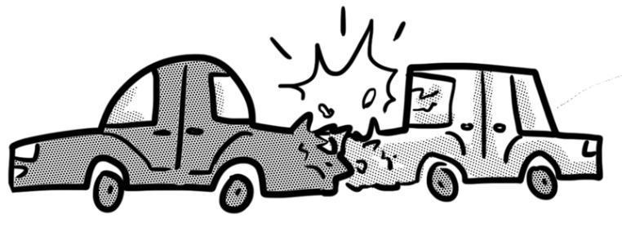
Spot the order
It’s easy when you know the story. But what if you don’t? Using what you know about stories and life in general, see if you can sequence these events.
Write the numbers 1 – 4 in the boxes to show the order in which the events happen. Click to check.
The car crashed into another parked car.
A car was driving too fast down a road.
A cat ran across the road.
The car swerved to avoid the cat.
4
1
2
3

Slide 8
Spot the reason
Very often, the author gives us clues to help us predict what might happen or understand why an event occurred.
Thinking about the example from the previous slide, which words gave us a clue that an accident might happen?
The car crashed into another parked car.
A car was driving too fast down a road.
A cat ran across the road.
The car swerved to avoid the cat.
4
1
too fast
2
3

Slide 9
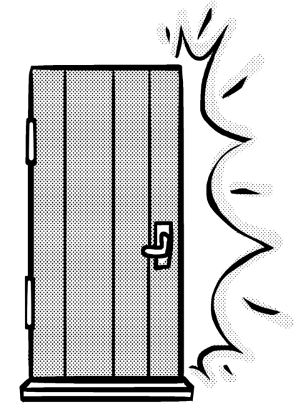
Spot the reason
Let’s try it with a text extract. What might have happened to cause this reaction from Jed? Explain your reasoning.
Jed’s chair scraped across the floor as he jumped to his feet, ready to pounce but Mum had already stepped between him and Ashley, signalling with a slight shake of her head for him to leave. Jed darted out of the room, slamming the back door behind him. He sprinted down the short garden path, through the gate and out on to the hillside.
Your answer should suggest that Ashley had said or done something to make Jed angry. How did you do?

Slide 10
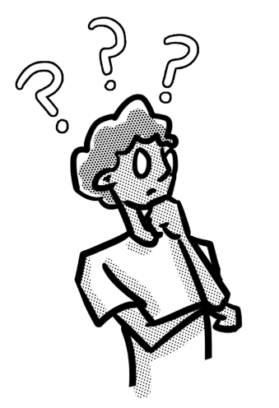
Changes in characters
Changes in the way characters behave, speak, move or act can tell us a lot about the story. For example, if a character starts moving more slowly and forgetting things, this could be because the character is getting older. Or, if a character starts snapping at someone and doesn’t listen to what they are saying, then this could demonstrate that they are becoming angry or frustrated with them.
Discussion: what could these changes in a character suggest is happening in the story?
Begins to lack energy; can’t concentrate; decreased appetite.
Becomes secretive; avoids friends; cross if asked where he’s been.

Slide 11
Finding the evidence
Read this story extract. Then go to the following slide.
As the year grew old, Alice noticed William furtively sneaking out to the grounds alone, making sure nobody followed him. Then, one chilly November morning, he appeared in a thick coat and told his family that he was ready for the challenge. Intrigued that his weedy, bookworm of a brother thought he could out-throw him, Max joined Alice and Father by the lake while Isobel sulked in her room.
Rather like a stage magician, William let his family check that it was a ‘just an ordinary stone’, then proceeded to perform a mysterious sequence of crouching and stretching movements. Finally, he sprang forward and flung out his arm. The stone rocketed out of his hand and sailed right over the lake, thudding into the ground a good few metres beyond the far bank.

Slide 12
Finding the evidence
What is the evidence that William is behaving strangely? Discuss with your partner or group, then click to check.
Why doesn’t he want anyone to follow him?
Furtively means slyly and secretly.
As the year grew old, Alice noticed William furtively sneaking out to the grounds alone, making sure nobody followed him. Then, one chilly November morning, he appeared in a thick coat and told his family that he was ready for the challenge. Intrigued that his weedy, bookworm of a brother thought he could out-throw him, Max joined Alice and Father by the lake while Isobel sulked in her room.
As the year grew old, Alice noticed William furtively sneaking out to the grounds alone, making sure nobody followed him. Then, one chilly November morning, he appeared in a thick coat and told his family that he was ready for the challenge. Intrigued that his weedy, bookworm of a brother thought he could out-throw him, Max joined Alice and Father by the lake while Isobel sulked in her room.
Intrigued suggests that Max finds William’s behaviour odd.
Slide 1 of 2

Slide 13
Finding the evidence
What is the evidence that William is behaving strangely? Discuss with your partner or group, then click to check.
Magicians can be fun but they are deceptive.
Mysterious actions are clearly strange.
Rather like a stage magician, William let his family check that it was a ‘just an ordinary stone’, then proceeded to perform a mysterious sequence of crouching and stretching movements. Finally, he sprang forward and flung out his arm. The stone rocketed out of his hand and sailed right over the lake, thudding into the ground a good few metres beyond the far bank.
Rather like a stage magician, William let his family check that it was a ‘just an ordinary stone’, then proceeded to perform a mysterious sequence of crouching and stretching movements. Finally, he sprang forward and flung out his arm. The stone rocketed out of his hand and sailed right over the lake, thudding into the ground a good few metres beyond the far bank.
Slide 2 of 2

Slide 14

What does this mean?
Now that we know William is acting strangely, what do you think the next stage of the story will be? Pick one of the following possibilities.
William wins the competition, fair and square.
William is found to have cheated.
William wins but gives his prize to Max.
William shows everyone how he did it.

Slide 15
What does this mean?
Let’s find out. Here is the next part of the story.
‘Oh well done William!’ said Father. Max walked over to his brother, offering his congratulations like a true sportsman. As William gleefully shook his hand, Max suddenly snatched his back sharply. There was a snap and a twang, followed by a triumphant ‘Aha!’ from Max, who was now holding aloft a length of strong elastic which had been concealed in the sleeve of William’s coat.
‘I said no catapults, sling shots, or any other devices,’ growled Father. ‘Your throw is disqualified.’ That left Alice. Just Alice.
William is found to have cheated.

Slide 16
Spotting the change
Sometimes we are required to show that we understand the sequence of events by identifying when there is a change in mood for the characters.
Re-read the extract on the previous page and answer this question: How does Father’s opinion of William change?

Slide 17
Spotting the change
At the beginning, Father is pleased or impressed.
‘Oh well done William!’ said Father. Max walked over to his brother, offering his congratulations like a true sportsman. As William gleefully shook his hand, Max suddenly snatched his back sharply. There was a snap and a twang, followed by a triumphant ‘Aha!’ from Max, who was now holding aloft a length of strong elastic which had been concealed in the sleeve of William’s coat.
‘I said no catapults, sling shots, or any other devices,’ growled Father. ‘Your throw is disqualified.’ That left Alice. Just Alice.
By the end, Father is cross and disappointed.

Slide 18

Spotting the change
Your turn – read this story extract and answer the questions on the following slide.
Alan and Beth are mischievous aliens who have just played a trick on an unsuspecting Earthling.
An unimaginable distance away, Alan and Beth were fizzing about the craft in hysterics.
‘That was totally wicked!’ cried Alan.
‘I know! And they fall for it every time,’ said Beth.
Still howling with laughter, they star-jumped all the way back to their home system. Overriding the parking tractor beam, they sneaked around the dark side of their planet and touched down in the deepest part of their parents’ crater.
Just as they were trying to creep into their sleeping pods, a booming thought crashed into their minds. ‘Where in the cosmos have you two been? I’ve been worried sick! Just you wait till your father gets home!’

Slide 19
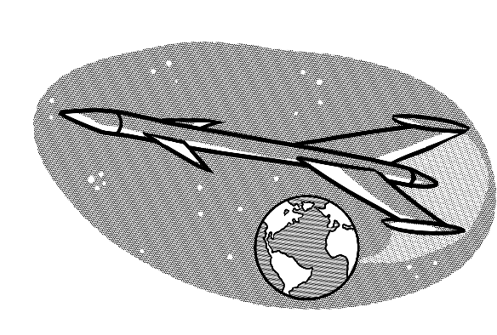
Spotting the change
Answer these questions. Click to check.
How are Alan and Beth feeling at the beginning of the extract?
Very happy – in hysterics
How do you think they are feeling right at the end?
Worried that they’re in trouble
Find and copy the words that show where the mood changes.
‘a booming thought crashed into their minds’

Slide 20

Reflection
Think about today’s lesson and talk to your partner about what you feel confident about and what you feel you need to practise more.
I am confident with …
I would like more practice with …

