Slide 1


Y6 Therapy
Reading
R6b. Can explain their prediction choices fully, using evidence from the text.
Commissioned by The PiXL Club Ltd.
May 2019
This resource is strictly for the use of member schools for as long as they remain members of The PiXL Club. It may not be copied, sold nor transferred to a third party or used by the school after membership ceases. Until such time it may be freely used within the member school.
All opinions and contributions are those of the authors. The contents of this resource are not connected with nor endorsed by any other company, organisation or institution.
PiXL Club Ltd endeavour to trace and contact copyright owners. If there are any inadvertent omissions or errors in the acknowledgements or usage, this is unintended and PiXL will remedy these on written notification.
© Copyright The PiXL Club Limited, 2019

Slide 2
Teacher Notes
Pupils will need access to dictionaries for this therapy.
Pupils could benefit from having some highlighters.
The longer text on slide 6 could be printed for pupils as appropriate.
Pupils will need a copy of ‘Astronuts’ from slide 13 & 14 or download from here

Slide 3
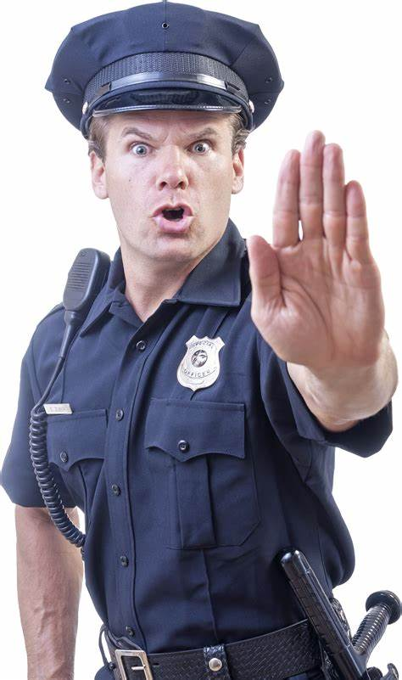
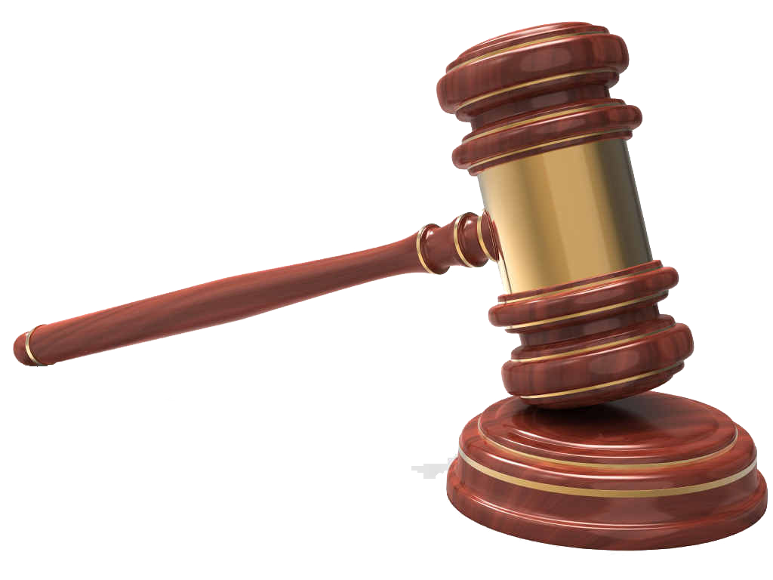

Vocabulary: Evidence
The word is: | Meaning: _________________ _________________ _________________ _________________ _________________
Image/graphic: | In context: _________________ _________________ _________________ _________________ _________________
evidence
Answer these questions on your whiteboards.

Slide 4
We need to use evidence to back up our prediction.
To do this you need to consider everything you have read in the text. This is where you will find your evidence.
A prediction is when you make an informed guess about what might happen with a given character or situation…
Predictions need to be rooted in what it says in the text e.g. based on how a character has acted before or what they have said.

Slide 5
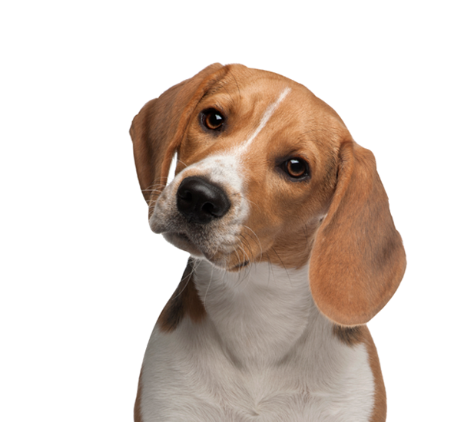
Predict what happens next…
Attempting to relieve his stress, Sam decided to take Rover for a peaceful walk through the woods, showing trust in his friend by removing the lead. The pair soon came to a clearing which included a murky swamp, with stagnant water and grotesque, thick mud surrounding the banks. Knowing the canine had spotted what was ahead, what happened next was inevitable…
Sometimes what is going to happen next can be very easy to predict. What parts of this text help you to make your prediction?
Are there any words you do not understand? Let’s grab a dictionary and look them up!

Slide 6
Predict what happens next…
Attempting to relieve his stress, Sam decided to take Rover for a peaceful walk through the woods, showing trust in his friend by removing the lead. The pair soon came to a clearing which included a murky swamp, with stagnant water and grotesque, thick mud surrounding the banks. Knowing the canine had spotted what was ahead, what happened next was inevitable…
Did you choose those parts of the text? How did they help you make a prediction?

Slide 7
What would a good answer look like?
Attempting to relieve his stress, Sam decided to take Rover for a peaceful walk through the woods, showing trust in his friend by removing the lead. The pair soon came to a clearing which included a murky swamp, with stagnant water and grotesque, thick mud surrounding the banks. Knowing the canine had spotted what was ahead, what happened next was inevitable…
Answer: I predict that Rover is going to jump into the murky swamp and get covered in mud. I think this because the text tells me that Sam removed his lead so I know that Rover is running freely. The text also gives you a very detailed description of the swamp and uses the word ‘inevitable’ which means something that is certain to happen.

Slide 8
The Hobbit by J.R.R. Tolkein
After a while, Balin bade Bilbo “Good luck!” and stopped where he could still see the faint outline of the door, and by a trick of the echoes of the tunnel hear the rustle of the whispering voices of the others just outside. Then the hobbit slipped on his ring and warned by the echoes to take more than hobbit’s care to make no sound, he crept noiselessly down, down, down into the dark. He was trembling with fear, but his little face was set and grim. Already he was a very different hobbit from the one that had run out without a pocket-handkerchief from Bag-End long ago. He had not had a pocket-handkerchief for ages. He loosened his dagger in its sheath, tightened his belt, and went on.
Before we can predict, we need to have a good understanding of the key points in the whole text. We gather those points (evidence) to make an informed prediction.

Slide 9
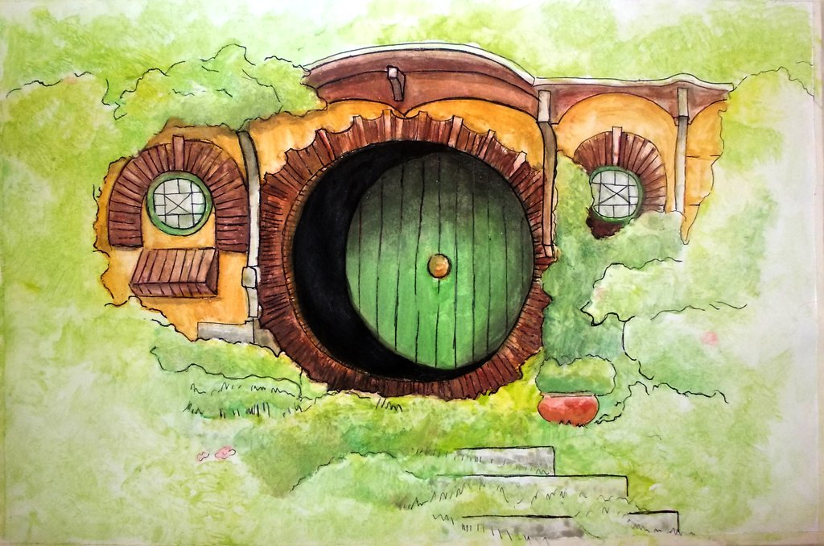
Finding the key points
After a while, Balin bade Bilbo “Good luck!” and stopped where he could still see the faint outline of the door, and by a trick of the echoes of the tunnel hear the rustle of the whispering voices of the others just outside. Then the hobbit slipped on his ring, and warned by the echoes to take more than hobbit’s care to make no sound, he crept noiselessly down, down, down into the dark. He was trembling with fear, but his little face was set and grim. Already he was a very different hobbit from the one that had run out without a pocket-handkerchief from Bag-End long ago. He had not had a pocket-handkerchief for ages. He loosened his dagger in its sheath, tightened his belt, and went on.
What are the key points from this part of the story?
What parts play an important role in helping you decide what might happen next?
Work with a partner highlight some key points in the text.

Slide 10
How do these key points help us to predict?
Look at these key points with a partner and come up with reasons as to why they are important.
What do they tell us and how does that help us to be able to make a prediction?
“Good luck!”
Trick of the echoes
Rustle of whispering voices
An example:
Wishing someone good luck suggests they are going to need it, in this situation it implies that the hobbit is going to be doing something or going somewhere dangerous.
Warned by the echoes
Make no sound

Slide 11
How do these key points help us to predict?
Crept noiselessly
Look at these key points with a partner and come up with reasons as to why they are important.
What do they tell us and how does that help us to be able to make a prediction?
Trembling with fear
A very different Hobbit
Loosened his dagger
And went on

Slide 12
How do these key points help us to predict?
Make no sound
Trick of the echoes
Trembling with fear
Crept noiselessly
Warned by the echoes
His body is having a physical reaction to what he is feeling, seeing and hearing.
Rustle of whispering voices
Places that echo have to be large and empty. The fact that the words ‘trick’ and ‘warned’ are used suggest that there maybe something to fear.
These parts suggest that it is a place where you need to be quiet or you could be in danger. He seems to be concerned about making too much noise and getting noticed.
A very different Hobbit
And went on
The text implies he has changed from the mischievous Hobbit he once was. The fact he ‘went on’ despite his fears suggests bravery. He goes on despite all of the noises, sights and feelings he is having about the environment.
Loosened his dagger
He is preparing to defend himself against whatever it is that is in the tunnel.

Slide 13

Conscience Alley
What should the Hobbit do next and why?
One of you needs to become the Hobbit, the rest of you need to split into two groups. One group will be for the Hobbit carrying on with his journey, and one group will be against it.
As the Hobbit walks down conscience alley, you will need to give him your opinion, based on what you have read, as to what he should do. He will also need to hear your reasons for this.
The hobbit will then decide which was the most persuasive opinion and reason. Reasons must be based on evidence in the text.

Slide 14

Reasons to go:
Evidence from the text suggests there is something down there.
Bilbo is obviously going in after something and as a reader we are curious as to what that is.
He wouldn’t be risking going in there if it wasn’t important to him.
‘he loosened his dagger. Tightened his belt and went on’ suggests he is ready and brave enough to take on the challenge.
Reasons to turn back:
He’s ‘trembling’ so he is quite clearly afraid of what he is going to face.
Other thoughts:
As a reader, there wouldn’t be much of a story if he didn’t carry on with the journey.
There is more evidence, based on the text, for Bilbo to carry on with his journey.
Your prediction should always be based on evidence from the text.

Slide 15
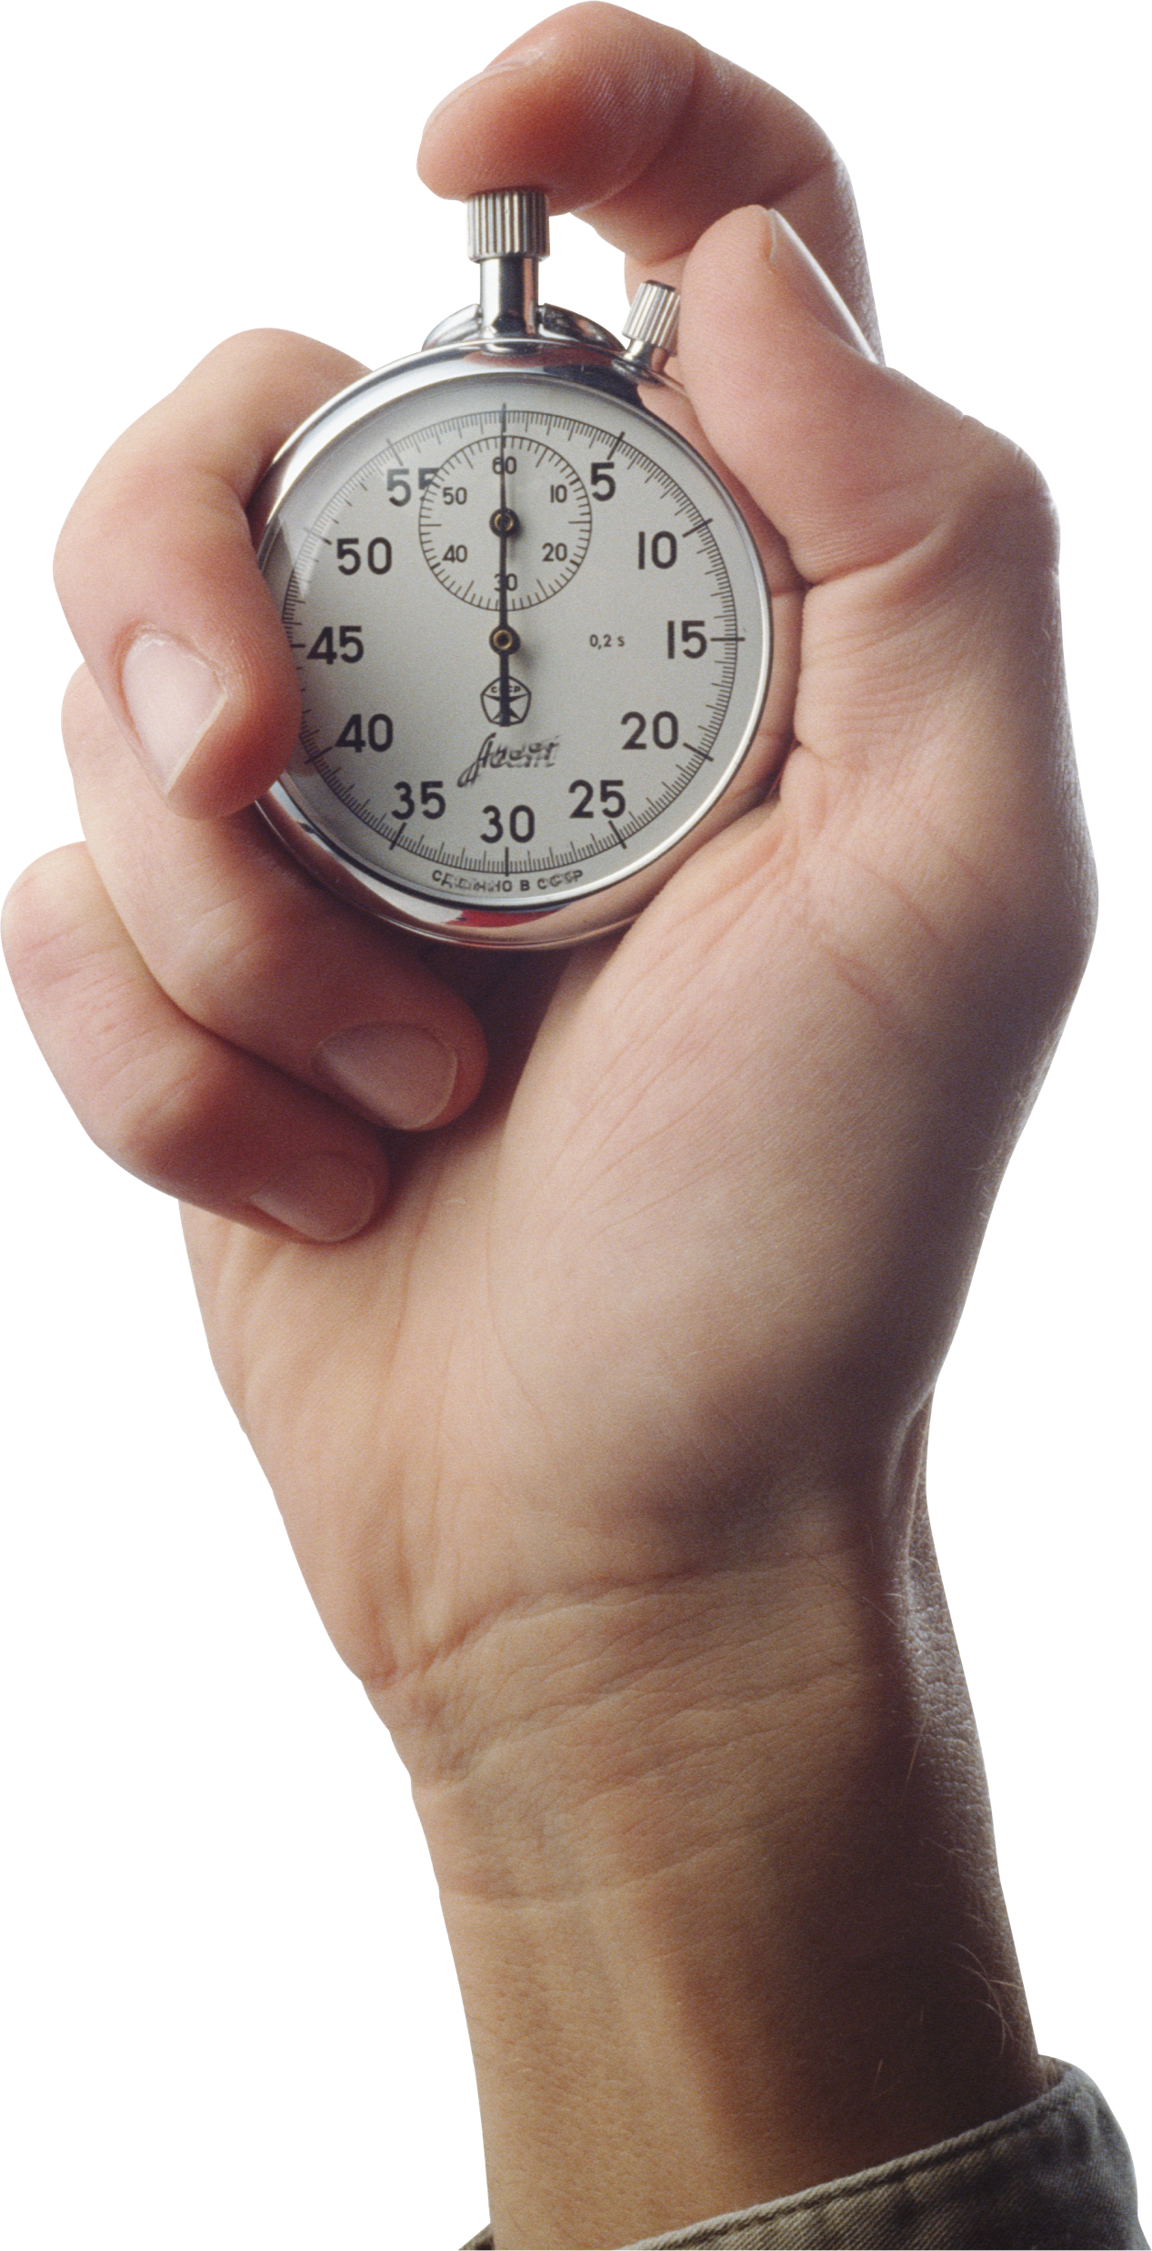
Your prediction: Talk partners
Using the evidence gathered from the text and what we feel as a reader of the story, let’s talk about what our prediction might sound like.
You have five minutes with your talk partner to discuss your prediction and then we will share as a group. Make sure you are always using evidence that is rooted in the text!

Slide 16
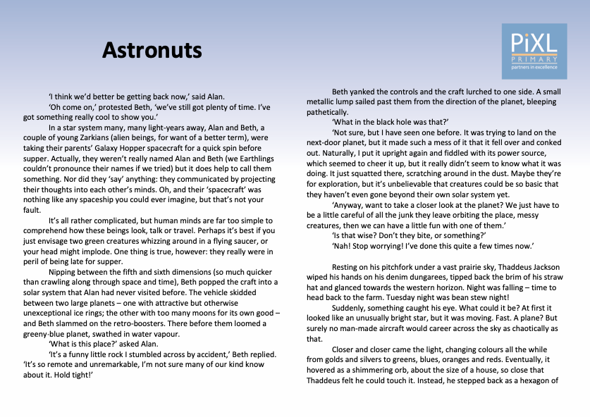
Read this text and answer the question using evidence to support your prediction.

Slide 17
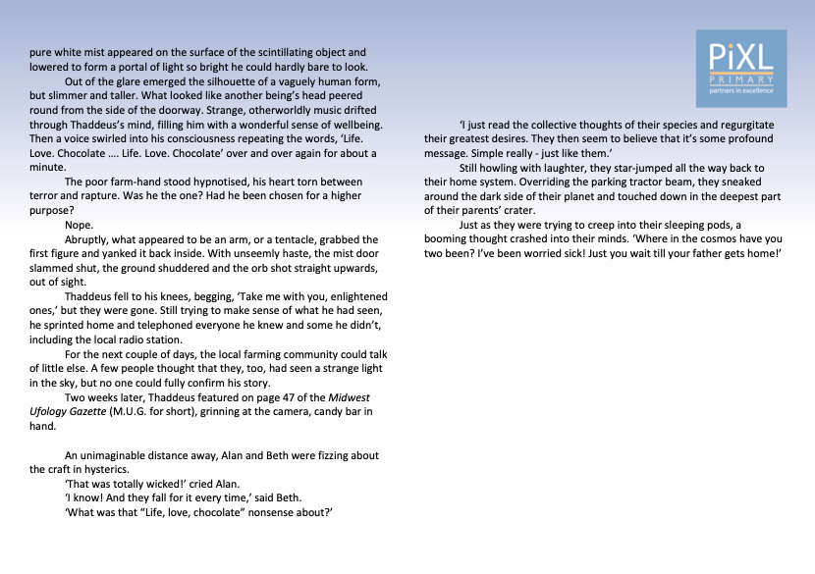
Q: Predict what their parents reaction would be if they found out exactly what they had been up to. Use evidence from the text to support your answer.

Slide 18
Time to share your predictions
I predict that their parents’ reaction would have been…
shock
horror
anger
fear
Did you come up with any other reactions?
I predict this because…
they have taken the space-craft out on their own. It says: Alan and Beth…were taking their parents’ Galaxy Hopper spacecraft for a quick spin before supper.
they have flown into an unknown solar system. It says: Beth popped the craft into a solar system that Alan had never visited before.
they have been seen by the creatures on that planet. It says: The poor farm-hand stood hypnotised, his heart torn between terror and rapture.
they have visited an unknown planet. ‘Anyway, want to take a closer look at the planet?...’

Slide 19

Reflection
When you are looking for evidence, remember to:
Find all the key words in the text.
Highlight them.
Use them to justify your prediction.

