Slide 1


Y6 Therapy
Reading
R6a. Can make developed predictions that are securely rooted in the text
Commissioned by The PiXL Club Ltd.
May 2019
This resource is strictly for the use of member schools for as long as they remain members of The PiXL Club. It may not be copied, sold nor transferred to a third party or used by the school after membership ceases. Until such time it may be freely used within the member school.
All opinions and contributions are those of the authors. The contents of this resource are not connected with nor endorsed by any other company, organisation or institution.
PiXL Club Ltd endeavour to trace and contact copyright owners. If there are any inadvertent omissions or errors in the acknowledgements or usage, this is unintended and PiXL will remedy these on written notification.
© Copyright The PiXL Club Limited, 2019

Slide 2
Teacher Notes
Pupils need to:
Carefully consider the events or information given in the text already.
Think about personal experience, or examples of similar texts.
Formulate sensible predictions that fit with the evidence they have gathered.
The longer text on slide 11 could be printed for pupils as appropriate.

Slide 3
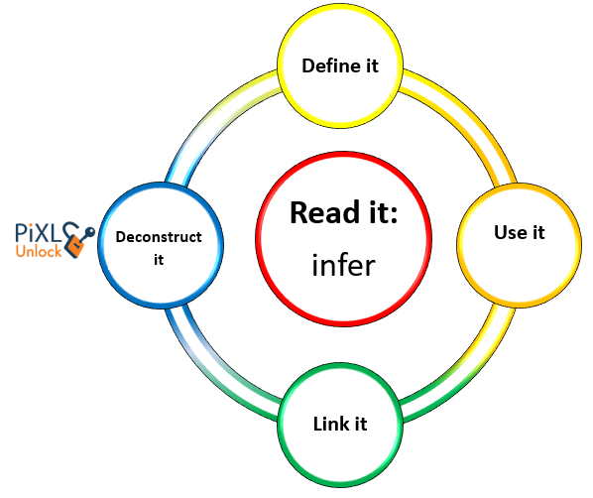

Vocabulary
guess
clues
evidence
statement
Use the words in the box opposite to define ‘prediction’.
prediction

Slide 4
Prediction
What is a prediction?
How do we make one?
Prediction
Try to complete this table.
What can we use to help us?
Where do we find the information?

Slide 5
What is a prediction?
A prediction is a guess you make using clues you are given in the text or from the pictures.
How do you make a prediction?
You make a prediction by using what you have read or seen to guess what a character might do next or what might happen next in a story. You need to consider the events and information you have been given and you can also use your personal experience to help you too!

Slide 6
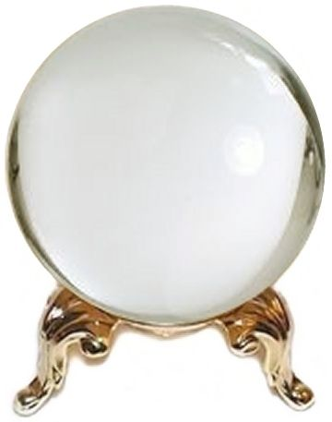
Crystal Ball
Amber’s face flushed a bright red and she clenched both her fists tightly. Stomping along the corridor, she had eyes only for the groups of girls who had been making her life a misery. As she reached the gang of girls, she raised an arm above her head and…
Try to predict what Amber will do next.

Slide 7
Crystal Ball
Amber’s face flushed a bright red and she clenched both her fists tightly. Stomping along the corridor, she had eyes only for the groups of girls who had been making her life a misery. As she reached the gang of girls, she raised an arm above her head and…
In order to make a prediction, we must retrieve the evidence from the text. Use these questions to support this:
What can we guess about how Amber is feeling? - upset, angry
How is she acting? - raising arm above head
What actions is she using? – clenching fists, stomping, face flushed
How does that language help us? – clenched, stomping, misery (emotive)

Slide 8
Crystal Ball
I predict that Amber may hit something or someone. She is angry, her life is a misery and her emotions are not under control.

Slide 9
Crystal Ball
Gliding down the white powdery hills, Daniel felt on top of the world. His first time skiing and he had taken to it like a natural. Or so he thought. Just as he began to think about taking a trickier route, he felt a jolt. ‘Uh oh,’ he thought to himself, as all of a sudden…
Draw a crystal ball on your whiteboard and write down your prediction of what might happen to Daniel next.

Slide 10

Predict and confirm
Using evidence from the text, it is now time to confirm why you made your predictions.
Can you write down any particular parts or key words that can confirm why you made that prediction?
Draw a spy glass on your whiteboards and fill it in.
Questions to think about:
Where is he?
What is he doing?
How is he acting?
What actions is he using?
How does the language used help us?

Slide 11
A sensible prediction?
Read this passage of text.
As the intrepid explorers embarked on what could be their most lucrative – yet most dangerous – expedition, their loved ones waved goodbye from the docks. The sun that had been throwing out a warm glow earlier began to fade. Sailors carried out routine duties rhythmically with the swaying of the ship. Even though night time was a couple of hours away, the sky had transformed into a palette of midnight blues and inky blacks. The thick white sails were beginning to flap wildly and the crew were having to frantically tighten the ropes. At the head of the ship, the captain peered intently into his telescope, wearing a troubled expression. Menacing black clouds sprawled across the sky causing the captain’s face to darken even more so.

Slide 12
A sensible prediction?
Are these sensible predictions? Give reasons and evidence to support your answer.
Is this a sensible prediction?
How does the language help us decide?
How do we know there is a storm?
Is there anything that tells us that the weather will get brighter?
I predict that the storm is about to pass and the weather is going to get brighter.

Slide 13
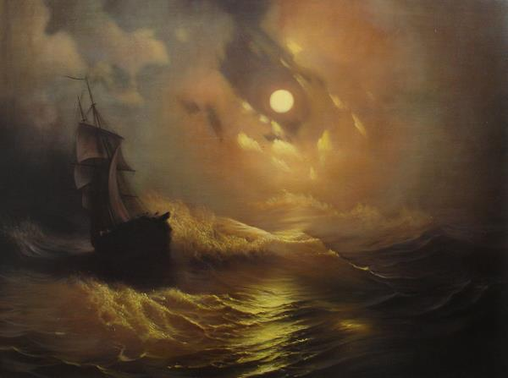
Now do the same with these predictions. Talk to your partner and remember to use evidence from the text to support your answer.
Practise
I think that there is going to be something terrible ahead of the ship. I think they are heading for danger.
The characters seem to be reacting quite calmly so I think they aren’t too worried and they will get where they are going safely.

Slide 14

When predicting it is a good idea to think about what you know or have experienced already.
You have read a range of books during your time at school and all those stories will help you to be able to decide and predict things about new stories!
I predict this book will be about an old mystery pathway that leads to a magical kingdom. I think that because it uses the word ‘forgotten’ which means the path can’t have been used for a long time.
It reminds me of Alice in Wonderland as she discovers a rabbit hole to a weird and magical land.
I predict this book will be about an old mystery pathway that leads to a magical kingdom. I think that because it uses the word ‘forgotten’ which means the path can’t have been used for a long time.
It reminds me of Alice in Wonderland as she discovers a rabbit hole to a weird and magical land.
The forgotten
path

Slide 15
Practise
You should be able to make predictions using your knowledge of previous books that you have read.
Write down what type of book you think it is and give a reason for your answer.
Use the example we just saw to help you.
Can you keep a secret?
Deeper Underground

Slide 16
Practise
You should be able to make predictions using your knowledge of previous books that you have read.
Write down what type of book you think it is and give a reason for your answer.
Use the example we just saw to help you.
The Wizard in the Wardrobe
Help Me!

Slide 17

Reflection
When you are answering prediction questions, remember to:
search for clues in the text
find the evidence
use the evidence to justify your thoughts.

