Slide 1


Reading
Y6 Therapy
R3f. Can decide whether statements about a text are true or false, using direct reference to the text
Commissioned by The PiXL Club Ltd.
May 2019
This resource is strictly for the use of member schools for as long as they remain members of The PiXL Club. It may not be copied, sold nor transferred to a third party or used by the school after membership ceases. Until such time it may be freely used within the member school.
All opinions and contributions are those of the authors. The contents of this resource are not connected with nor endorsed by any other company, organisation or institution.
PiXL Club Ltd endeavour to trace and contact copyright owners. If there are any inadvertent omissions or errors in the acknowledgements or usage, this is unintended and PiXL will remedy these on written notification
© Copyright The PiXL Club Limited, 2019

Slide 2

Vocabulary Task
Read it:
statement
Define it
Use it
Link it
synonym:
Deconstruct it
focus element: ment
meaning:

Slide 3


Why ‘true or false’ questions?
True or False questions often appear in tests. They check if you have paid close attention to what you’ve been reading!
The wording can trick you, so you must be careful!
The aim is to not read too quickly and scan carefully.

Slide 4

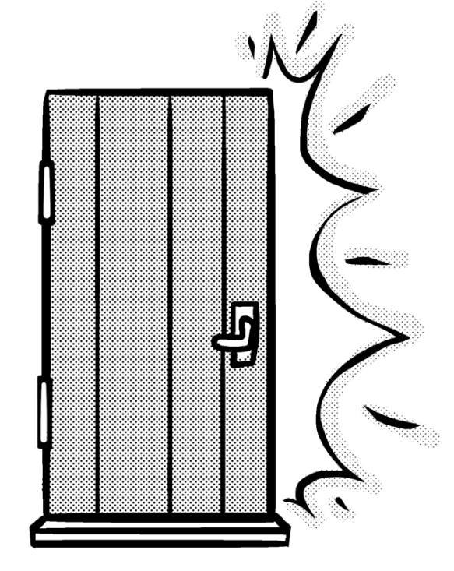
The importance of evidence
Some things you just know to be true. Sometimes, however, you are expected to provide evidence to support your decision. This means you have to find and refer to the facts that show how you know. Have a look at this example.
“It’s time for your sister to use the computer now,” said Dad.
“No way!” yelled Thomaz, before stomping out of the room and slamming the door.
Question: Thomaz was happy to let his sister use the computer: true or false?

Slide 5
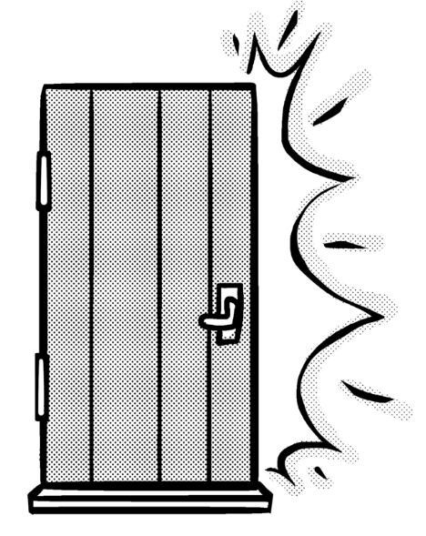
The importance of evidence
Thomaz yells, “No way!”
Thomaz stomps out of the room.
“It’s time for your sister to use the computer now,” said Dad.
“No way!” yelled Thomaz, before stomping out of the room and slamming the door.
Thomaz slams the door.
Question: Thomaz was happy to let his sister use the computer: true or false?
Answer: false.

Slide 6
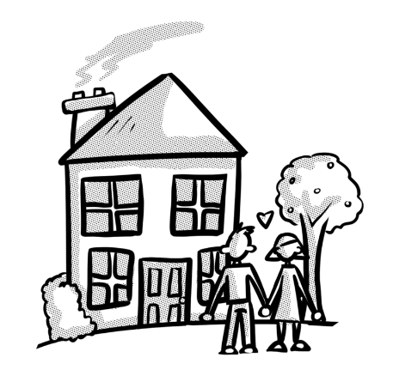
Your turn
Read the text, then discuss the evidence. When you think you know, answer the question true or false.
Click to see the answer and evidence.
The windows were wonky, the paint was peeling and the door was falling off its hinges. Even so, they looked at each other and smiled. “It’s perfect,” she said.
Question: the couple really liked the house: true or false?

Slide 7
How did you do?
‘Even so’ suggests that the problems with the house did not bother them.
By saying “It’s perfect,” they mean that they think it couldn’t be better.
The windows were wonky, the paint was peeling and the door was falling off its hinges. Even so, they looked at each other and smiled. “It’s perfect,” she said.
Question: the couple really liked the house: true or false?
Answer: true.

Slide 8
Completing a table
Often, you will be asked to read a text and then complete a table, ticking in the true or false column. Practise with this example. Click to check.
Alice shivered, wrapped her dressing gown tightly around her and braved the short journey from her bed to the window. Outside, the heavily-frosted grounds were glistening in the weak, early morning sunshine. A faint smile twitched at the corners of her mouth.
 | True | False
Alice’s room was cold.
The sun was setting outside.
Alice placed a dressing gown loosely around herself.
 | True | False
Alice’s room was cold.
The sun was setting outside.
Alice placed a dressing gown loosely around herself.

Slide 9
Providing answers with evidence
Now let’s answer the same questions, providing evidence this time. Discuss your answer. Click to check.
Alice shivered, wrapped her dressing gown tightly around her and braved the short journey from her bed to the window. Outside, the heavily-frosted grounds were glistening in the weak, early morning sunshine. A faint smile twitched at the corners of her mouth.
Alice shivered, wrapped her dressing gown tightly around her and braved the short journey from her bed to the window. Outside, the heavily-frosted grounds were glistening in the weak, early morning sunshine. A faint smile twitched at the corners of her mouth.
Statement: Alice’s room was cold.
True or false: true
Evidence: she shivers and has to wrap the dressing gown around her so the room must have been cold.
Statement: Alice’s room was cold.
True or false: true
Evidence:

Slide 10
Providing answers with evidence
Now let’s answer the same questions, providing evidence this time. Discuss your answer. Click to check.
Alice shivered, wrapped her dressing gown tightly around her and braved the short journey from her bed to the window. Outside, the heavily-frosted grounds were glistening in the weak, early morning sunshine. A faint smile twitched at the corners of her mouth.
Alice shivered, wrapped her dressing gown tightly around her and braved the short journey from her bed to the window. Outside, the heavily-frosted grounds were glistening in the weak, early morning sunshine. A faint smile twitched at the corners of her mouth.
Statement: The sun was setting outside.
True or false: false
Evidence: the text mentions the “early morning sunshine” so the sun was rising, not setting.
Statement: The sun was setting outside.
True or false: false
Evidence:

Slide 11
Providing answers with evidence
Now let’s answer the same questions, providing evidence this time. Discuss your answer. Click to check.
Alice shivered, wrapped her dressing gown tightly around her and braved the short journey from her bed to the window. Outside, the heavily-frosted grounds were glistening in the weak, early morning sunshine. A faint smile twitched at the corners of her mouth.
Alice shivered, wrapped her dressing gown tightly around her and braved the short journey from her bed to the window. Outside, the heavily-frosted grounds were glistening in the weak, early morning sunshine. A faint smile twitched at the corners of her mouth.
Statement: Alice placed a dressing gown loosely around herself.
True or false: false
Evidence: the text mentions that she does put on a dressing gown, but says that she wrapped it tightly around herself, not loosely.
Statement: Alice placed a dressing gown loosely around herself.
True or false: false
Evidence:

Slide 12



Your turn: read this text and then answer the true or false questions on the next slide.
‘He doesn’t say much, does he?’
He was watching the news. He was getting annoyed. He was trying to listen to what the presenters were saying: something about a dangerous animal that had escaped from a private zoo.
‘He’ was Jed. But ‘He’ could have been his actual name as far as Mum’s latest boyfriend, Ashley, was concerned. That or ‘Mate’. Jed never seemed to get called anything else.
Since Dad had abandoned them, Jed had seen a succession of boyfriends come and go. Some made more of an effort to bond with him than others, but they all bolted sooner or later. From some of the angry words exchanged in the final shouting matches, Jed wondered whether he might be part of the problem, but Mum never blamed him.

Slide 13

Your turn
Using information from the text, indicate whether the following statements are true or false.
Statement 1. Ashley always called Jed by his name.
This statement is _________ because ____________________
_____________________________________________________
Statement 1. Ashley always called Jed by his name.
This statement is __false_____ because Ashley always seemed
to call Jed ‘He’ or ‘Mate’_______________________________
Statement 2. Jed’s dad had passed away.
This statement is __false_____ because the text says that his
dad had abandoned them, which means he ran away.
Statement 2. Jed’s dad had passed away.
This statement is _________ because ____________________
_____________________________________________________

Slide 14
Now try with a later excerpt from the same story. Answer the questions on the next slide.
It was a good couple of minutes before he slowed down. By this time, he was deep into the dense tangle of ferns that covered the Beacons, following one of the many narrow sheep trails that pushed through the undergrowth. Although shoulder-height to an average grown-up, the ferns were taller than him, so Jed knew he was well-hidden. Best of all, very few people ever ventured far from the paths and tracks that led hikers around these popular, picturesque hills, so he knew that he would be blissfully alone.
By the time he had reached his secret den in the small, grassy clearing, his breathing had calmed down to a normal rate and his heart had stopped thumping against his ribs. He dropped to his knees and crawled into the rough shelter he had built the previous week out of sturdy branches, interwoven with leafy twigs.

Slide 15

Your turn
Using information from the text, indicate whether the following statements are true or false.
Statement 1. People tended to stick to the paths when hiking.
This statement is __true_____ because it says that very few people ventured far from the paths and tracks that led hikers around the hills.
Statement 1. People tended to stick to the paths when hiking.
This statement is ___________ because ____________________
_____________________________________________________
Statement 2. Jed started building himself a shelter out of twigs.
This statement is __false_____ because the text says that he
had built the shelter the previous week.
Statement 2. Jed started building himself a shelter out of twigs.
This statement is _________ because ____________________
_____________________________________________________

Slide 16
Non-fiction texts
You can apply the same approach with non-fiction texts. Read this extract and then answer the questions.
Light blockers
Light travels in straight lines until it meets a different material. Some materials, like air and flat glass, are largely transparent, which means the light can go straight through them. Other materials are translucent: light can pass through, but is scattered so you can’t clearly see what’s on the other side. (Frosted glass is translucent rather than transparent, which makes it useful for bathroom windows where people want to be private!) Finally, there are materials that are opaque, meaning that they don’t let any light pass through them. Translucent objects do cast shadows but opaque materials create the clearest ones.

Slide 17
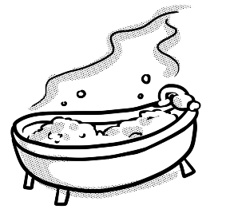
Your turn
Using information from the text, indicate whether the following statements are true or false.
Statement 1. Translucent materials block most light but let some of it through.
This statement is ___________ because___________________
_____________________________________________________
Statement 1. Translucent materials block most light but let some of it through.
This statement is __false_____ because it says that translucent materials do let light through but they scatter it, not block it.
Statement 2. Having translucent windows means
that you can’t be seen clearly.
This statement is ___________ because___________________
_____________________________________________________
Statement 2. Having translucent windows means
that you can’t be seen clearly.
This statement is __true_____ because the light gets scattered so they are useful for when people want to be private.

Slide 18
Reflection
Think about today’s lesson complete the table below. Talk to your partner about how confident you feel about your answers.
 | True | False
I know what true and false mean.
I can scan a text for evidence.
I can decide whether a statement is true or false.
I can support my decision by referring to evidence in the text.

