Slide 1


KS1 Common Exception Words
Family 18
Commissioned by The PiXL Club Ltd.
October 2018
This resource is strictly for the use of member schools for as long as they remain members of The PiXL Club. It may not be copied, sold nor transferred to a third party or used by the school after membership ceases. Until such time it may be freely used within the member school.
All opinions and contributions are those of the authors. The contents of this resource are not connected with nor endorsed by any other company, organisation or institution.
PiXL Club Ltd endeavour to trace and contact copyright owners. If there are any inadvertent omissions or errors in the acknowledgements or usage, this is unintended and PiXL will remedy these on written notification.
© Copyright The PiXL Club Limited, 2018

Slide 2
What is a common exception word?
Common exception words are words for which the Grapheme Phoneme Correspondence (GPC) is rare or unique. There are a number of words that children are expected to know in Years 1 and 2 that contain GPCs which have not been taught at this age because they are unusual. These are sometimes also called ‘Red’ words or ‘Tricky’ words, depending on the teaching programme being used.

Slide 3
Ways to learn to spell these words
Visual recall
Mnemonics
Segmentation
Graphic representation
Others…

Slide 4
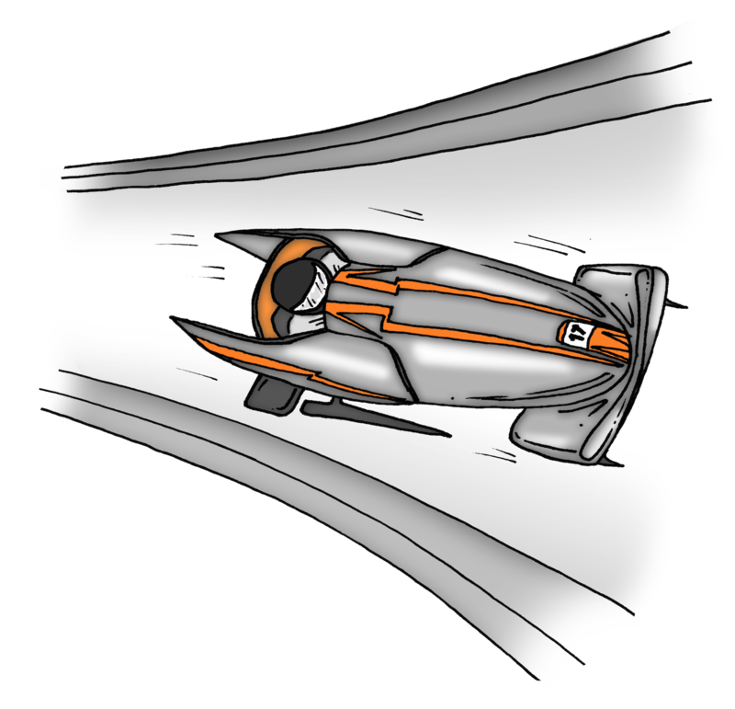
Word family 18
ah, it’s as (some say)
fast
last
past
ask

Slide 5
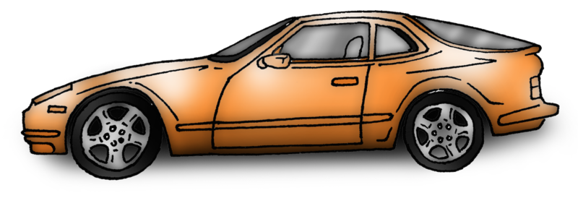
fast
Meaning: fast means quick or at speed.
Example: She drove a fast car.
Your example: ________________________________________________
Trick: as fast
Now practise:

Slide 6
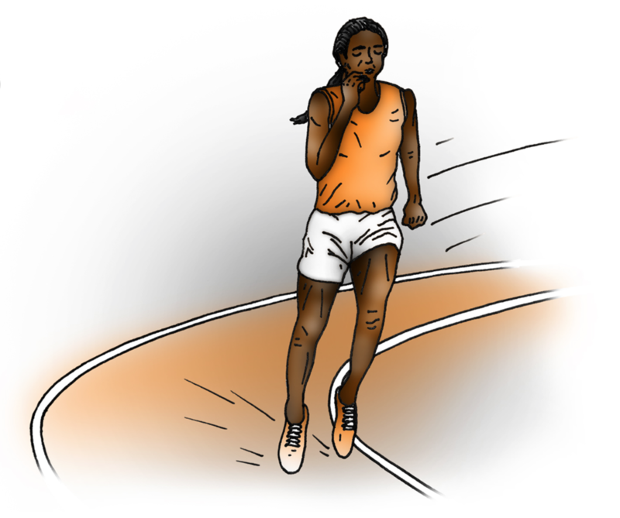
last
Meaning: last means in the final position or to remain unchanged.
Example: I came last in the race.
Your example: ________________________________________________
Trick: l as t
Now practise:

Slide 7
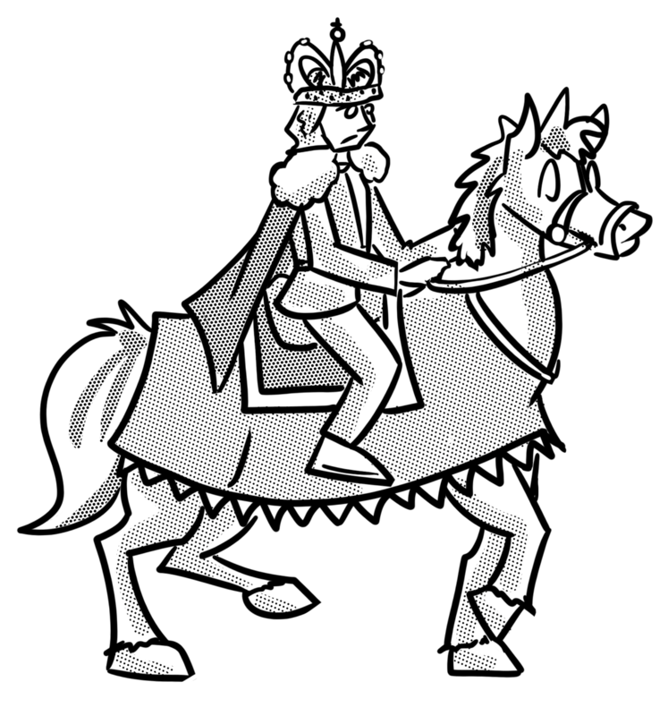
past
Meaning: past means finished or in the time
before now.
Example: History happened in the past.
Your example: ________________________________________________
Trick: p as t
Now practise:

Slide 8

ask
Meaning: ask means speak or write to get
an answer.
Example: Ask me any question.
Your example: ________________________________________________
Trick: as k
Now practise:

