Slide 1


KS1 Common Exception Words
Family 15
Commissioned by The PiXL Club Ltd.
October 2018
This resource is strictly for the use of member schools for as long as they remain members of The PiXL Club. It may not be copied, sold nor transferred to a third party or used by the school after membership ceases. Until such time it may be freely used within the member school.
All opinions and contributions are those of the authors. The contents of this resource are not connected with nor endorsed by any other company, organisation or institution.
PiXL Club Ltd endeavour to trace and contact copyright owners. If there are any inadvertent omissions or errors in the acknowledgements or usage, this is unintended and PiXL will remedy these on written notification.
© Copyright The PiXL Club Limited, 2018

Slide 2
What is a common exception word?
Common exception words are words for which the Grapheme Phoneme Correspondence (GPC) is rare or unique. There are a number of words that children are expected to know in Years 1 and 2 that contain GPCs which have not been taught at this age because they are unusual. These are sometimes also called ‘Red’ words or ‘Tricky’ words, depending on the teaching programme being used.

Slide 3
Ways to learn to spell these words
Visual recall
Mnemonics
Segmentation
Graphic representation
Others…

Slide 4
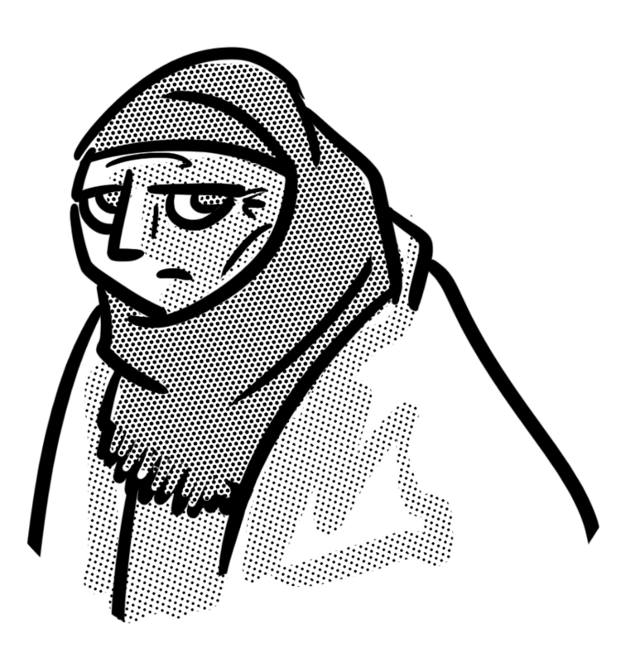
Word family 15
o you sound old
old
cold
gold
hold
told

Slide 5
old
Meaning: old means having lived for a long time.
Example: It was the old woman’s eightieth birthday.
Your example: ________________________________________________
Trick: you are o ld
Now practise:

Slide 6
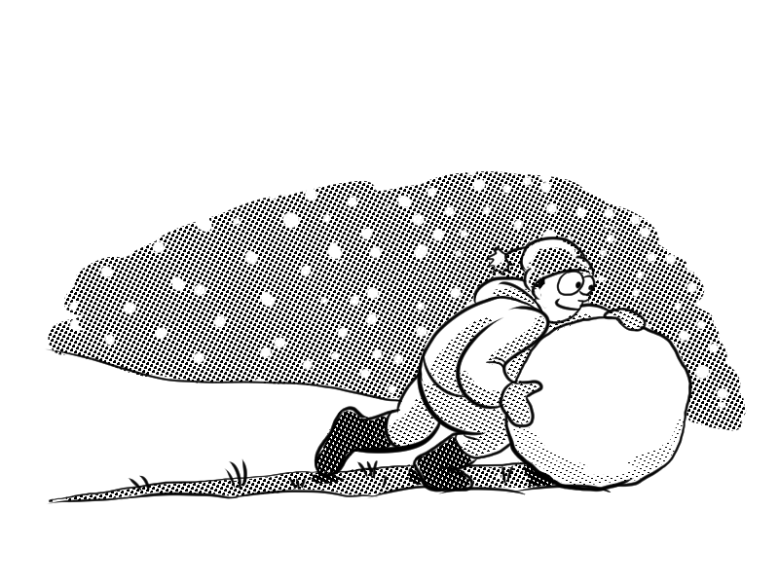
cold
Meaning: cold means not having much heat.
Example: My hands get cold without gloves.
Your example: ________________________________________________
Trick: c – old
Now practise:

Slide 7

gold
Meaning: gold is a yellow-coloured precious metal.
Example: She won the gold medal.
Your example: ________________________________________________
Trick: g – old
Now practise:

Slide 8
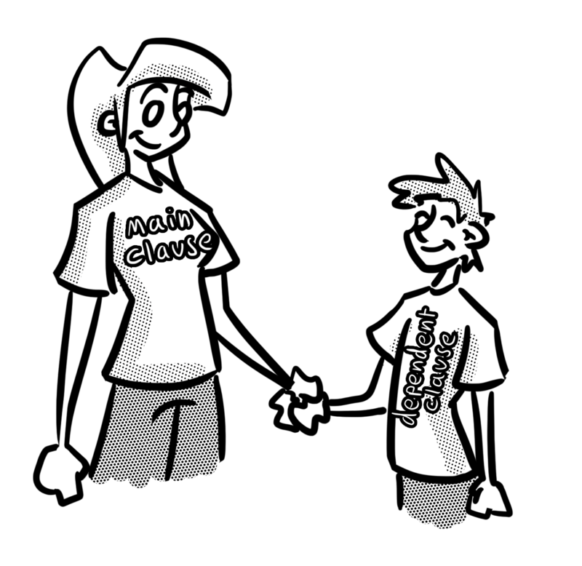
hold
Meaning: hold means to have, keep or clasp.
Example: Please hold my hand.
Your example: ________________________________________________
Trick: h – old
Now practise:

Slide 9
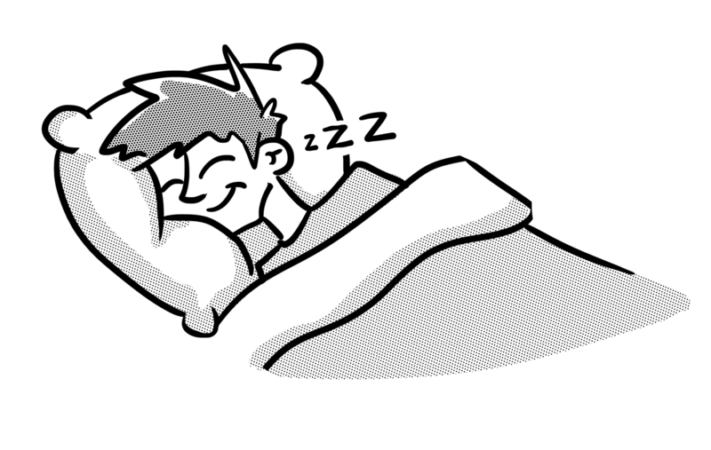
told
Meaning: told means having let someone know something.
Example: Mum told me to stay in bed.
Your example: ________________________________________________
Trick: t – old
Now practise:

