Slide 1


KS1 Common Exception Words
Family 8
Commissioned by The PiXL Club Ltd.
October 2018
This resource is strictly for the use of member schools for as long as they remain members of The PiXL Club. It may not be copied, sold nor transferred to a third party or used by the school after membership ceases. Until such time it may be freely used within the member school.
All opinions and contributions are those of the authors. The contents of this resource are not connected with nor endorsed by any other company, organisation or institution.
PiXL Club Ltd endeavour to trace and contact copyright owners. If there are any inadvertent omissions or errors in the acknowledgements or usage, this is unintended and PiXL will remedy these on written notification.
© Copyright The PiXL Club Limited, 2018

Slide 2
What is a common exception word?
Common exception words are words for which the Grapheme Phoneme Correspondence (GPC) is rare or unique. There are a number of words that children are expected to know in Years 1 and 2 that contain GPCs which have not been taught at this age because they are unusual. These are sometimes also called ‘Red’ words or ‘Tricky’ words, depending on the teaching programme being used.

Slide 3
Ways to learn to spell these words
Visual recall
Mnemonics
Segmentation
Graphic representation
Others…

Slide 4
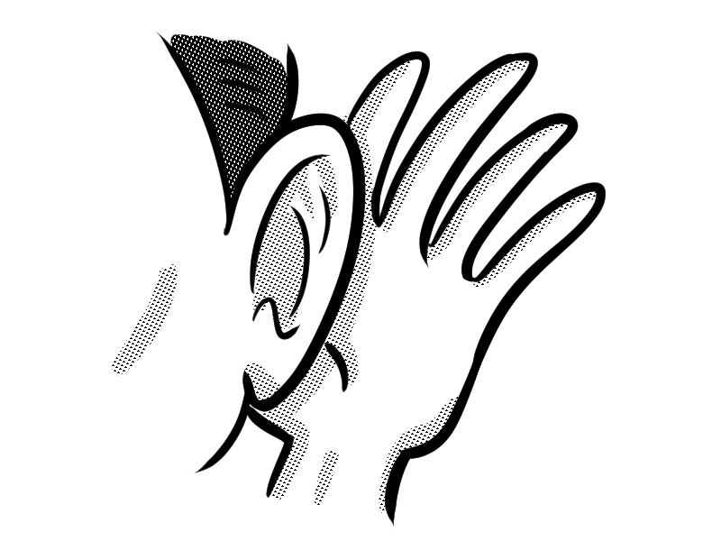
Word family 8
O, u sound odd
love
come
some
one
once
money
o
u

Slide 5

love
Meaning: love means to have great affection for.
Example: I love my cat.
Your example: ________________________________________________
Trick: o how I love that
Now practise:

Slide 6
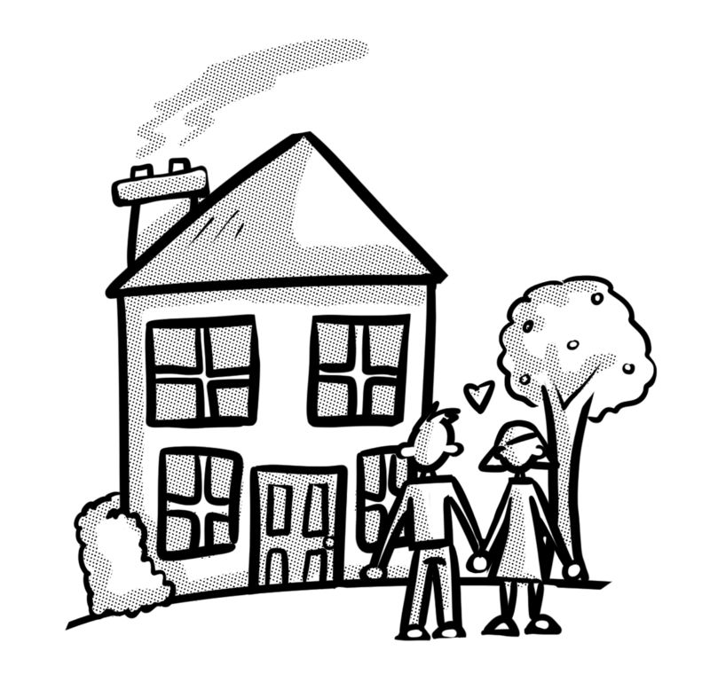
come
Meaning: come means to move towards something.
Example: Come to my house.
Your example: ________________________________________________
Trick: o come with an e
Now practise:

Slide 7
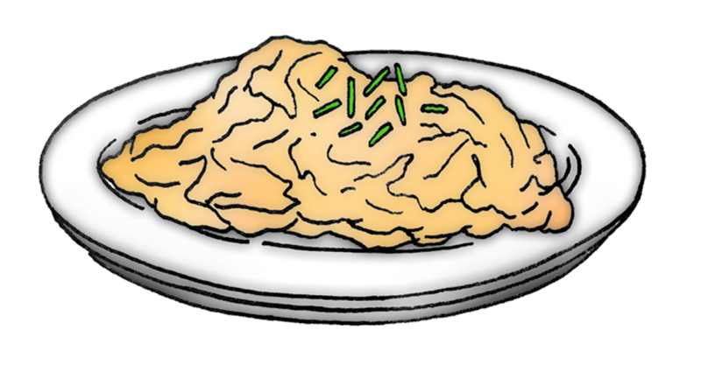
some
Meaning: some means a certain amount.
Example: I want some dinner.
Your example: ________________________________________________
Trick: come and have some
Now practise:

Slide 8

one
Meaning: one means a single thing.
Example: There is just one left.
Your example: ________________________________________________
Trick: one is on the e
Now practise:

Slide 9
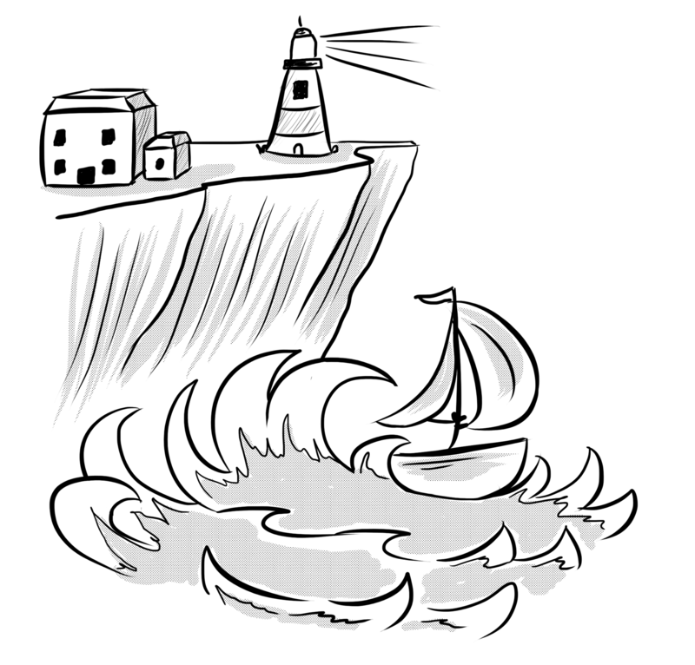
once
Meaning: once means one time.
Example: I was here once before.
Your example: ________________________________________________
Trick: once on the c e
Now practise:

Slide 10
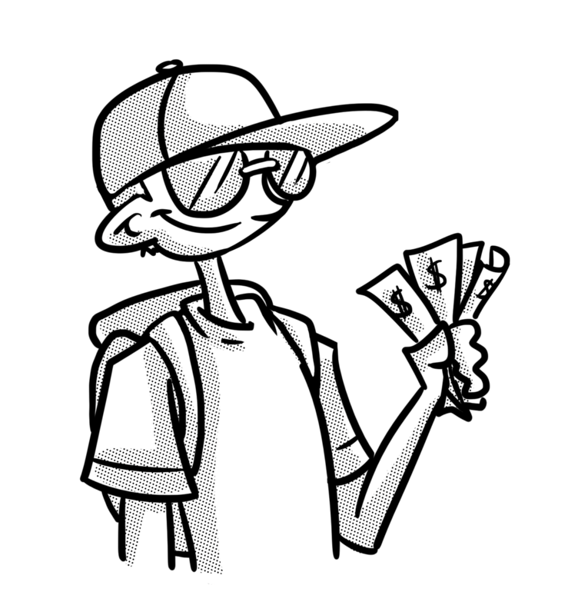
money
Meaning: money means the notes and coins used to buy things.
Example: I got some money for my birthday.
Your example: ________________________________________________
Trick: mon – e – y
Now practise:

